Slide 1
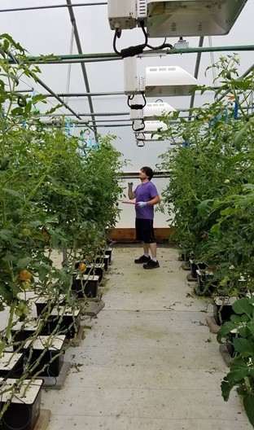
Module B: Produce Safety for Health and Hygiene of Staff and Customers during COVID-19
Barbara E. Liedl, PH.D.
West Virginia State University
liedlbe@wvstateu.edu
Cindy Martel, M.S., CTIS
Future Generations University
cindy.martel@future.edu

Slide 2
Learning Outcomes
Review SARS-CoV-2 mode of transmission
Assess human resources and contact points within the produce operation.
Review existing Staff Health, Hygiene and Training best practices
Develop new SOP’s, processes and enhancements for COVID-19 and other communicable diseases
Create staff training to deploy, retrain or refresh Staff Health, Hygiene and Training best practices
Establish recordkeeping, monitoring and corrective action protocols using public health and other resources in a produce operation

Slide 3
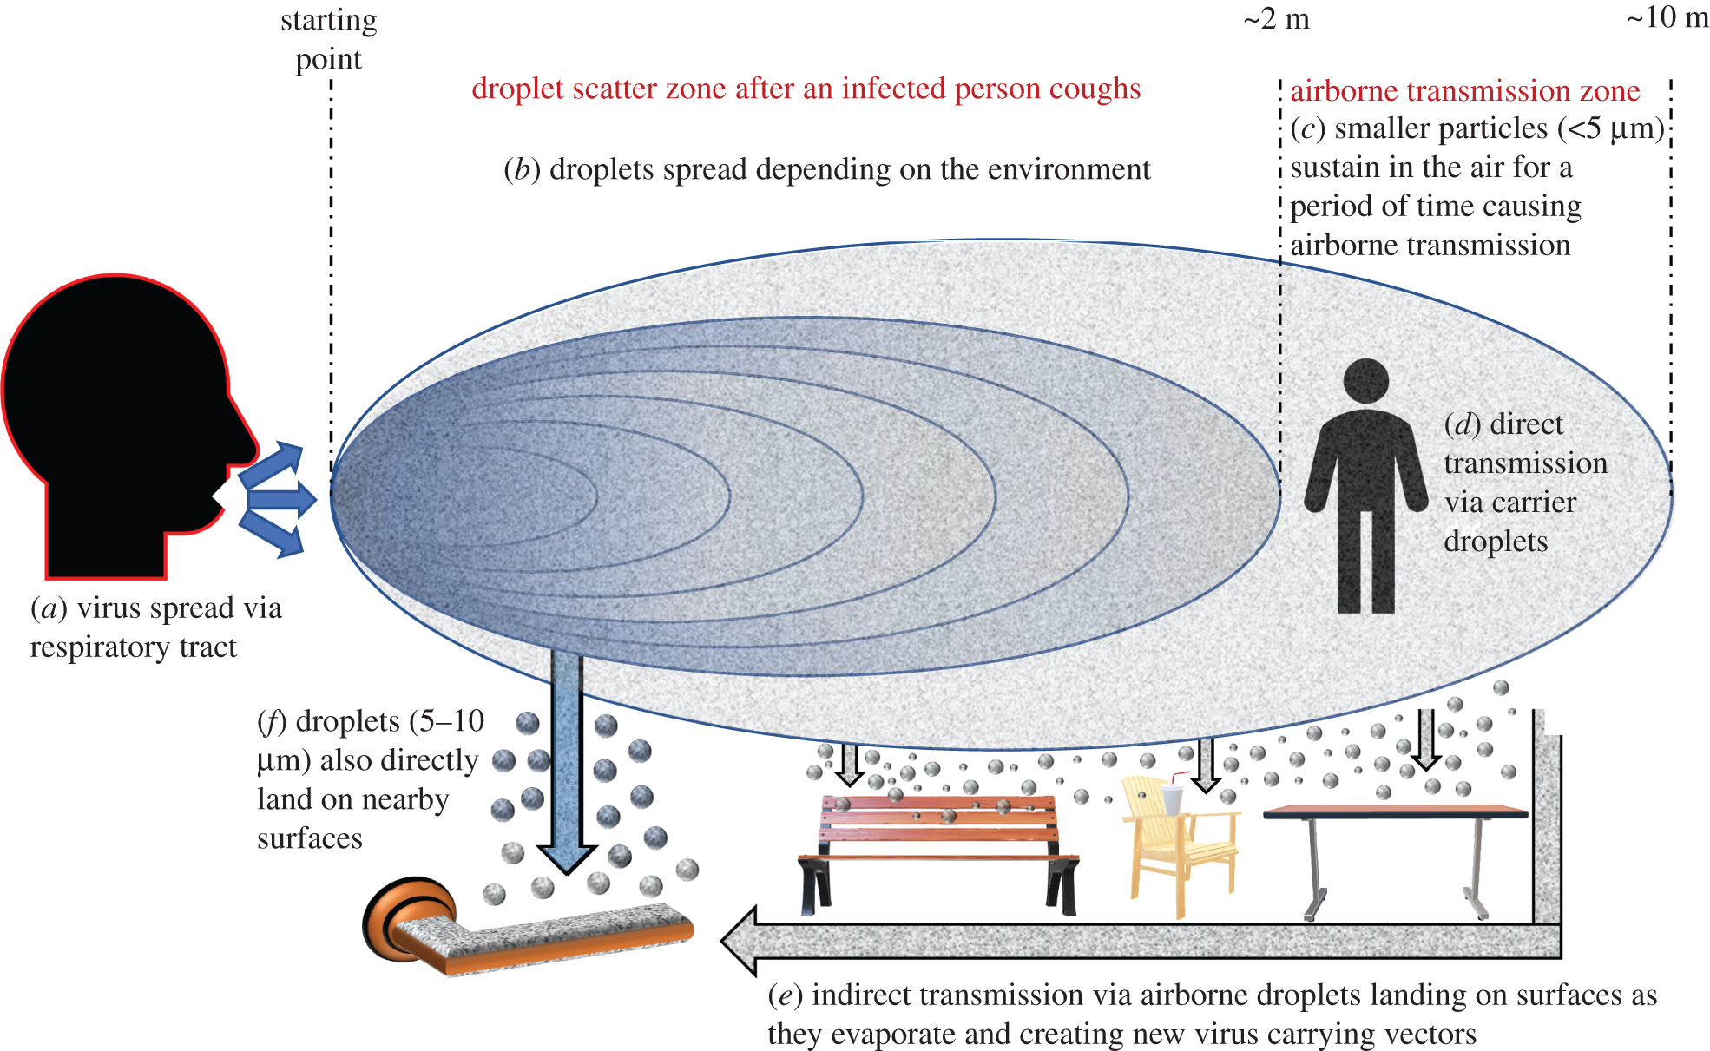
Transmission of SARS-CoV-2 is Primarily Person to Person
Viral transfer is via respiratory droplets from someone diagnosed with COVID-19
Respiratory droplets are released into the air though coughing, sneezing, talking, singing, yelling, etc.
Usually travel only a few feet = social distancing is recommended (minimum 6 ft apart)
Masks are recommended to trap respiratory droplets
Notes:
Notes:
The virus is carried through moisture droplets and released into the air through coughing, talking, singing, yelling, sneezing,
The viral particles in the droplets in the air can attach to cells in a healthy person and then infect, replicate and be dispersed once again to infect other healthy people
Particles usually only travel a few feet which is why 6 ft of social distancing is recommended. BUT particles may travel further by aerosols and air conditioning/vents by helping them move further from infected people
Masks and face coverings are therefore recommended as they trap some of or most of these viral particles and reduce the spread of the SARS-CoV-2 (the virus)
In the beginning of the pandemic, recommendations did not include using masks because it was unclear the major route(s) of transmission.
Resources:
SARS-CoV-2 Virus Transmission – NCSU poster – pdf
How Coronavirus Spreads – CDC - https://www.cdc.gov/coronavirus/2019-ncov/prevent-getting-sick/how-covid-spreads
COVID-19 Information for Food Industry Workers – Cornell Cooperative Extension - https://www.youtube.com/watch?v=9NXhZ3V-VMQ
Episode 4: What’s a Respiratory Droplet? Why Does It Matter? https://www.youtube.com/watch?v=qWiA3NUD1Mw
Episode 7: How does COVID-19 spread? A review – CDC video - https://www.youtube.com/watch?v=OQUMLJa0tAE

Slide 4
Who are “visitors?”
Any one-on-one interaction within a farm
Any one-on-one interaction outside of the farm
Not only the general public and staff interaction
Hint: not all visitors need to be human
Use this interactive flow chart to consider (assess) individuals on the farm
Consider the pathogen threat to finish this self-assessment
Notes:
Notes
Since SARS-CoV-2 main transmission is via respiratory droplets that means the primary spread is from people.
So besides yourself and your family, who are the “visitors” to the farm?
Consider the following:
Who do you interact within on the farm
Who do you interact with outside of the farm
Consider not only your staff but any vendors, ag service providers, buyers, etc
What about other visitors to the farm that aren’t human – we will discuss this later on
The next slide will show you an example self-assessment of who your visitors are to the farm, then we will do one of off the farm
Resources
COVID-19 Response Plan Template for Fruit and Vegetable Farms https://docs.google.com/document/d/12sLifH-6Dm48lm_s2OIM3rIrN54Fv__z_i52Mvy5yGA/edit
Agriculture Workers and Employers https://www.cdc.gov/coronavirus/2019-ncov/community/guidance-agricultural-workers.html
COVID-19 and Food Safety FAQ Is Coronavirus a Food Safety Issue? https://foodsafety.ces.ncsu.edu/wp-content/uploads/2020/03/Food-Safety_COVID-19_Flyer_031720-1.pdf
COVID-19 Facility/Site Compliance: Agricultural – Business Checklist https://psla.umd.edu/sites/psla.umd.edu/files/files/documents/Food%20Safety/Ag%20COVID19%20BusinessChecklist_v1%20(2).pdf

Slide 5
Self Assessment
General Public
Sales Representatives
Volunteers
Visitors to farm and/or packing area
Repair and Service Technicians
Pre-registered groups & tours (i.e. schools)
Suppliers & Deliveries
Media
Me!, staff, Fido
Notes:
Notes
This is an example of a self assessment to generate a list of who are visitors to the farm and/or packing area.
An alternative would be to delete these examples and let the group add their own for an interactive exercise
A blank Word document is available that can be used in a teaching setting to allow participants to develop their own farm assessments.
Resources
COVID-19 Response Plan Template for Fruit and Vegetable Farms https://docs.google.com/document/d/12sLifH-6Dm48lm_s2OIM3rIrN54Fv__z_i52Mvy5yGA/edit
Agriculture Workers and Employers (CDC) https://www.cdc.gov/coronavirus/2019-ncov/community/guidance-agricultural-workers.html

Slide 6
Self Assessment
Off-farm interactions by farm staff
Notes:
Notes
This is an example of a self assessment to generate a list of who farm staff interact with off the farm that may expose them to SARS-CoV-2 or another pathogen.
Use this blank example to let the group add their own answers for an interactive exercise
A blank Word document is available that can be used in a teaching setting to allow participants to develop their own farm assessments.
Resources
COVID-19 Response Plan Template for Fruit and Vegetable Farms https://docs.google.com/document/d/12sLifH-6Dm48lm_s2OIM3rIrN54Fv__z_i52Mvy5yGA/edit
Agriculture Workers and Employers (CDC) https://www.cdc.gov/coronavirus/2019-ncov/community/guidance-agricultural-workers.html

Slide 7
Handwashing & Rest Room Facilities
Basics of handwashing technique should be reinforced and practiced
Review number and location of handwashing stations
Evaluate number and location of restrooms and consider more frequent cleanings
Make sure signage is clear and language appropriate
Notes:
Notes
Remind participants SARS-CoV-2 is spread primarily through person-to-person contact between an infected person and another person. One of the best ways to minimize spread is by encouraging people to wash their hands regularly.
Review the basics of handwashing using the resources from PSA or other health organization
Consider the number and location of handwashing stations. Do you need more?
The number and location of restrooms should also be re-evaluated as there may need to be more of these when working large crews
Signage should also be re-evaluated. Updating or moving signage may also remind staff of the policies and procedures.
Resources
Handwashing (CDC) https://www.cdc.gov/coronavirus/2019-ncov/global-covid-19/handwashing.html
How to Handwash? (WHO) https://www.who.int/philippines/emergencies/covid-19-response-in-the-philippines/information/handwashing
COVID-19 Preventative Measures https://foodsafety.ces.ncsu.edu/wp-content/uploads/2020/04/Handwashing_COVID-19_Flyer.pdf?fwd=no
COVID-19 Response Plan Template for Fruit and Vegetable Farms https://docs.google.com/document/d/12sLifH-6Dm48lm_s2OIM3rIrN54Fv__z_i52Mvy5yGA/edit

Slide 8
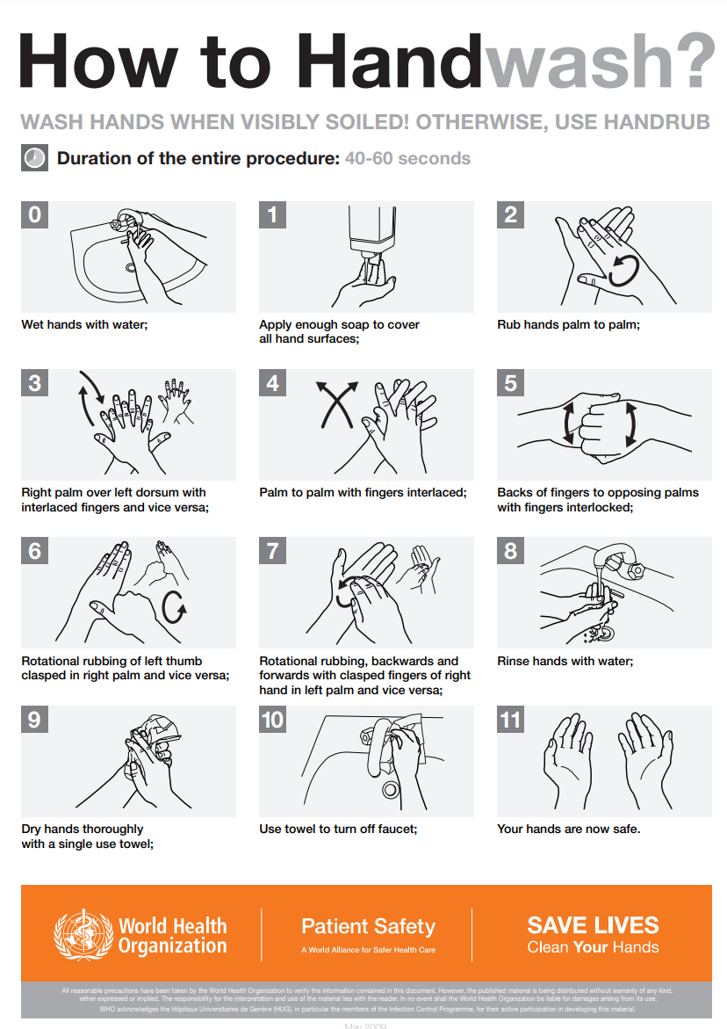
Notes:
Notes
Wash hands when hands are visibly dirty (soiled).
After blowing your nose, coughing or sneezing
After being in a public place
Before and after caring for someone who is sick
Before, during and after preparing food
Before eating food
After using the toilet
After touching an animal, animal feed or animal waste
After touching garbage
Use potable water and soap (liquid or bar)
Five steps
Wet hands with clean, running water and apply soap
Lather hands by rubbing them together with soap
Scrub at least 20 seconds
Rinse your hands under clean running water
Dry your hands using single use paper towels
Resources
Handwashing (CDC) https://www.cdc.gov/coronavirus/2019-ncov/global-covid-19/handwashing.html
How to Handwash? (WHO) https://www.who.int/philippines/emergencies/covid-19-response-in-the-philippines/information/handwashing
COVID-19 Preventative Measures https://foodsafety.ces.ncsu.edu/wp-content/uploads/2020/04/Handwashing_COVID-19_Flyer.pdf?fwd=no

Slide 9
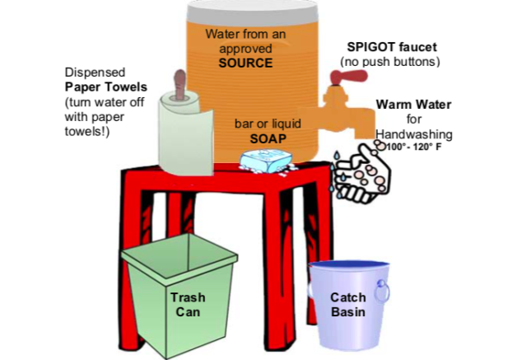
Handwash Station Basics
Notes:
Notes
Review the components of a basic hand washing station
Potable water from an approved source
Spigot faucet
Warm water 100 to 120 degrees F
Catch basin/gray water disposal
Trash can
Single use, disposable paper towels
Resources
Build a low-cost handwashing station for food safety on the farm https://extension.umn.edu/growing-safe-food/handwashing-station
Food Safety Hand Washing Station Demonstration (Tuskegee University) https://www.facebook.com/281495325336707/videos/762403254296877
Handwashing station https://foodsafety.ces.ncsu.edu/wp-content/uploads/2021/04/Handwashing-station_Safe-Plates.png
Making your own handwashing station https://www.youtube.com/watch?v=0XCXVcTVQMc
Portable handwashing stations https://www.youngfarmers.org/fsma_resources/portable-handwashing-stations/

Slide 10
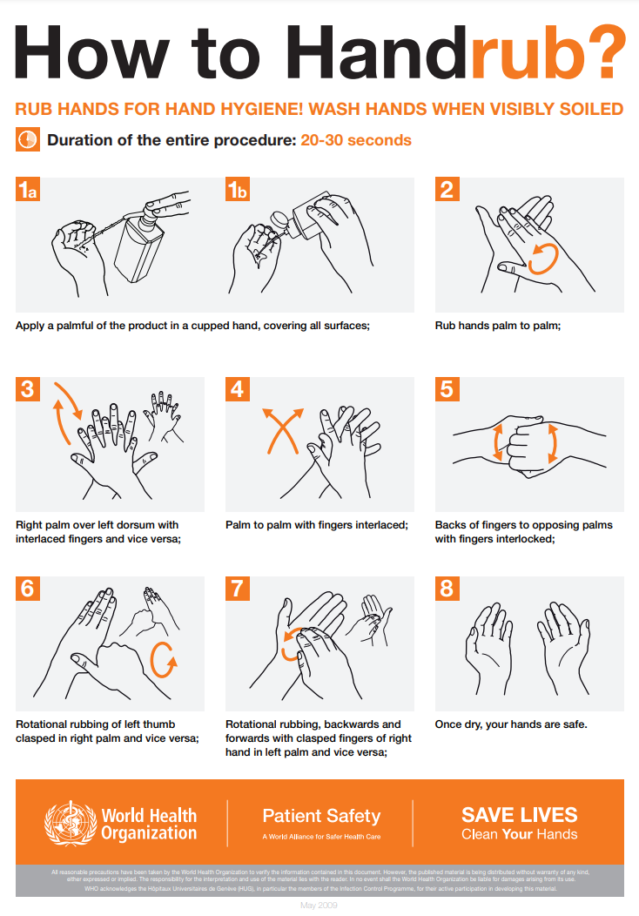
Notes:
Notes
The recommendation is to use a hand sanitizer and rub hands for hand hygiene when hands are not visibly dirty (soiled)
Use a hand sanitizer product with at least 60% alcohol
WARNING: hand sanitizer products containing methanol, or wood alcohol — a substance often used to create fuel and antifreeze that is not an acceptable active ingredient for hand sanitizer products and can be toxic when absorbed through the skin as well as life-threatening when ingested.
Resources
How to Handrub? (WHO) https://www.who.int/philippines/emergencies/covid-19-response-in-the-philippines/information/handwashing
Coronavirus (COVID-19) Update: FDA Takes Action to Warn, Protect Consumers from Dangerous Alcohol-Based Hand Sanitizers Containing Methanol https://www.fda.gov/news-events/press-announcements/coronavirus-covid-19-update-fda-takes-action-warn-protect-consumers-dangerous-alcohol-based-hand#:~:text=If%20soap%20and%20water%20are,least%2060%20percent%20ethanol

Slide 11
Personal Protection Equipment (PPE)
Consider local and state guidelines for additional PPE based on the SARS-CoV-2 mechanism of spread
Review existing SOPs during critical periods
Develop or revise SOPs, train staff, implement SOPs and remain consistent with PPE requirements
Provide required PPE
Train staff on the wearing, removal and disposal of all PPE
CREATE EXPECTATIONS AND COMMUNICATE THEM
Notes:
Notes
The first step should always be to determine the local and state guidelines for use of additional PPE, such as face coverings/masks.
Next, even if there is no requirement by the local or state government to wear it, it can be made a farm policy if that is deemed necessary due to risk assessments – such as a staff or family member who can not wear a mask or be vaccinated due to a medical condition.
Consider all types of PPE including but not limited to: masks, gloves and respirators. Remember you should choose PPE based on what you are trying to accomplish with it, not just use it because it is available. For COVID-19, PPE should be used to stop respiratory droplets.
Review existing SOPs for use and disposal of PPE or develop new SOPs
Train staff and implement SOPs. The next slide will show how to properly apply a mask as well as dos and don’ts.
Gloves vs No gloves - Although gloves can reduce virus spread, gloves should be worn with caution, since they can be misused i.e. contamination can happen if gloves touch dirty surfaces and then the food. In addition, if workers are sick and wipe their nose with their hands, or cough on hands (with or without gloves) and touch the food, it is no better than not wearing gloves. It is also important to choose the right gloves for the job as well as properly training workers on how to put on and take off gloves as well as disposing of them and to also wash your hands before wearing them and after removing them.
Besides standard PPE, you may also consider using physical barriers such as Plexiglas, plastic shower curtains, tables or displays as a way to create a barrier or distance between yourself, your workers and your customers. Another option to consider is contactless transactions.
Resources
COVID-19 Response Plan Template for Fruit and Vegetable Farms https://docs.google.com/document/d/12sLifH-6Dm48lm_s2OIM3rIrN54Fv__z_i52Mvy5yGA/edit
COVID-19 Preventative measures Cloth coverings for Food Employees https://foodsafety.ces.ncsu.edu/wp-content/uploads/2021/04/Foodservice-Facecovers_COVID-19_Flyer_040920.pdf

Slide 12
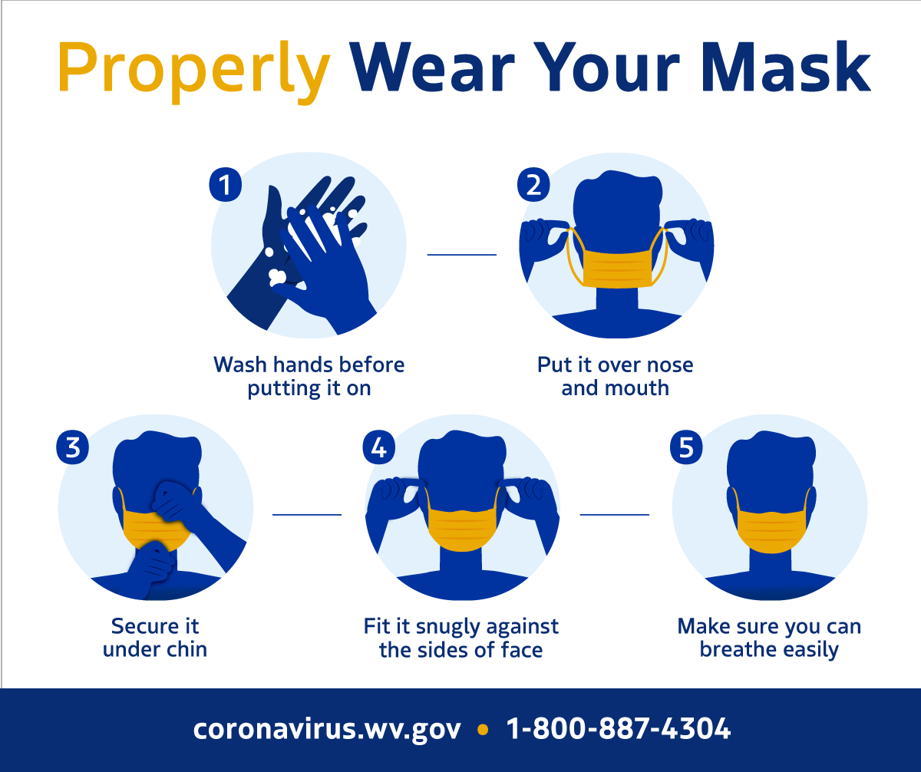
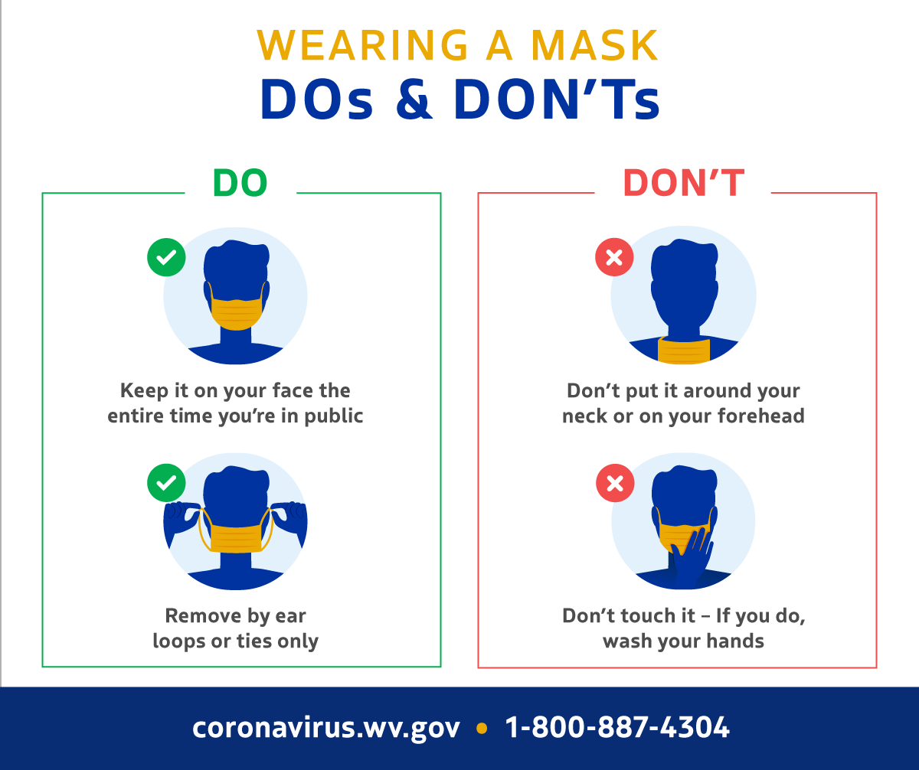
Notes:
Notes
It is important to provide training in proper use of PPE as well as signage to help remember how to do the procedure properly.
Resources
Properly Wear Your Mask https://dhhr.wv.gov/COVID-19/Documents/face%20covering%20social%20media/GOV_COVID19_FaceCovering_ProperWear_FB.png
Wearing a Mask Dos & Don’ts https://dhhr.wv.gov/COVID-19/Documents/face%20covering%20social%20media/GOV_COVID19_FaceMask_DosAndDontsV2_FB.png

Slide 13

Shared & Common Areas
Review and implement local and state guidelines for staff interaction
Deploy recommended PPE especially face masks
Create strategies that limit close contact
Create social distancing zones following recommendations
Review cleaning and sanitizing schedules and procedures
Make handwashing available prior to and after breaks and meals
Notes:
Notes
Remember there is no evidence that livestock, crops, or products that may be handled by staff involved in production agriculture are sources of COVID-19 infection. However, close contact with coworkers may contribute to spreading the virus among staff.
Because there will be shared and common areas as well as your employees may often be in close contact with one another at your operation, you will need to consider:
Distance between workers during their assigned tasks
Duration of contact both at the farm as well as during transpiration and is shared housing is being used.
Type of contact. Contact where repiratory droplets in the air can be transmitted are of the highest concern for possible spread. Exposure may also occur when workers have contact with contaminated surfaces, such as tools, equipment, restrooms, or break room tables as well as touching their own mouth, nose, or possibly their eyes.
Resources
COVID-19 Response Plan Template for Fruit and Vegetable Farms https://docs.google.com/document/d/12sLifH-6Dm48lm_s2OIM3rIrN54Fv__z_i52Mvy5yGA/edit
Recommended Practices for Safety and Health Programs - https://www.osha.gov/safety-management

Slide 14
Illness, Health and Injury
Revisit existing policies and reporting procedures; assign a point person
Train staff on signs and symptoms of SARS CoV-2
Encourage and incentivize self-reporting
Consider visitor logs and staff check in questionnaires
Have contact tracing procedures in place
Provide signage indicating visually and in writing your operational requirements
Comply with quarantine recommendations
Communicate with staff and visitors
Notes:
Notes
Identify one person to be the main point of contact for emplyees with questions about COVID-19 as well as havint this person be the one that employees report to if they become ill. This person should also be the one that takes the lead in training employees and keeping everyone up to date on COVID-19 as well as changes in policies and procedures
This contact person can also be the one that deals with the local health department in case contact tracing is needed.
Encourage employees to self-report any sicknesses not just COVID-19 to move towards creating a food safety culture at your farm. Consider using a screening questionnaire each day (see Excel workbook with this training).
You may need to talk with employees if they or someone in their family has a higher risk of severe consequences if they contract COVID-19. For instance, someone who is immunocompromised or with a heart condition is at a higher risk. If so you may want to rethink placing this employee working in a group with others to reduce possibility of they being exposed.
Providing clear signage will also help remind your employees what your expectations are as well as those for your visitors as well.
Resources
COVID-19 Response Plan Template for Fruit and Vegetable Farms https://docs.google.com/document/d/12sLifH-6Dm48lm_s2OIM3rIrN54Fv__z_i52Mvy5yGA/edit
Health Screening Employee Questionnaire https://www.wsgr.com/a/web/26191/COVID-19-Health-Screening-Questionnaire.pdf
Agriculture Workers and Employers https://www.cdc.gov/coronavirus/2019-ncov/community/guidance-agricultural-workers.html
Handling COVID-19 Produce Farms and Packinghouses https://foodsafety.ces.ncsu.edu/wp-content/uploads/2020/03/Packinghouse_COVID-19_Flyer-2.pdf
COVID-19 Facility/Site Compliance: Agricultural – Workforce Guidance https://psla.umd.edu/sites/psla.umd.edu/files/files/documents/Food%20Safety/Ag%20COVID19%20WorkforceGuidance_v1.pdf
COVID-19 Facility/Site Compliance: Agricultural – Workforce Training Guidance https://psla.umd.edu/sites/psla.umd.edu/files/files/documents/Food%20Safety/Ag%20COVID19%20WorkforceTraining_v1%20(1).pdf

Slide 15
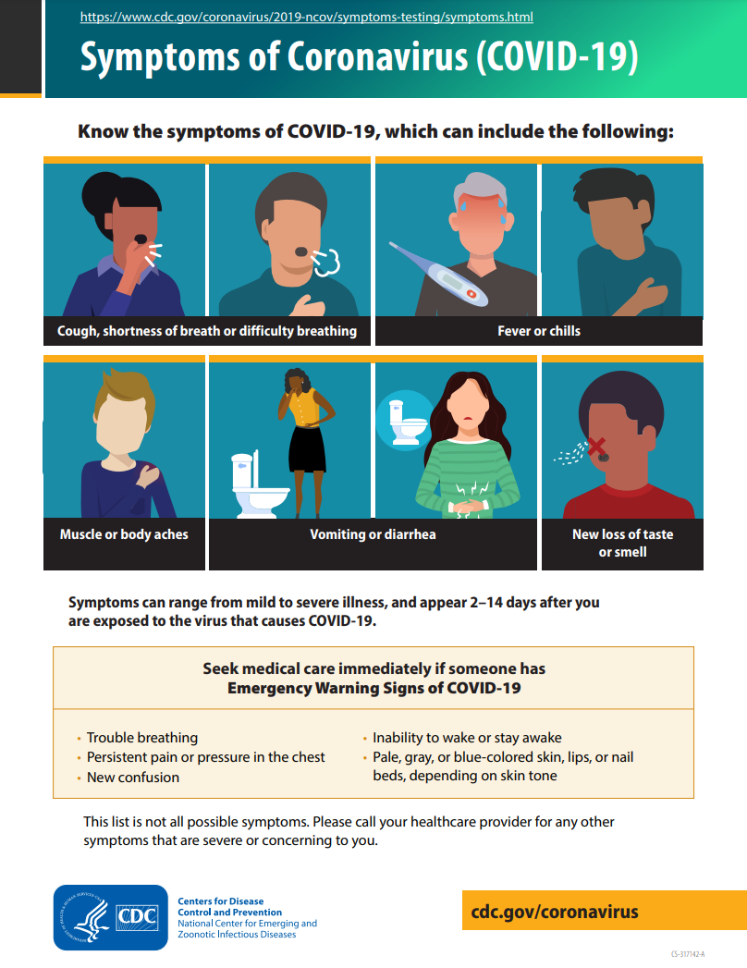
Signs & Symptoms Checklist
Notes:
Notes
Providing training backed up with signage of the symptoms of COVID-19 will help your staff know if they have the disease.
Resources
Symptoms of Coronavirus (COVID-19) https://www.cdc.gov/coronavirus/2019-ncov/symptoms-testing/symptoms.html

Slide 16
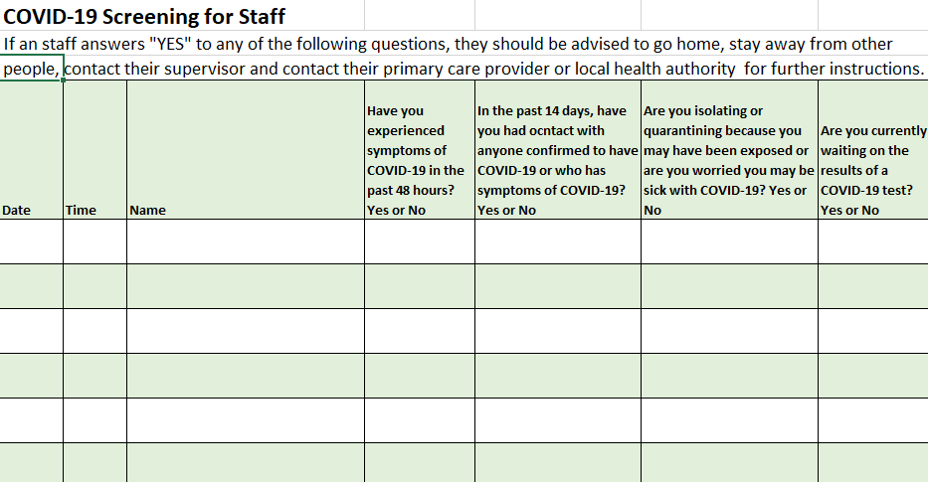
Example Screening Sign In Sheet
Notes:
Notes
Keeping a sign-in sheet for both staff/workers and visitors will allow you to be able to contact people in case someone contracts COVID-19 or your operation is contacted by the local health department about a case through contact tracing.
Resources
This is available from this site as an Excel workbook with worksheets for both Staff and Visitors.

Slide 17

Hydration
Provide additional hydration stations with hand wash
Make sure water is potable
No sharing
Provide garbage cans that are changed regularly
Notes:
Notes
Keeping yourself and your staff hydrated will be important during COVID-19 since you will be working with a mask on at least part of the time.
An easy way would be to provide additional hydration stations where hand washing is available.
Remember to keep social distant while hydrating.
Consider providing identifying cups or bottles for your staff to use to reduce the possibility of sharing of containers.
Also remember to remove garbage on a regular basis to also remove the chance that someone may get exposed to the virus thru contaminated materials in the garbage.
Resources
10 warning signs of dehydration. And staying hydrated while wearing a mask https://thrive.kaiserpermanente.org/thrive-together/live-well/10-warning-signs-dehydration-watch-out

Slide 18

Shared Tools
Consider issuing assigned tools to staff
Determine proper sanitation procedures, develop SOPs, train staff, provide materials and log sheets
Train staff on contamination routes of tools and equipment
Encourage staff to frequently wash their hands
Evaluate storage of tools and their exposure to airborne pathogens
Notes:
Notes
Because of the possibility of transfer of SARS-CoV-2 on surfaces, it may be time to consider assigning tools to individual employees that they are responsible for the care, upkeep and sanitation of them.
Whether tools are assigned or not, there should be SOPs in place on how tools and equipment are sanitized.
Revising or creating SOPs, also means that the employees will need to be trained for that protocol.
Some surface will be easier to sanitize so if new or replacement tools or equipment are needed that may factor into the decision to purchase replacements.
Evaluate the storage site for tools and equipment to reduce the potential for contamination from SARS-CoV-2 as well as any other pathogens.
Resources
COVID-19 Response Plan Template for Fruit and Vegetable Farms https://docs.google.com/document/d/12sLifH-6Dm48lm_s2OIM3rIrN54Fv__z_i52Mvy5yGA/edit
Handling COVID-19 Produce Farms and Packinghouses https://foodsafety.ces.ncsu.edu/wp-content/uploads/2020/03/Packinghouse_COVID-19_Flyer-2.pdf
Prevent the spread of COVID-19 through shared equipment and tools https://www.ncat.edu/caes/cooperative-extension/covid-19/prevent-the-spread.php

Slide 19
Off Farm for Staff
Same level of safety and PPE whether on farm or off
Evaluate off site location like the farm
Provide appropriate level of PPE protection for the site and in line with on premise protocols
Provide a handwash station and hand sanitizer
If possible, avoid washing produce; notify customers
Consider pre-ordering/pre-packaging for market pick up
Notes:
Notes
Your staff needs to understand your expectations for safety and use of PPE will be the same whether on the farm or off.
For each off site location – farmers market, CSA pickup, restaurant, etc – evaluate each location to determine ways to reduce you and your staffs risks of contracting the SARS-CoV-2 virus.
Outdoor activities generally are lower risk than indoor activities but there are still important ways to prevent the spread of COVID-19 that should be followed
Just as on the farm provide the required PPE for your employees
Consider providing a portable hand wash station for your employees and/or provide hand sanitizer that contains at least 60% alcohol.
Resources
COVID-19 Response Plan Template for Fruit and Vegetable Farms https://docs.google.com/document/d/12sLifH-6Dm48lm_s2OIM3rIrN54Fv__z_i52Mvy5yGA/edit
Agriculture Workers and Employers https://www.cdc.gov/coronavirus/2019-ncov/community/guidance-agricultural-workers.html
COVID-19 Facility/Site Compliance: Agricultural – Delivery Guidance https://psla.umd.edu/sites/psla.umd.edu/files/files/documents/Food%20Safety/Ag%20COVID19%20DeliveryGuidance_v1%20(1).pdf

Slide 20
Communicating with Customers
Use social media and other marketing tools to inform customers of what is available & what they can expect
Signage is critical; need to tell customers what to do; masks, social distancing and illness signs & symptoms
How will your customers make their product selection?
Consider touchless transactions
Sampling, if done, should be single serving, pre-packaged and follow local and state mandates
Consumers may not be able to use their own bags and containers due to local and state mandates
Notes:
Notes
Over the last year, farms and businesses that have provided clear communications on their operations and how they are dealing with the pandemic have done the best and even gained new customers, which is why it is important to provide clear communications.
Outdoor activities generally are lower risk than indoor activities but there are still important ways to prevent the spread of COVID-19 that should be followed
Social media as well as other marketing tools are a great way to inform customers about what you will have available and when as well as if you have any restrictions (i.e. masks required).
If you have a website or Facebook page be sure to include what you require for your customers to buy your products. For instance, can they come to the farm or not? What farmers markets you will be at and when?
Remind customers to stay hom e if they are sick.
Consider offering a curbside service for pre-paid orders similar to the “big box” stores
Signage is also critical to remind customers what they need to do to be at your operation
Rather than offering open bins to choose produce you may want to either pre-package products or use a display case and allow they to point to what they want and have your staff package their choices.
Switching to touchless transactions or pre-paying for their product is a great option now to reduce person to person contact.
If you are allowed to do sampling (local health department will determine this), you may want to consider doing single-serving, prepackaged samples to have your customers take home. This will reduce people taking off their masks to eat the samples as well as reducing person to person contact.
Depending on the local and state mandates, customers may not be able to bring their own bags and containers. In addition, you may want to rethink having them bringing items that may contain pathogens (not just COVID-19).
Consider providing a portable hand wash station for your customers or provide hand sanitizer that contains at least 60% alcohol.
Resources
COVID-19 Response Plan Template for Fruit and Vegetable Farms https://docs.google.com/document/d/12sLifH-6Dm48lm_s2OIM3rIrN54Fv__z_i52Mvy5yGA/edit
Considerations for Outdoor Farmers Markets https://www.cdc.gov/coronavirus/2019-ncov/community/outdoor-farmers-markets.html
Handling COVID-19 Best Practices for Agribusiness https://foodsafety.ces.ncsu.edu/wp-content/uploads/2020/04/Agribusiness_COVID-19_Flyer-2.pdf
COVID-19 Facility/Site Compliance: Agricultural – Business Checklist https://psla.umd.edu/sites/psla.umd.edu/files/files/documents/Food%20Safety/Ag%20COVID19%20BusinessChecklist_v1%20(2).pdf
COVID-19 Facility/Site Compliance: Agricultural – Delivery Guidance https://psla.umd.edu/sites/psla.umd.edu/files/files/documents/Food%20Safety/Ag%20COVID19%20DeliveryGuidance_v1%20(1).pdf

Slide 21

Easy to Forget
Training
Documentation
On hand supplies
Checking local and state agencies for updates
Review and adjust your action plan
Do NOT file your action plan on the shelf!
Notes:
Notes
This is a list of the top things each operation should do to stay prepared for COVID-19 or future pandemics
The top item is trainings and should never be overlooked as well as documenting training and another SOPs utilized
Just as the run on toilet paper early in the pandemic, we have all learned the importance of thinking ahead on having supplies on hand not just for the operation but also any PPE or cleaning/distinfecting supplies as well.
Lastly do not forget that rules and regulations will change over time and as such your action plan should be updated as necessary and not just filed away on a shelf.
Resources
COVID-19 Response Plan Template for Fruit and Vegetable Farms https://docs.google.com/document/d/12sLifH-6Dm48lm_s2OIM3rIrN54Fv__z_i52Mvy5yGA/edit
COVID-19 Facility/Site Compliance: Agricultural – Business Checklist https://psla.umd.edu/sites/psla.umd.edu/files/files/documents/Food%20Safety/Ag%20COVID19%20BusinessChecklist_v1%20(2).pdf

Slide 22
Agritourism Considerations
Set expectations to staff and visitors prior to arrival; take reservations if possible
Mandate staff follow established protocols to set example
Provide essential training and PPE (especially situational and timely)
Post signs reflecting requirements for visitors such as masks, etc.
Provide plenty of rest rooms and handwash stations
Provide electronic payment, waiver and permission forms prior to arrival
Pick Your Own must practice social distancing in and out of the field, use mask requirements, meet local & state sampling requirements and not reuse picking buckets
Notes:
Notes
Communications as has been mentioned before is critical with both staff and visitors/customers
Consider taking reservations especially if you have a capacity limit to maintain social distancing
Continually remind the staff they step the example for the visitors/customers
Posting signage as well as providing rest rooms and additional handwash stations
Consider as mentioned earlier doing pre-payment or pre-submitted permission forms to go as paperfree and touchless as possible
In Pick Your Own operation it may be necessary to change how you have operated in the past to maintain social distancing both in and out of the field. In some cases, this may be done thru planting differently to create “islands” or separate your visitors into rows 6+ feet apart and having them pick down the row not jumping back and forth.
Resources
COVID-19 Response Plan Template for Fruit and Vegetable Farms https://docs.google.com/document/d/12sLifH-6Dm48lm_s2OIM3rIrN54Fv__z_i52Mvy5yGA/edit
Farm Pick-Your-Own (PYO)/Agricultural Tourism Activities – Guidance Memo #5 https://www.mass.gov/doc/mdar-bulletin-16-farm-pick-your-own-pyoagricultural-tourism-activities/download
Best Management Practices for Agritourism Farms During the COVID-19 Pandemic https://smallfarms.cornell.edu/resources/farm-resilience/best-management-practices-for-agritourism-covid/
COVID-19 Agritourism Resources & Information https://ucanr.edu/sites/agritourism/COVID-19/
Ways to Keep Agritourism Relevant Through the COVID-19 Pandemic https://www.growingproduce.com/vegetables/ways-to-keep-agritourism-relevant-through-the-covid-19-pandemic/
COVID-19 Facility/Site Compliance: Agricultural – Business Checklist https://psla.umd.edu/sites/psla.umd.edu/files/files/documents/Food%20Safety/Ag%20COVID19%20BusinessChecklist_v1%20(2).pdf
Bucket Sticker https://www.canr.msu.edu/resources/bucket-sticker

Slide 23
Putting it Together
Each farm is unique and requires a custom approach to food safety and SARS-CoV-2/COVID-19 situation
No two action plans will look alike.
Understand what you are trying to prevent and implement; this is a great time to be creative
Start with a 360 view then map out your staff, visitors and others
Create strategies to assist with the challenges of the pandemic
Notes:
Notes
There is no one plan that all farms and businesses can use in food safety (not just dealing with COVID-19. Thus it is up to each operation to develop their own farm food safety plan and plans for dealing with pandemics such as COVID-19
What is important is starting with doing risk assessments and understanding their importance to create your action plan.
We suggest starting with a map of your farm to help identify the risks as well as the interaction between staff, visitors and others.
Resources
COVID-19 Response Plan Template for Fruit and Vegetable Farms https://docs.google.com/document/d/12sLifH-6Dm48lm_s2OIM3rIrN54Fv__z_i52Mvy5yGA/edit
COVID-19 Facility/Site Compliance: Agricultural – Workforce Guidance https://psla.umd.edu/sites/psla.umd.edu/files/files/documents/Food%20Safety/Ag%20COVID19%20WorkforceGuidance_v1.pdf
COVID-19 Facility/Site Compliance: Agricultural – Workforce Training Guidance https://psla.umd.edu/sites/psla.umd.edu/files/files/documents/Food%20Safety/Ag%20COVID19%20WorkforceTraining_v1%20(1).pdf

Slide 24
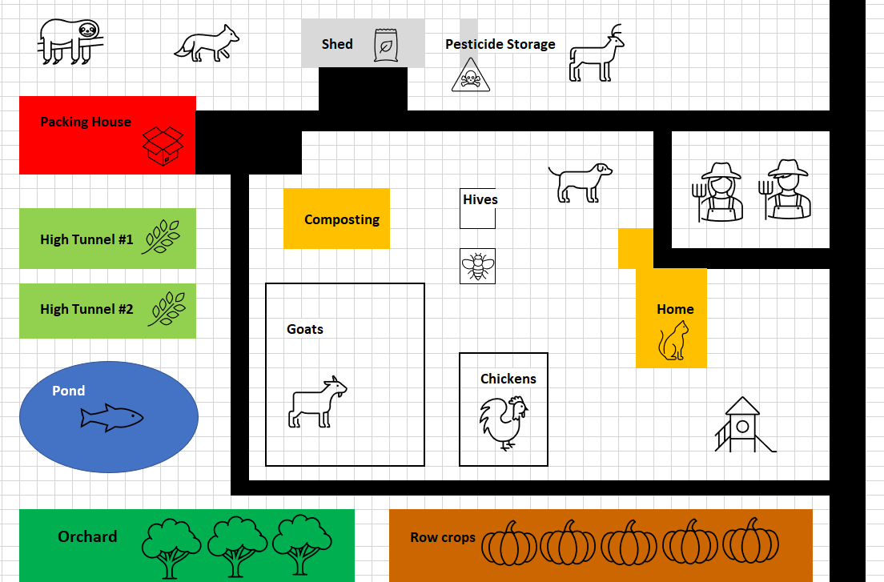
Implementing Practices to Reduce Risks from SARS-CoV-2
Notes:
Notes:
Focus on preventing person to person exposure and contamination from COVID-19
Identify your highest risk areas and develop practices that will reduce these risks.
Some possible considerations:
Create a single entry point on the farm for everyone working, visiting or coming on the farm to record their contact info, answer questions and take the temperature
Policies on what to do if someone appears to be “sick” and what to do
Decide on farmer’s markets based on their adherence to the appropriate guidance by the local/state health department
Eliminate farm pickups to reduce the number of people coming on the farm
Create a farm stand that is away from the majority of the farm and workers (and your family)
Many of these changes may require modification of current practices and ALSO additional training for employees, visitors, vendors, etc.
In the past year, you may have already implemented these practices.
Ask for help and seek training if you are unsure from the local and state health departments and agriculture service providers
Resources:
Agriculture Workers and Employers – CDC - https://www.cdc.gov/coronavirus/2019-ncov/community/guidance-agricultural-workers.html
Food Safety and the Coronavirus Disease 2019 (COVID-19) – FDA - https://www.fda.gov/food/food-safety-during-emergencies/food-safety-and-coronavirus-disease-2019-covid-19

Slide 25
Summary
Risk assessment must be assessed for each operation because there is no one size fits all in food safety
SOPs, training material and records for new health and hygiene issues will need to be modified or created to account for transmission of SARS-CoV-2 to both staff and visitors
Additional and/or revised signage will be necessary for both staff and visitors
Resources are available to assist you with this task

Slide 26

Acknowledgements
This work is supported by Rapid Response to Novel Coronavirus (SARS-CoV-2) Impacts Across Food and Agricultural Systems grant no. 2021-69006-33355 from the USDA National Institute of Food and Agriculture.
Any opinions, findings, conclusions, or recommendations expressed in this publication are those of the author(s) and do not necessarily reflect the view of the U.S. Department of Agriculture.

