Slide 1
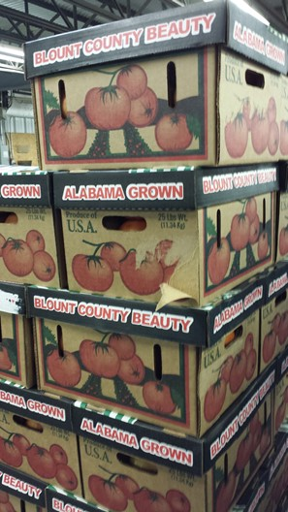
Module C: Produce Safety for Cleaning and Disinfecting Spaces and Equipment during COVID-19
Barbara E. Liedl, PH.D.
West Virginia State University
liedlbe@wvstateu.edu
Cindy Martel, M.S., CTIS
Future Generations University
cindy.martel@future.edu

Slide 2
Learning Outcomes
Identify potential SARS-CoV-2 sources of contamination for surfaces, tools and equipment
Describe the differences between cleaning, sanitizing and disinfecting
Review existing SOPs from production, harvesting, packing, storage, and transportation to incorporate concerns for SARS-CoV-2
Evaluate contact surfaces, tools, equipment as well as production, processing, packaging, storage and transportation areas as possible SARS-CoV-2 threats to staff and customers
Modify or create SOPs, trainings, signage and logs to reduce SARS-CoV-2 pathogen transmission from production to sales of produce

Slide 3
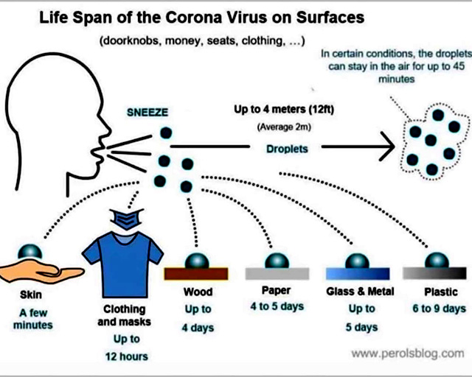
Surface Transmission of SARS-CoV-2
SARS-CoV-2 can survive on surfaces and play a role in indirect transmission
Transferred by touch with the virus must migrate and infect a cell
Less infectious over time but depends on material, temperature and other factors
Notes:
Notes:
Not all of what is on a surface will be transferred to their hand which is why it is less likely than person to person
IF CONCERNED ->
Avoid touching surfaces or items unnecessarily
Avoid touching your mouth, nose or face
Follow with handwashing and/or using hand sanitizer
Resources:
Cleaning and Disinfecting Your Facility https://www.cdc.gov/coronavirus/2019-ncov/community/disinfecting-building-facility.html
COVID-19 Preventative Measures Cleaning and Disinfection https://foodsafety.ces.ncsu.edu/wp-content/uploads/2020/03/Cleaning-and-disinfection_COVID-19_Flyer_031520.pdf?fwd=no
COVID-19 Response Plan Template for Fruit and Vegetable Farms https://docs.google.com/document/d/12sLifH-6Dm48lm_s2OIM3rIrN54Fv__z_i52Mvy5yGA/edit
Agricultural Employer Checklist for Creating a COVID-19 Assessment and Control Plan https://www.cdc.gov/coronavirus/2019-ncov/community/pdf/Agricultural-Employer-checklist.pdf
COVID-19 FAQ for Foodservice Cleaning and Disinfection https://foodsafety.ces.ncsu.edu/wp-content/uploads/2020/03/Retail-Cleaning_COVID-19_032620.pdf?fwd=no

Slide 4
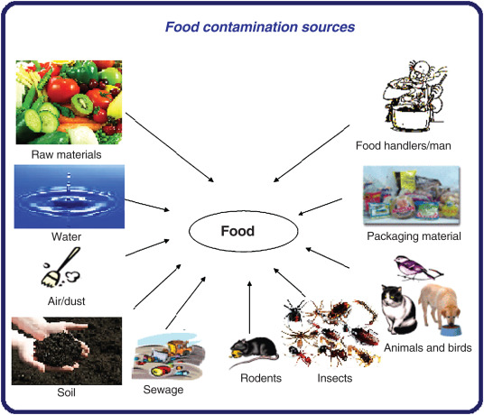
Sources of Contamination
Humans
Soil
Animals
Water
Tools, equipment, packing lines and packaging materials
What areas are of greatest concern for SARS-CoV-2 spread?
https://www.canr.msu.edu/resources/contamination-infographic
Notes:
Notes
Review where sources of food contamination including but not limited to:
Humans from fecal material, saliva, mucous, bodily fluids, improper hand washing & hygiene, illness or injury
Soil from raw manure used as a soil amendment, improper composting of manures, as well as other sources
Animals such as domestic and wild animals from feces and body shedding
Water can contaminate food by having contaminants within as well as spreading it, consider irrigation water, contained feeding areas, crop spray, washing and cleaning (gray water), flooding
Equipment that has been contaminated from humans, soil, manure, animals as well as water
Resources
Kamala, K. Kumar, V.P. 2018. Chapter 1 – Food Products and Food Contamination. Pg. 1-19. In: Holban, A.M. and Grumezescu, A.M. (eds), Handbook of Food Bioengineering, Microbial Contamination and Food Degradation, Academic Press. https://doi.org/10.1016/B978-0-12-811515-2.00001-9
Contamination Infographic https://www.canr.msu.edu/resources/contamination-infographic
Microorganisms Infographic https://www.canr.msu.edu/resources/microorganisms

Slide 5
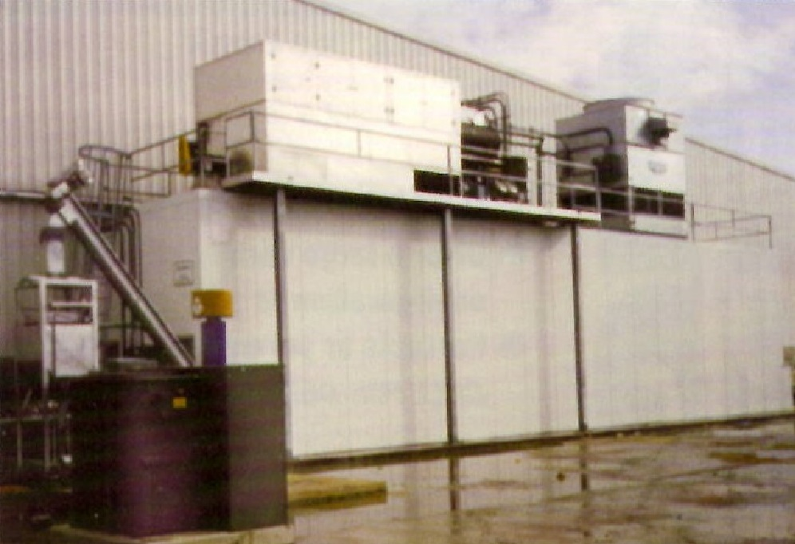
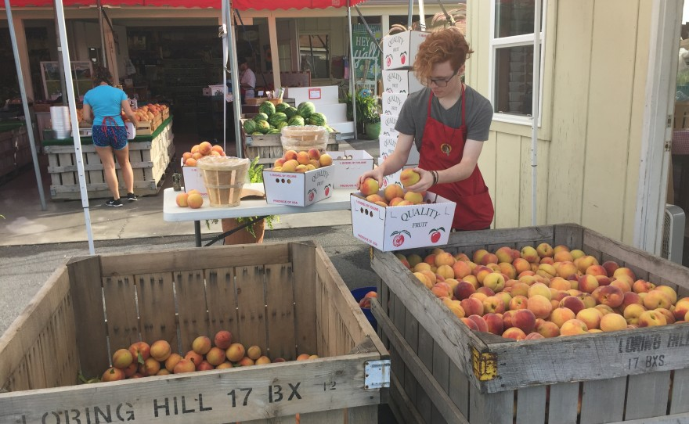
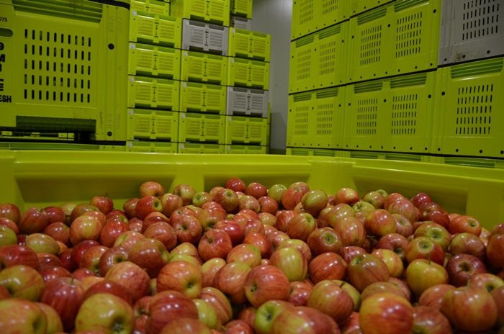
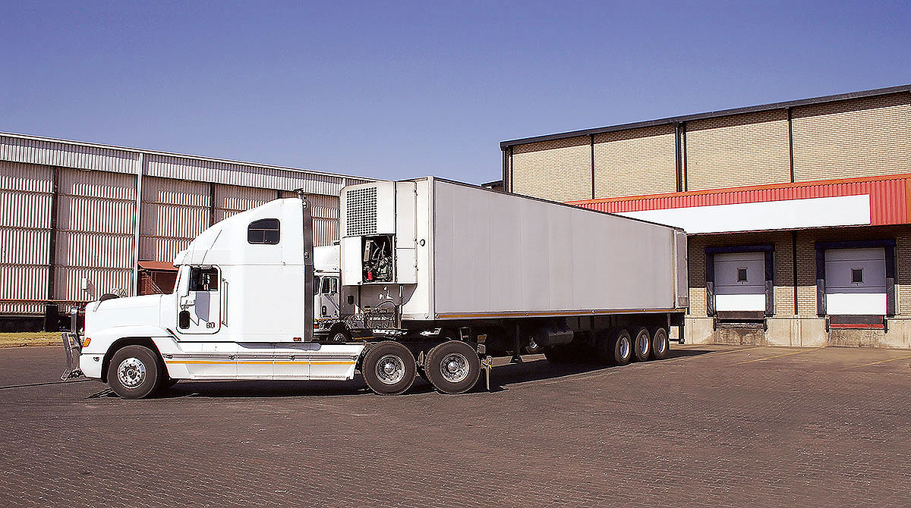
The Story of the Harvest Bin
https://semcoice.com/methods-cooling-apples-harvest/
https://www.wvpublic.org/news/2016-08-10/w-va-peach-season-is-here-but-theres-little-to-harvest-heres-why
https://apal.org.au/storing-apples/
https://www.fleetowner.com/fleet-management/article/21693105/new-food-safety-rules-pose-impact-for-refrigerated-carriers
Notes:
Notes
Just like you have completed a risk assessment on the farm as a whole, you should also consider also evaluating in-depth the risks of SARS-CoV-2 on harvest bins
The upper left hand side shows Hydrocooling unit which can drip water onto harvested product and bins if they are placed any where near
The upper right photo shows peaches harvested in wooden bins that are open for packaging into smaller bins. Wooden bins are harder to clean and sanitize which puts them at a higher risk for contamination issues
The lower left photo shows apples in a large plastic bins which are stacked and runs the possibility that if an upper bin is contaminated it can contaminate bins below it.
Finally the last photo (lower right) shows a semi loaded with product to be shipped. As with any transport, it is important that the container is cleaned so that lowers the risk for contamination from inside
Resources
30 tips for safe produce packing and transportation https://www.producegrower.com/article/food-safety-30-tips-safe-produce-packing-transportation/
Transportation https://gaps.cornell.edu/educational-materials/decision-trees/transportation/
Bins, Buckets, Baskets and Totes https://blog.uvm.edu/cwcallah/2018/11/14/bins-buckets-baskets-totes/

Slide 6
Have in place . . .
Field harvest procedures
Packing house flow
Packing line
Transportation plans
Material and supply storage controls
Pest and other contaminant controls
Plans to monitor, correct and review
WHERE CAN SARS-CoV-2 BE INTRODUCED?
WHAT ADDITIONAL STEPS CAN I TAKE TO ENHANCE MY CURRENT PROCESS?
Notes:
Notes
While surface transmission is not the primary way that the virus spread from person to person, it is possible for the virus to transfer from a contaminated surface via hands.
Consider the following areas:
Field harvest procedures: Employee issued harvest tools, Sharing, Cleaning and sanitizing procedures, Harvest containers and vehicles
Packing house flow: Hydrocooling, Quality control/culls, Ice bath, Storage, Cleanliness
Packing line: Employee PPE and social distancing, Quality control/culls Round 2, Food contact surfaces, Cleaning procedures, Environmental monitoring, Storage of packaging materials, Overall cleanliness
Transportation plans: include farm vehicles (trucks, gators and tractors), dollies, etc.
Material and supply storage controls: Do you have materials SARS-CoV-2 will stay on, where are you storing your materials and supplies to keep them out of contamination from normal items as well as SARS-CoV-2
Pest and other contaminant controls
Plans to monitor correct and review
Resources
Handling COVID-19 Produce Farms and Packinghouses https://foodsafety.ces.ncsu.edu/wp-content/uploads/2020/03/Packinghouse_COVID-19_Flyer-2.pdf?fwd=no
Agriculture Workers and Employers – CDC - https://www.cdc.gov/coronavirus/2019-ncov/community/guidance-agricultural-workers.html
Agricultural Employer Checklist – CDC - https://www.cdc.gov/coronavirus/2019-ncov/community/pdf/Agricultural-Employer-checklist.pdf
COVID-19 Response Plan Template for Fruit and Vegetable Farms https://docs.google.com/document/d/12sLifH-6Dm48lm_s2OIM3rIrN54Fv__z_i52Mvy5yGA/edit

Slide 7

Sanitation SOPs
Cleaning is not sanitizing
Sanitizing is not disinfecting
Disinfecting CANNOT happen without cleaning
Assess effectiveness of your current SOPs
Modify or create SOPs for cleaning and sanitizing as well as log sheet to track the process
Train staff and monitor activity
Notes:
Notes
IMPORTANT TO EMPHASIZE: Cleaning is NOT Sanitizing AND Sanitizing is not Disinfecting.
Sanitizing can’t occur without Cleaning and Disinfecting can’t occur without Sanitizing
Safety Standard Operating Procedures (SOPs) are written practices and procedures that are critical to producing safe food.
The decision to sanitize or disinfect should be based on the probability of the presence of a known hazard.
Sample Documents are available in Word from a variety of sources, but remember it is important that they be edited to fit your operation
SOPs need to be created or revised for any changes in the cleaning/sanitizing/disinfecting procedures
Also do not forget to train the staff to any changes and monitor the new procedures to allow corrections as needed
Resources
Cleaning vs. Sanitizing https://producesafetyalliance.cornell.edu/sites/producesafetyalliance.cornell.edu/files/shared/documents/Cleaning-vs-Sanitizing.pdf
Cleaning vs Sanitizing Infographic https://www.canr.msu.edu/resources/cleaning-vs-sanitizing-infographic
Agriculture Workers and Employers – CDC - https://www.cdc.gov/coronavirus/2019-ncov/community/guidance-agricultural-workers.html
National Good Agricultural Practices Program https://gaps.cornell.edu/educational-materials/decision-trees/log-sheets-sops/
Standard Operating Procedures https://ag.umass.edu/vegetable/fact-sheets/standard-operating-procedures
Sample SOPs for GAP Plan of Action Manual (AgCon) https://www.agconfoodsafety.com/200-standard-operating-procedures.html
COVID-19 Facility/Site Compliance: Agricultural – Workforce Guidance https://psla.umd.edu/sites/psla.umd.edu/files/files/documents/Food%20Safety/Ag%20COVID19%20WorkforceGuidance_v1.pdf
COVID-19 Facility/Site Compliance: Agricultural – Workforce Training Guidance https://psla.umd.edu/sites/psla.umd.edu/files/files/documents/Food%20Safety/Ag%20COVID19%20WorkforceTraining_v1%20(1).pdf
COVID-19 disinfecting guidelines developed for produce farms https://vegetablegrowersnews.com/news/covid-19-disinfecting-guidelines-developed-for-produce-farms/

Slide 8
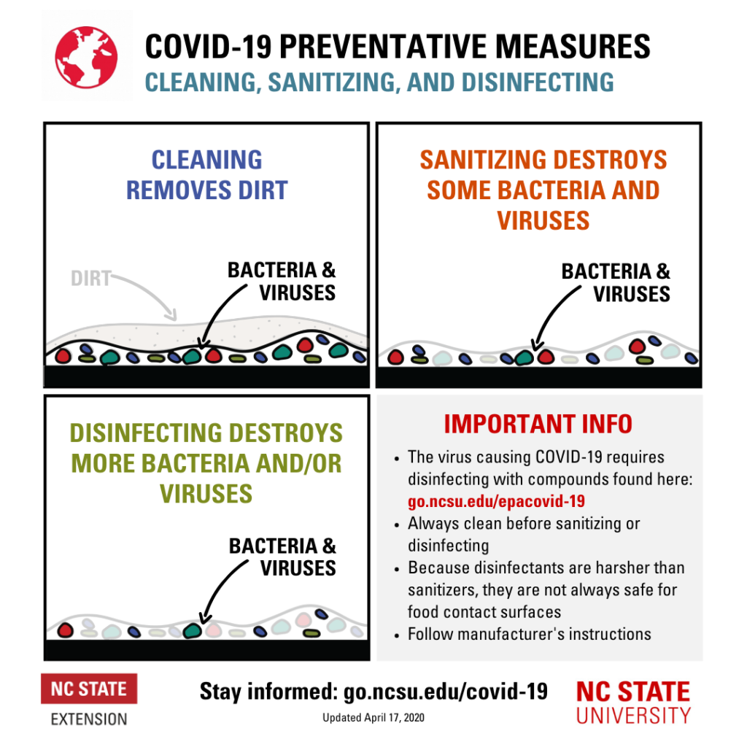
https://healthyhomes.ces.ncsu.edu/2020/04/cleaning-sanitizing-and-disinfecting-whats-the-difference/
Notes:
Notes
Infographic that will differentiate between Cleaning, Sanitizing and Disinfecting
Resources
Cleaning vs. Sanitizing https://producesafetyalliance.cornell.edu/sites/producesafetyalliance.cornell.edu/files/shared/documents/Cleaning-vs-Sanitizing.pdf
COVID-19 Preventative Measures Cleaning, Sanitizing and Disinfecting https://healthyhomes.ces.ncsu.edu/2020/04/cleaning-sanitizing-and-disinfecting-whats-the-difference/

Slide 9
High-touch surfaces to sanitize regularly if not dirty
Field: vehicle door handles, steering wheels, stick shifts, PTO handles, shared tools
Pack shed: dolly handles, cooler handles, door handles, light switches, scale buttons
Greenhouse: watering wand, germination chamber handles, door handles, vent openers
Office: keyboard, mouse, iPad, phones, chair armrests
Restrooms: toilet handles and seats, faucet handles, door handles
Tools and equipment: Sorting tables, harvest totes and buckets, scales, clippers, knives
Other: buttons, pads and touch screens used by staff or volunteers
Notes:
Notes
You might already have a robust cleaning and sanitizing routine for your farm’s food contact surfaces like tools, totes and tables.
Sanitizing for COVID-19 might not be significantly different from those current procedures, with the addition of more attention to the "high-touch" areas.
However, some items and areas should be frequently cleaned and sanitized such as door handles, equipment, bins, point of sale equipment, chairs, tables and other heavily touched surfaces.
Resources
COVID-19 disinfecting guidelines developed for produce farms https://vegetablegrowersnews.com/news/covid-19-disinfecting-guidelines-developed-for-produce-farms/
Interim Standard Operating Procedure (SOP) for Cleaning and Disinfection of High Touch Surfaces on Farms during communicable disease outbreak of COVID-19 https://www.calstrawberry.com/Portals/2/Documents/Announcements/2020/SOP%20for%20Cleaning%20High-Touch%20Surfaces%20During%20COVID-19.pdf?ver=2020-06-03-143716-437

Slide 10
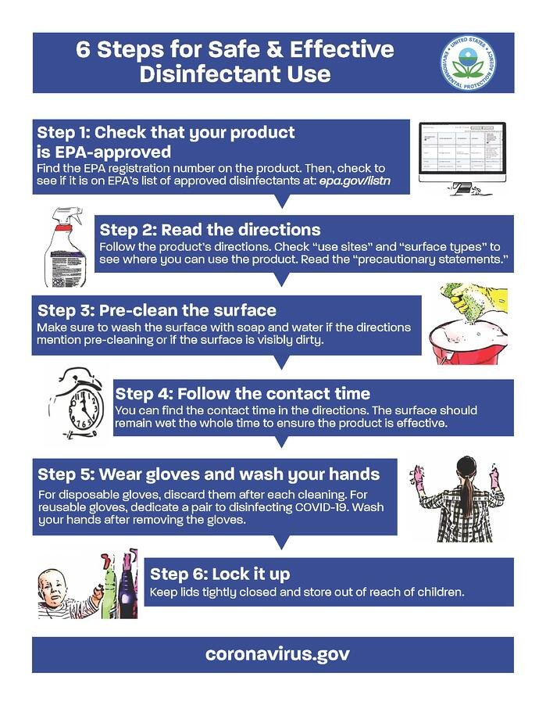
https://www.epa.gov/sites/production/files/2020-04/documents/disinfectants-onepager.pdf
Notes:
Notes
Using a disinfectant is the third step is needed.
Here is a six step list for safe and effective use of disinfectants
Resources
6 Steps for Safe & Effective Disinfectant Use https://www.epa.gov/sites/production/files/2020-04/documents/disinfectants-onepager.pdf
Cleaning vs. Sanitizing https://producesafetyalliance.cornell.edu/sites/producesafetyalliance.cornell.edu/files/shared/documents/Cleaning-vs-Sanitizing.pdf

Slide 11
What sanitizers can be used?
EPA "List N" is the list of disinfectants effective against SARS CoV-2
Use according to the LABEL
Some options
  Ultra Clorox Regular Brand Bleach (6.0% sodium hypochlorite)
  VigorOx SP-15 (15% peroxyacetic acid and 10% hydrogen peroxide) OMRI approved
  Sanidate 5.0 (5.3% peroxyacetic acid and 23.0% hydrogen peroxide) OMRI approved
Notes:
Notes
While the most important way to minimize the spread of the SARS-CoV-2 virus is by minimizing person-to-person contact, cleaning and sanitizing surface on the farm is also important.
If a surface has been contaminated by SARS-CoV-2 or been in contact with someone with COVID-19, then it surface should be not only cleaned and sanitized but also disinfected as per the label.
The best way to find products are to use the list developed by EPA that is a list of disinfectants for use against SARS-CoV-2 in March 2020 (List N). However, this is a list of ALL disinfectants that can be used against SARS-CoV-2 which includes products not appropriate for use in produce production, harvest, post-harvest and transport.
Here are three examples of products.
Resources
Cleaning and Sanitizing on the Farm for COVID-19 https://blog-fruit-vegetable-ipm.extension.umn.edu/2020/05/cleaning-and-sanitizing-on-farm-for.htmlList N Tool: COVID-19 Disinfectants https://cfpub.epa.gov/wizards/disinfectants/
Introduction to Selecting an EPA-Labeled Sanitizer https://producesafetyalliance.cornell.edu/sites/producesafetyalliance.cornell.edu/files/shared/documents/Sanitizer-Factsheet.pdf
Labeled Sanitizers for Produce - Excel Tool https://producesafetyalliance.cornell.edu/sites/producesafetyalliance.cornell.edu/files/shared/documents/PSA-Labeled-Sanitizers-for-Produce.xlsx and Video Tutorial: How to use the Excel Tool Labeled Sanitizer for Produce https://youtu.be/wNNJOeITtxU

Slide 12
Packing Areas Questions?
Is the area open or closed?
Does the engineering and/or landscaping affect the potential transmission of SARS-CoV-2?
Is the organization of the area maximize social distancing and reduce transmission of SARS-CoV-2?
Are changes needed in the pest control program?
Do not forget the surface areas for the staff, including rest rooms, break areas, lockers and changing areas
Notes:
Notes
Is your packing area/house open to the air or is a closed building? If open there are less risk concerns but there are still some. More concerns will need to be addressed for any closed building areas used for packing
Is how the building is structured increase or reduce the risk for SARS-CoV-2? This may include space size for equipment and people which may impact social distancing? The building or the landscaping may also make flow of people, supplies and harvested materials difficult. Just has been done in other businesses, things may need to be rearranged to reduce these risks.
What about pest control issues? Having your pets in the packing area is always a possible risk factor but now with COVID-19 which may now may need to be re-evaluated and exclude them as well as any other animals from the packing area.
Do not overlooking cleaning and sanitizing the areas for staff including the break areas, lockers and changing areas as well as the rest rooms they utilize at the farm. You may also add to the SOPs one for cleaning the break area used by staff after it has been used.
Resources
COVID-19 Response Plan Template for Fruit and Vegetable Farms https://docs.google.com/document/d/12sLifH-6Dm48lm_s2OIM3rIrN54Fv__z_i52Mvy5yGA/edit
Handling COVID-19 Produce Farms and Packinghouses https://foodsafety.ces.ncsu.edu/wp-content/uploads/2020/03/Packinghouse_COVID-19_Flyer-2.pdf?fwd=no
Interim Standard Operating Procedure (SOP) for Cleaning and Disinfection of High Touch Surfaces on Farms during communicable disease outbreak of COVID-19 https://www.calstrawberry.com/Portals/2/Documents/Announcements/2020/SOP%20for%20Cleaning%20High-Touch%20Surfaces%20During%20COVID-19.pdf?ver=2020-06-03-143716-437

Slide 13
Packing Zones
Assess space within the packing area and assigns a value from 1 (highest) to 4 (lowest) to prioritize sanitation focus
Zone 1 has greatest concern for SARS-CoV-2 as it has the highest level of exposure to humans
The concept of “zone” may be fluid in the packing area based on the product, length of line/contact and area of exposure
Ensure packaging used for sales and transport is clean and protected from contamination.
  Note: cardboard and wax boxes cannot be cleaned and sanitized in general, and reuse of packaging is discouraged
Notes:
Notes
Within the Packing Area/House there are zones that have higher risks for exposure to contaminants. These are assigned levels from 1 (highest risk) to 4 (lowest risk).
In dealing with SARS-CoV-2, zone 1 is of the greatest concern as it has the highest level of exposure to humans which carries the most risk.
So it is worthwhile to re-evaluate zones in the packing area/house in regards to SARS-CoV-2 and remember this may be fluid. Zone 1 may be found not only where people are putting things on the line but also when they are taking them off and any other locations down the line where people may be in contact with the product.
Also remember that it is important to keep any packing clean and protected from all sources of contamination.
Resources
COVID-19 Response Plan Template for Fruit and Vegetable Farms https://docs.google.com/document/d/12sLifH-6Dm48lm_s2OIM3rIrN54Fv__z_i52Mvy5yGA/edit
Tools for farmers: Harvest http://foodsafety.uconn.edu/Food_Processing_landing_page/Processing_Meat_&_Poultry/toolsworkerharvest.php
Tools for farmers: Post-Harvest Handling http://foodsafety.uconn.edu/Food_Processing_landing_page/Processing_Meat_&_Poultry/toolsworkerpostharvesthandling.php
Handling COVID-19 Produce Farms and Packinghouses https://foodsafety.ces.ncsu.edu/wp-content/uploads/2020/03/Packinghouse_COVID-19_Flyer-2.pdf?fwd=no

Slide 14
Storage
Reduce the risk of transmission by regular cleaning and maintenance
Create a cleaning, sanitizing and disinfecting schedule
Monitor temperature and humidity for produce and to evaluate possibility of increased risk of SARS-CoV-2 transmission
Map the storage layout to reduce time staff are in the facility
Increase the frequency of “deep” cleans
Notes:
Notes
During COVID-19 do not overlook dealing with your storage areas as this can be of higher risk.
Because SARS-CoV-2 is transmitted via respiratory droplets, any areas that have higher humidity or reduced temperatures will extend the time the respiratory droplets are in air. As a result it may be worth while changing some procedures and protocols to lessen exposure to your staff in the storage areas
Map the storage layout and create a flow that reduce staff time inside the storage area
Maintain regular cleaning and maintenance schedule
Disinfect the area of there was a possible SARS-CoV-2 episode
Increase the frequency of “deep” cleans
Resources
COVID-19 Response Plan Template for Fruit and Vegetable Farms https://docs.google.com/document/d/12sLifH-6Dm48lm_s2OIM3rIrN54Fv__z_i52Mvy5yGA/edit
Tools for farmers: Post-Harvest Handling http://foodsafety.uconn.edu/Food_Processing_landing_page/Processing_Meat_&_Poultry/toolsworkerpostharvesthandling.php

Slide 15
Transportation
Transport vehicles should be considered high contact areas – trucks, “gators”, 4-wheelers, pallet jacks, etc.
Create a cleaning, sanitizing and disinfecting schedule for vehicles inside and out
Restrict smoking and eating in all vehicles
If controlled storage vehicle, monitor temperature and humidity as well as produce condition during transport
Consider increasing the frequency of “deep” cleans of vehicles
Notes:
Notes
All transport vehicles and equipment should be considered high contact areas since they are used by people. This includes not only vehicles but also dollies and pallet jacks as well.
SOPs should be created for cleaning, sanitizing and disinfecting vehicles and equipment on a regular basis
Because smoking and eating require taking off a mask, these should be restricted activities in farm vehicles and equipment
If a controlled storage vehicle is used on the farm the temperature and humidity should be monitored as well as the condition of the produce during transport.
Resources
Transportation https://gaps.cornell.edu/educational-materials/decision-trees/transportation/
COVID-19 Facility/Site Compliance: Agricultural – Delivery Guidance https://psla.umd.edu/sites/psla.umd.edu/files/files/documents/Food%20Safety/Ag%20COVID19%20DeliveryGuidance_v1%20(1).pdf
COVID-19 Response Plan Template for Fruit and Vegetable Farms https://docs.google.com/document/d/12sLifH-6Dm48lm_s2OIM3rIrN54Fv__z_i52Mvy5yGA/edit

Slide 16
Agritourism
Increased potential for pathogen transmission via contact surface areas and people (staff and visitors)
Determine non-entry zones for visitors and clearly mark barriers
Pre-package items to discourage bare hand sorting
Limit samples to single-serving packaged, take away items
Increase number and location of handwash and hand sanitizer stations
Advise visitors to NOT pick or eat dropped produce
Notes:
Notes
Agritourism operations add a new level of risks over just a general farm operation and will require additional risk assessments such as these and others mentioned in previous modules.
Resources
COVID-19 Facility/Site Compliance: Agricultural – Business Checklist https://psla.umd.edu/sites/psla.umd.edu/files/files/documents/Food%20Safety/Ag%20COVID19%20BusinessChecklist_v1%20(2).pdf
COVID-19 Facility/Site Compliance: Agricultural – Workforce Guidance https://psla.umd.edu/sites/psla.umd.edu/files/files/documents/Food%20Safety/Ag%20COVID19%20WorkforceGuidance_v1.pdf
COVID-19 Facility/Site Compliance: Agricultural – Workforce Training Guidance https://psla.umd.edu/sites/psla.umd.edu/files/files/documents/Food%20Safety/Ag%20COVID19%20WorkforceTraining_v1%20(1).pdf
COVID-19 Facility/Site Compliance: Agricultural – Delivery Guidance https://psla.umd.edu/sites/psla.umd.edu/files/files/documents/Food%20Safety/Ag%20COVID19%20DeliveryGuidance_v1%20(1).pdf
Best Management Practices for Agritourism Farms During the COVID-19 Pandemic https://smallfarms.cornell.edu/resources/farm-resilience/best-management-practices-for-agritourism-covid/
COVID-19 Agritourism Resources & Information https://ucanr.edu/sites/agritourism/COVID-19/
COVID-19 Facility/Site Compliance: Agricultural – Delivery Guidance https://psla.umd.edu/sites/psla.umd.edu/files/files/documents/Food%20Safety/Ag%20COVID19%20DeliveryGuidance_v1%20(1).pdf
Farm Pick-Your-Own (PYO)/Agricultural Tourism Activities – Guidance Memo #5 https://www.mass.gov/doc/mdar-bulletin-16-farm-pick-your-own-pyoagricultural-tourism-activities/download
Handling COVID-19 Best Practices for Agribusiness https://foodsafety.ces.ncsu.edu/wp-content/uploads/2020/04/Agribusiness_COVID-19_Flyer-2.pdf
Ways to Keep Agritourism Relevant Through the COVID-19 Pandemic https://www.growingproduce.com/vegetables/ways-to-keep-agritourism-relevant-through-the-covid-19-pandemic/

Slide 17
Reduce Transmission from off The Farm
Pre-sell and pre-package produce when possible
Use separate containers to take off farm for sales instead of harvest boxes
Pack additional PPE and hand sanitizer for staff use
Choose retail display containers that can be cleaned, sanitized and disinfected
Provide locations to dispose of used PPE and collect clothing used by the staff off site to be cleaned
Create additional barriers to prevent contact that can bring SARS-CoV-2 back to the farm
Notes:
Notes
Review ways to reduce the potential for transmission when off the farm by using some of these options for both your staff and your customers
Resources
COVID-19 Response Plan Template for Fruit and Vegetable Farms https://docs.google.com/document/d/12sLifH-6Dm48lm_s2OIM3rIrN54Fv__z_i52Mvy5yGA/edit
Agriculture Workers and Employers – CDC - https://www.cdc.gov/coronavirus/2019-ncov/community/guidance-agricultural-workers.html
Agricultural Employer Checklist – CDC - https://www.cdc.gov/coronavirus/2019-ncov/community/pdf/Agricultural-Employer-checklist.pdf
Considerations for Outdoor Farmers Markets https://www.cdc.gov/coronavirus/2019-ncov/community/outdoor-farmers-markets.html
COVID-19 Preventative measures cloth coverings for Food Employees https://foodsafety.ces.ncsu.edu/wp-content/uploads/2021/04/Foodservice-Facecovers_COVID-19_Flyer_040920.pdf

Slide 18
Summary
Revisit “The Farm”
Identify potential contact and contamination points
Evaluate application of best practices with your staff and farm
Target areas of high risk for SARS-CoV-2 transmission
Modify or create SOPs to reduce risk, document change and monitor based on SARS-CoV-2 as well as the changing and future outbreaks

Slide 19
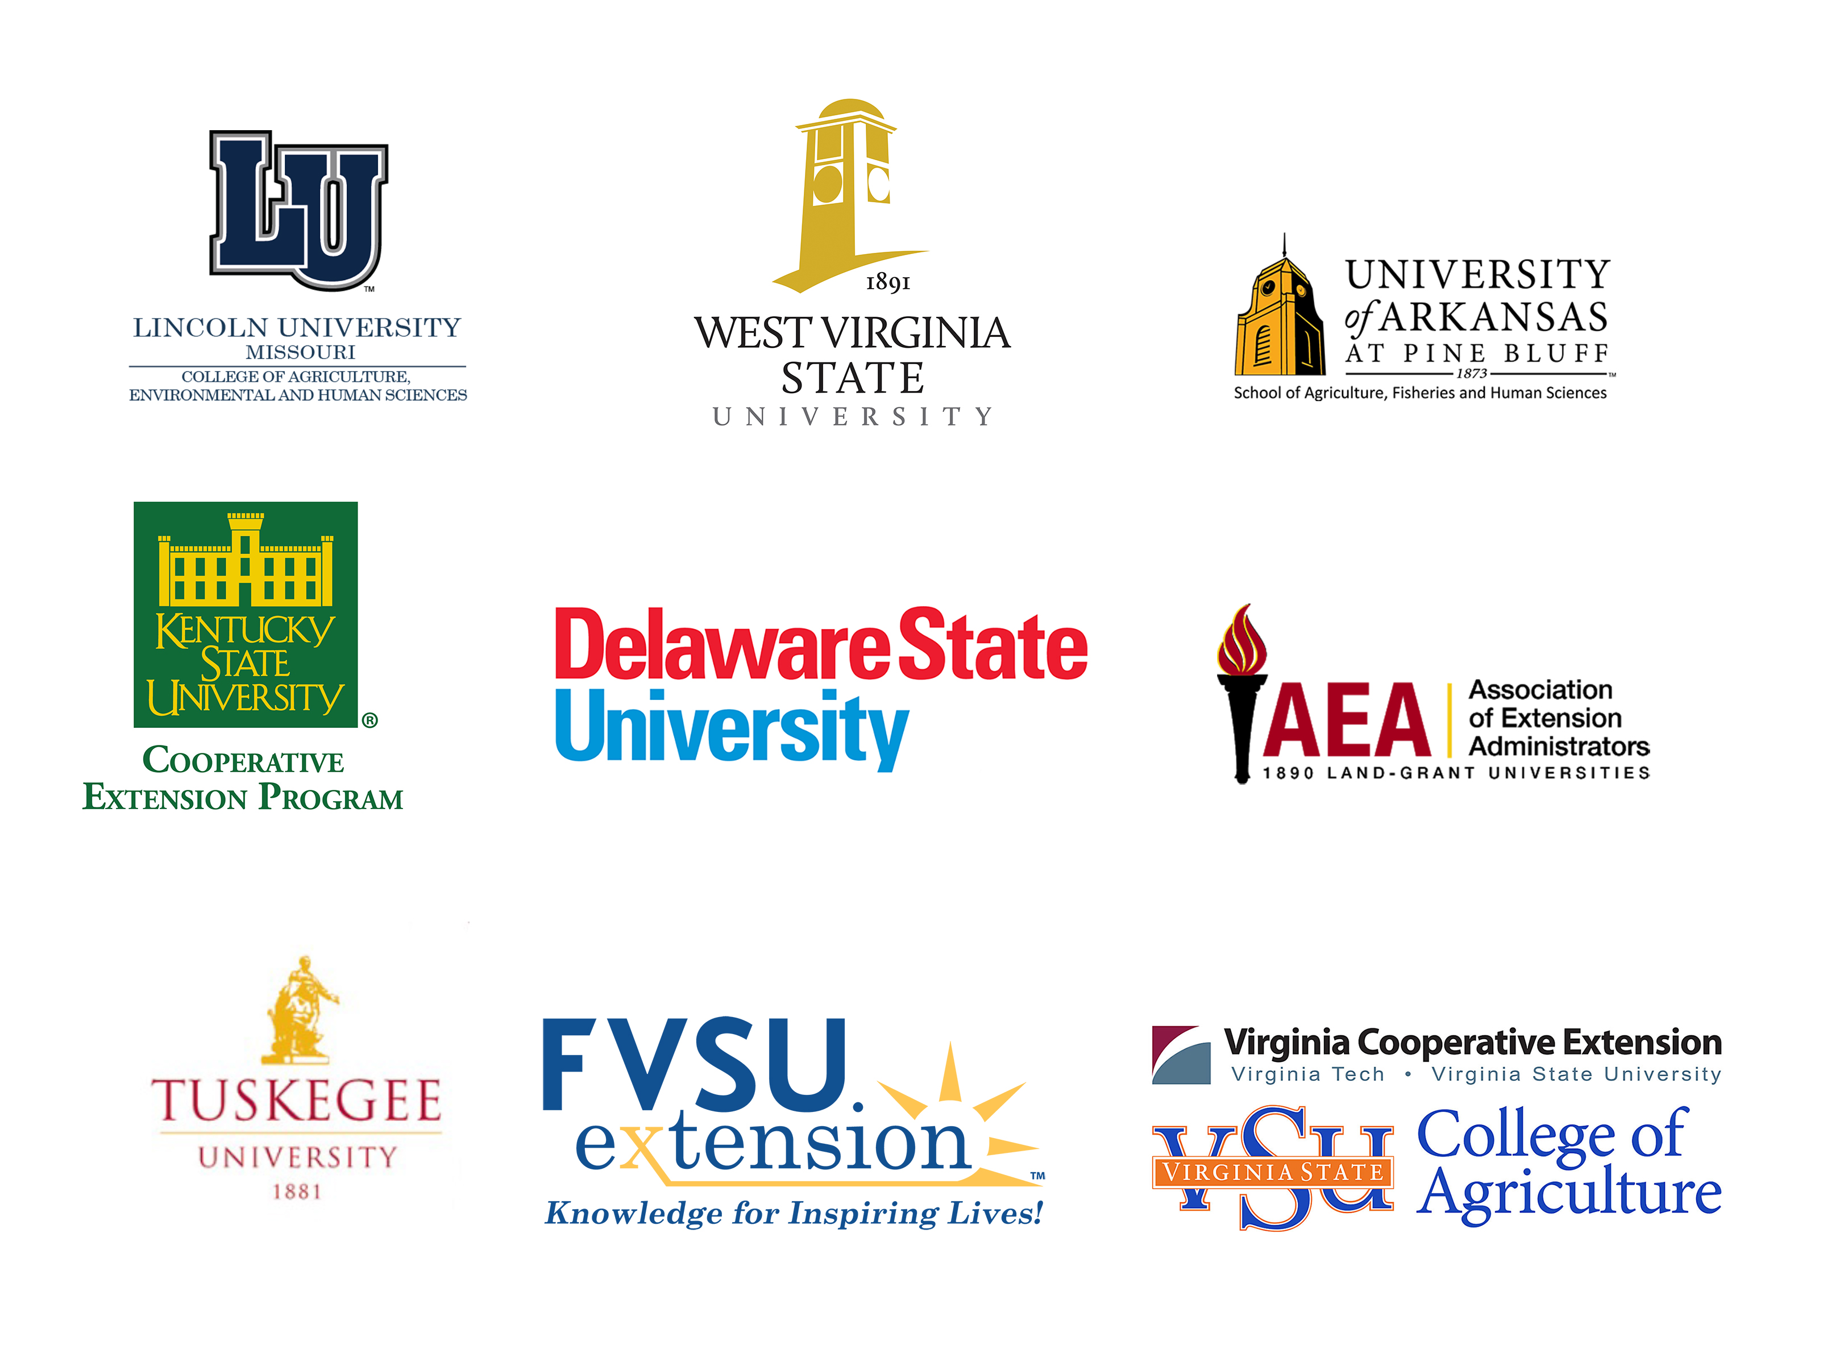
Acknowledgements
This work is supported by Rapid Response to Novel Coronavirus (SARS-CoV-2) Impacts Across Food and Agricultural Systems grant no. 2021-69006-33355 from the USDA National Institute of Food and Agriculture.
Any opinions, findings, conclusions, or recommendations expressed in this publication are those of the author(s) and do not necessarily reflect the view of the U.S. Department of Agriculture.

