Slide 1
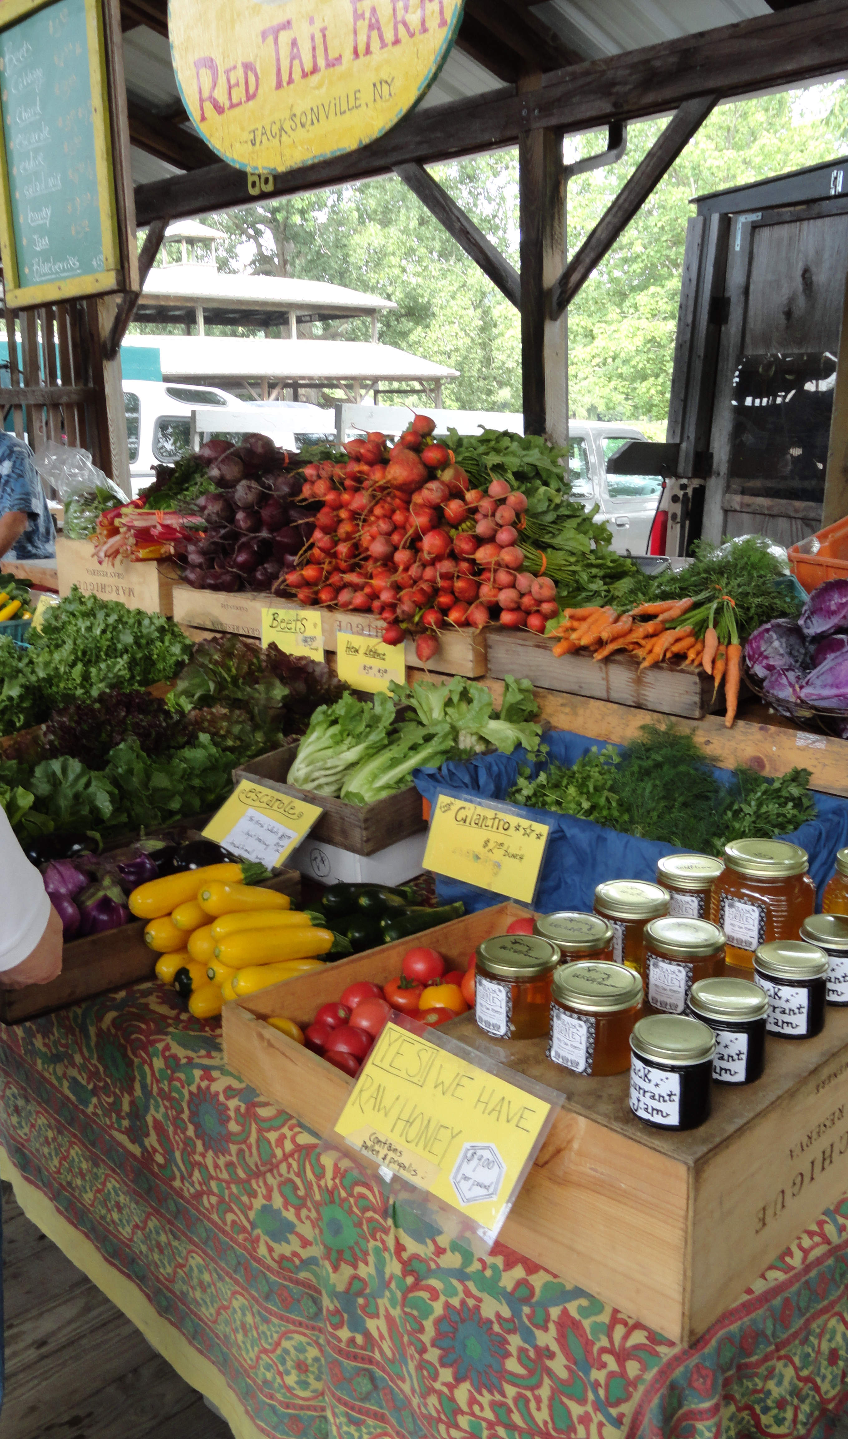
Module A: Produce Safety, the Human Pathogen SARS-CoV-2 and COVID-19
Barbara E. Liedl, PH.D.
West Virginia State University
liedlbe@wvstateu.edu
Cindy Martel, M.S., CTIS
Future Generations University
cindy.martel@future.edu

Slide 2
Learning Outcomes
Differentiate between SARS-CoV-2 and COVID-19
Describe common ways SARS-CoV-2 can be spread during production, harvest, postharvest, transport and at the market
Identify strategies to prevent and reduce risks of SARS-CoV-2 contamination along the supply chain.
Recognize the value of implementing additional SARS-CoV-2 food safety practices in your operation

Slide 3
SARS-CoV-2 and COVID-19 Addendum to the PSA Curriculum
This is NOT a replacement for the PSA Curriculum that covers the FSMA Produce Safety Rule requirements and includes GAPs and does not meet § 112.22(c)
This is NOT a replacement for recommendations from the federal, state or local health departments or the CDC.
This is additional training for growers and handlers of produce on accounting for SARS-COV-2 and COVID-19 food safety issues for produce.
Notes:
Notes:
This training NOT a way to meet § 112.22(c) which requires that at least one supervisor or responsible party from a farm subject to the FSMA Produce Safety Rule must have successfully completed food safety training at least equivalent to that received under standardized curriculum recognized as adequate by the Food and Drug Administration.
They also need to stay in contact with local and state health departments to make sure they are following the local and state regulations which vary.
Consider taking the Produce Safety Alliance (PSA) training, to lessen a grower’s risk and to make sure they are complying with the law.
Resources:
COVID-19 – CDC - https://www.cdc.gov/coronavirus/2019-ncov/index.html
Coronavirus Disease 2019 (COVID-19) – CDC - https://www.cdc.gov/media/dpk/diseases-and-conditions/coronavirus/coronavirus-2020.html
State, Territorial, Local and Tribal Health Department Search – CDC - https://www.cdc.gov/coronavirus/2019-ncov/php/hd-search/index.html
Food Safety Modernization Act (FSMA) – FDA - https://www.fda.gov/food/guidance-regulation-food-and-dietary-supplements/food-safety-modernization-act-fsma
Produce Safety Alliance – PSA - https://producesafetyalliance.cornell.edu/

Slide 4
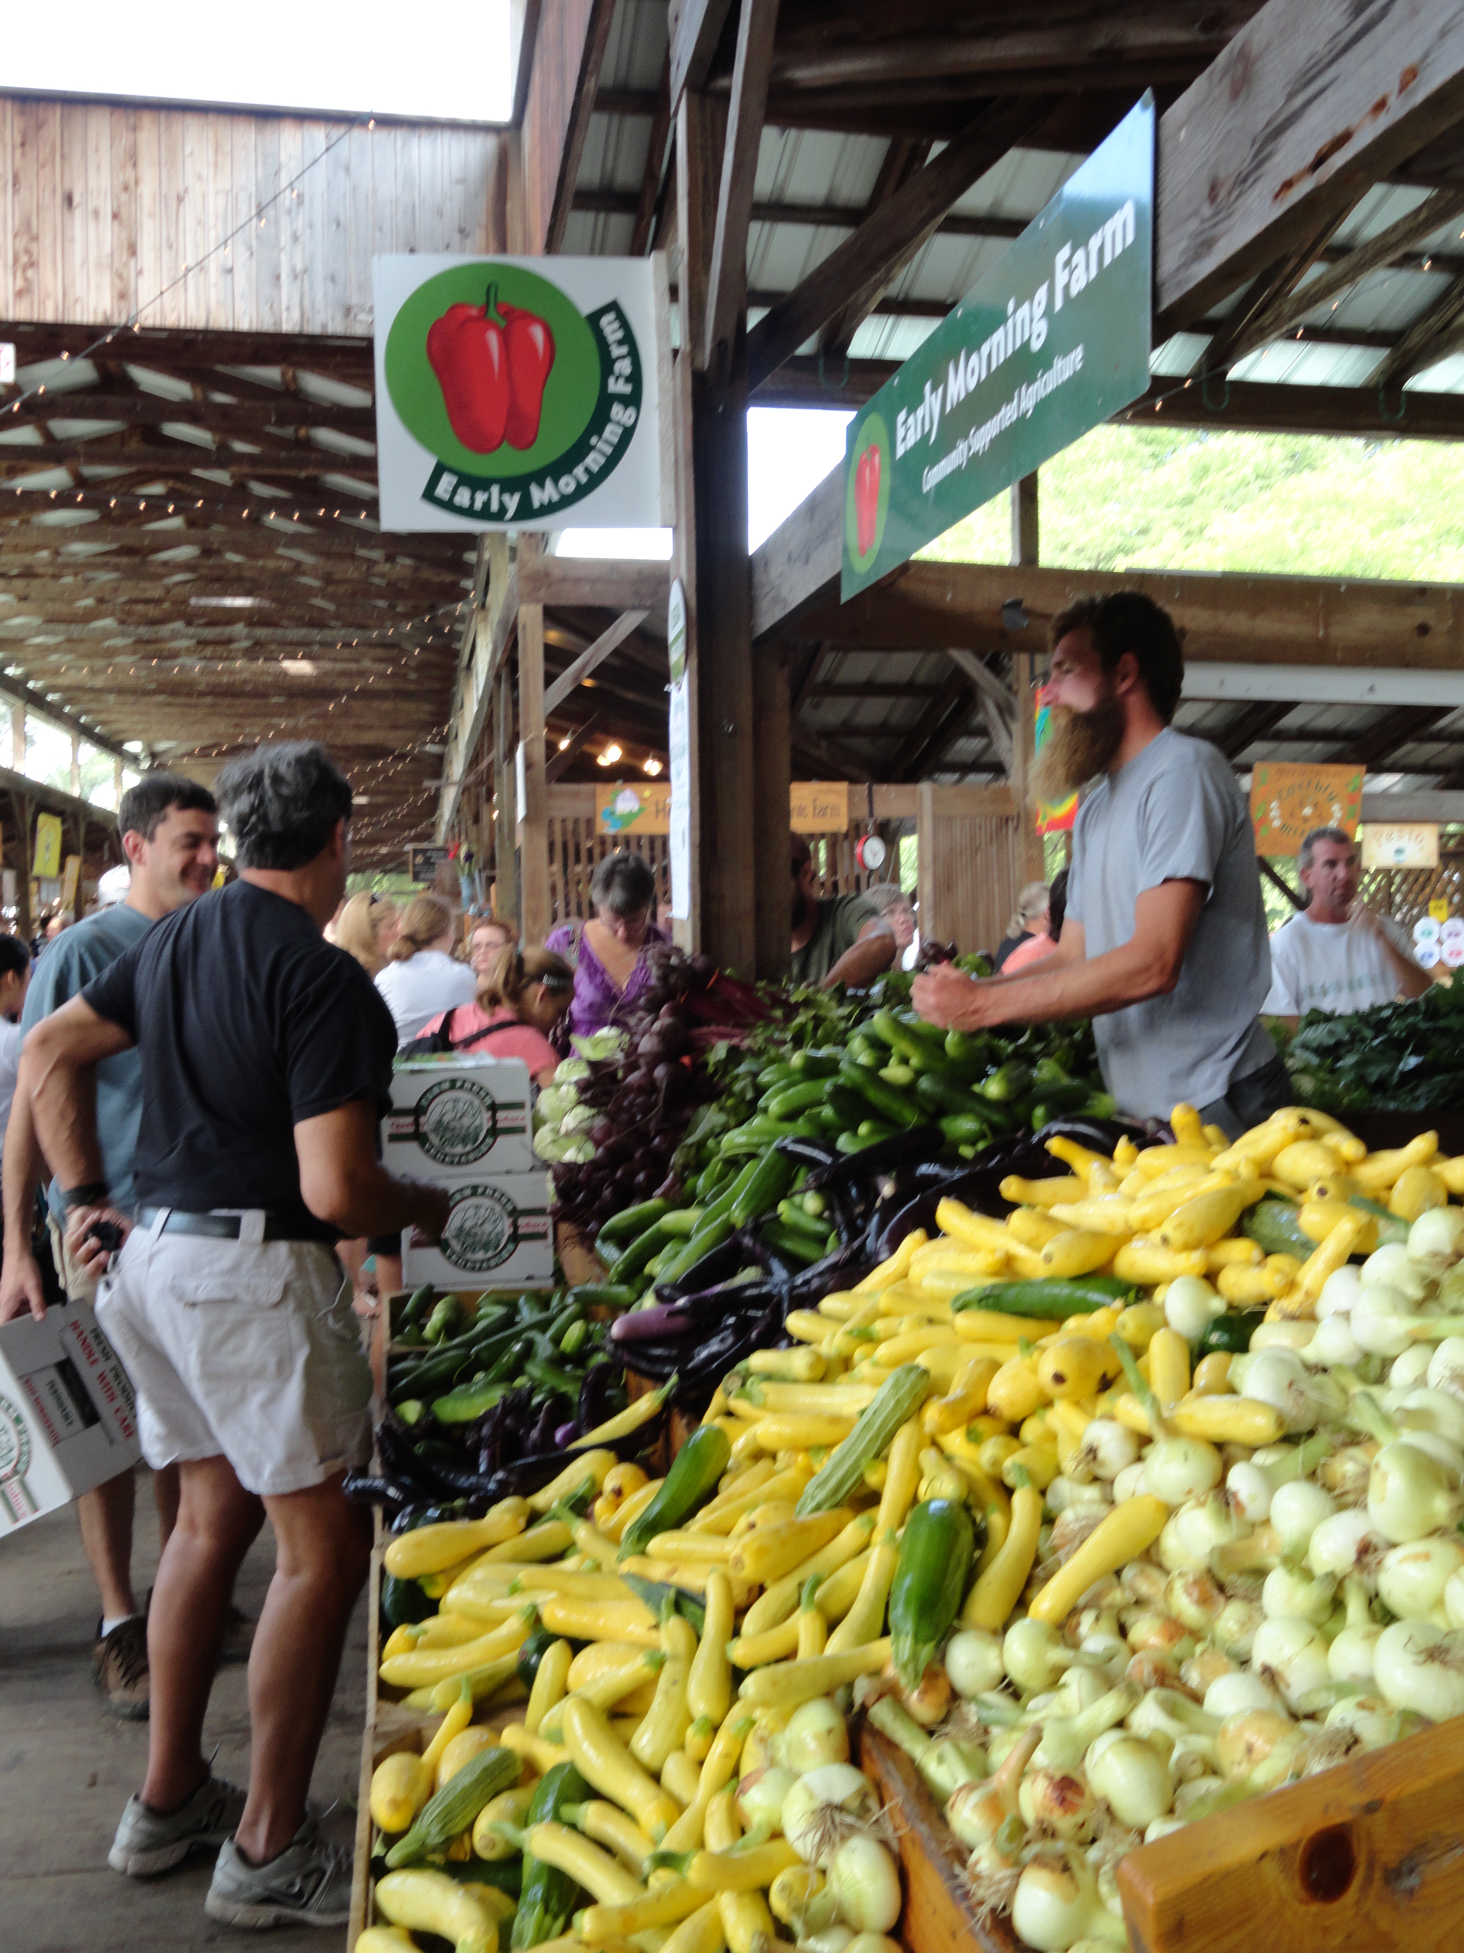
Relevance of COVID-19 to your Agricultural Operation
You can prevent and reduce the risks of getting COVID-19 in your agricultural operation
You know your operation and practices the best, but you may not know the consequences of your current practices on produce safety risks
Actions you take now and, in the future, will directly impact food safety along with the health of your staff and customers as well as the financial viability of your operation
Notes:
Notes:
Just like with PSA training, producers and their staff are the key to growing and distributing safety on and off the farm, thus making the decision to do something on the farm is up to them.
Producers know their operation the best—what they produce, how they produce, who works on the farm, who comes on the farm, how the produce is moved off the farm, and all of the other details that go into running a successful operation.
Thus, it is the person or people who make production, marketing and purchasing decisions for the operation and know the day-to-day activities that MUST be involved in assessing food safety risks and developing the farm’s food safety plan which must include dealing with COVID-19 and any future pandemics.
Actions to reduce food safety risks not only impact the financial viability of farms, but also the health and safety of those who work on the farm, as well as those who come on the farm in associated industries and those that consume the produce grown.
Resources:
COVID-19 Update: USDA, FDA, Underscore Current Epidemiologic and Scientific Information Indicating No Transmission of COVID-19 Through Food or Food Packaging https://www.usda.gov/media/press-releases/2021/02/18/covid-19-update-usda-fda-underscore-current-epidemiologic-and
COVID-19 Response Plan Template for Fruit and Vegetable Farms https://docs.google.com/document/d/12sLifH-6Dm48lm_s2OIM3rIrN54Fv__z_i52Mvy5yGA/edit
Agricultural Employer Checklist for Creating a COVID-19 Assessment and Control Plan https://www.cdc.gov/coronavirus/2019-ncov/community/pdf/Agricultural-Employer-checklist.pdf

Slide 5
What is SARS-CoV-2 and COVID-19?
SARS-CoV-2 is the virus that causes the disease COVID-19
SARS = Severe Acute Respiratory Syndrome
  Family of viral respiratory diseases caused by a SARS-associated coronavirus
COVID-19 = CO for corona, VI for virus and D for disease with 19 for the year this was identified
  Symptoms include a fever, cough, shortness of breath or difficulty breathing, chills, muscle pain, sore throat, or new loss of taste and smell.
Notes:
Notes:
SARS is caused by a virus that takes over your body’s cells and uses them to make copies of itself. The SARS virus is from a group known as coronaviruses, which also cause the common cold.
This family of viruses includes MERS-CoV and SARS-CoV, which are two earlier coronaviruses affecting humans
SARS can spread when people who have it cough or sneeze, spraying tiny droplets of liquid with the virus to other people within 2-3 feet. Other people may get the virus by touching something those droplets hit, then touching their nose, eyes, or mouth.
Some staff may be a at a higher risk including older adults and people with certain underlying medical conditions.
Resources:
Coronavirus and COVID-19: What You Should Know https://www.webmd.com/lung/coronavirus#:~:text=COVID%2D19%20is%20a,to%2Dperson%20contact.
Episode 2: SARS-CoV-2? COVID-19? What’s the Difference – CDC - https://youtu.be/VAX0he6vjU0
Mythbusters – CDC - https://www.who.int/emergencies/diseases/novel-coronavirus-2019/advice-for-public/myth-busters
What’s the Difference between a Cold, the Flu and COVID-19 https://www.cedars-sinai.org/blog/cold-flu-covid-differences.html#:~:text=The%20novel%20coronavirus%2C%20or,to%20COVID%2D19.

Slide 6
Transmission of SARS-CoV-2
Person to Person – Most common
Surface to Person – Possible but no reports
Animals to Person – Rare situations
Produce to Person – NONE
https://foodsafety.ces.ncsu.edu/wp-content/uploads/2020/08/SARS-CoV-2-TRANSMISSION-1.pdf?fwd=no
Notes:
Notes:
ICMSF opinion on SARS-CoV-2 and its relationship to food safety (3 Sept 2020)
“SARS-CoV-2 should NOT be considered a food safety hazard since a true food safety hazard enters the human body with food via the gastro-intestinal (GI) tract, where it can infect organs/tissues elsewhere in the human body.” Page 3
“. . . to date there has not been any evidence that food, food packaging or food handling is a source or important transmission route for SARs-CoV-2 resulting in COVID-19.” Page 3
“. . . it is prudent to emphasize to food producers, manufacturers and handlers the importance of using good food hygiene practices to minimize any possibility of food or food contact surfaces as a vector for SARS-CoV-2.” Page 4
COVID-19 Update: USDA, FDA Underscore Current Epidemiologic and Scientific Information Indicating No Transmission of COVID-19 Through Food or Food Packaging – Feb 18, 2021.
“no credible evidence of food or food packaging associated with or as a likely source of viral transmission of severe acute respiratory syndrome coronavirus 2 (SARS-CoV-2), the virus causing COVID-19.”
There are some rare instances of transfer of the virus from people to animals after close contact with a person with COVID-19.
cats, dogs, ferrets, fruit bats, hamsters, tree shrews and some other mammals can be infected but we don’t know all the animals that can be at this time.
Most of these are pets that have become sick after contact with people with COVID-19
Laboratory mice, pigs, chickens, and ducks do not seem to become infected or spread the infection based on results from studies.
Several animals in zoos have tested positive including lions, tigers, puma, snow leopard, cougar and great apes.
Reports of minks on mink farms that have reported COVID-19 but there may be a possibility (Netherlands and Denmark). There is guidance available from the USDA, CDC and state animal and public health partners on protecting work and animal health
Resources:
How Coronavirus Spreads – CDC - https://www.cdc.gov/coronavirus/2019-ncov/prevent-getting-sick/how-covid-spreads
SARS-CoV-2 Virus Transmission – NCSU– https://foodsafety.ces.ncsu.edu/wp-content/uploads/2020/08/SARS-CoV-2-TRANSMISSION-1.pdf?fwd=no
COVID-19 and Animals – CDC - https://www.cdc.gov/coronavirus/2019-ncov/daily-life-coping/animals.html
Interim Infection Prevention and Control Guidance for Veterinary Clinics Treating Companion Animals During the COVID-19 Response – CDC - https://www.cdc.gov/coronavirus/2019-ncov/community/veterinarians.html
Interim SARS-CoV-2 Guidance and Recommendations for Farmed Mink and Other Mustelids - https://www.aphis.usda.gov/animal_health/one_health/downloads/sars-cov-2-guidance-for-farmed-mink.pdf
Interim Guidance for Animal Health and Public Health Officials Managing Farmed Mink and other Farmed Mustelids with SARS-CoV-2pdf icon - https://www.aphis.usda.gov/publications/animal_health/sars-cov-2-mink-guidance.pdf
ICMSF opinion on SARS-CoV-2 and its relationship to food safety (3 Sept 2020) – https://www.icmsf.org/wp-content/uploads/2020/09/ICMSF2020-Letterhead-COVID-19-opinion-final-03-Sept-2020.BF_.pdf
USDA, FDA Underscore Current Epidemiologic and Scientific Information Indicating No Transmission of COVID-19 Through Food or Food Packaging – USDA - https://www.fda.gov/news-events/press-announcements/covid-19-update-usda-fda-underscore-current-epidemiologic-and-scientific-information-indicating-no
COVID-19: Information for food industry - https://nzfssrc.org.nz/covid19

Slide 7
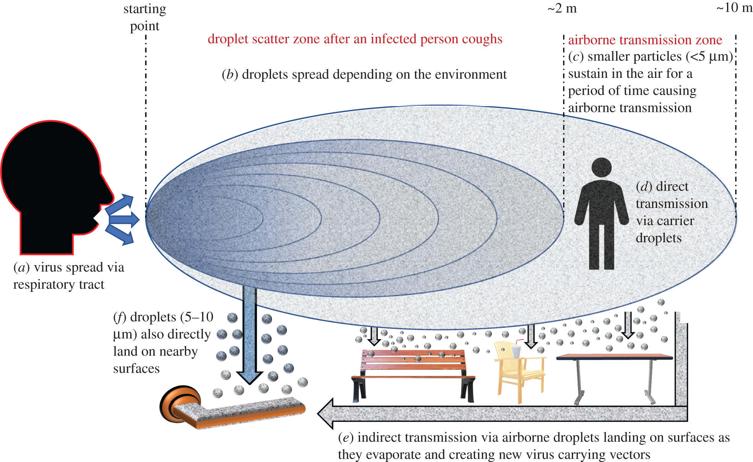
Transmission of SARS-CoV-2 is Primarily Person to Person
Viral transfer is via respiratory droplets from someone diagnosed with COVID-19
Respiratory droplets are released into the air though coughing, sneezing, talking, singing, yelling, etc.
Usually travel only a few feet = social distancing is recommended (minimum 6 ft apart)
Masks are recommended to trap respiratory droplets
Notes:
Notes:
Virus is carried through moisture droplets and released into the air through coughing, talking, singing, yelling, sneezing,
The viral particles in the droplets in the air can attach to cells in a healthy person and then infect, replicate and be dispersed once again to infect other healthy people
Particles usually only travel a few feet which is why 6 ft of social distancing is recommended. BUT particles may travel further by aerosols and air conditioning/vents by helping them move further from infected people
Masks and face coverings are therefore recommended as they trap some of or most of these viral particles and reduce the spread of the SARS-CoV-2 (the virus)
In the beginning of the pandemic, recommendations did not include using masks because it was unclear the major route(s) of transmission.
Resources:
SARS-CoV-2 Virus Transmission – NCSU– https://foodsafety.ces.ncsu.edu/wp-content/uploads/2020/08/SARS-CoV-2-TRANSMISSION-1.pdf?fwd=no
How Coronavirus Spreads – CDC - https://www.cdc.gov/coronavirus/2019-ncov/prevent-getting-sick/how-covid-spreads
COVID-19 Information for Food Industry Workers – Cornell Cooperative Extension - https://www.youtube.com/watch?v=9NXhZ3V-VMQ
Episode 4: What’s a Respiratory Droplet? Why Does It Matter? https://www.youtube.com/watch?v=qWiA3NUD1Mw
Episode 7: How does COVID-19 spread? A review – CDC video - https://www.youtube.com/watch?v=OQUMLJa0tAE

Slide 8
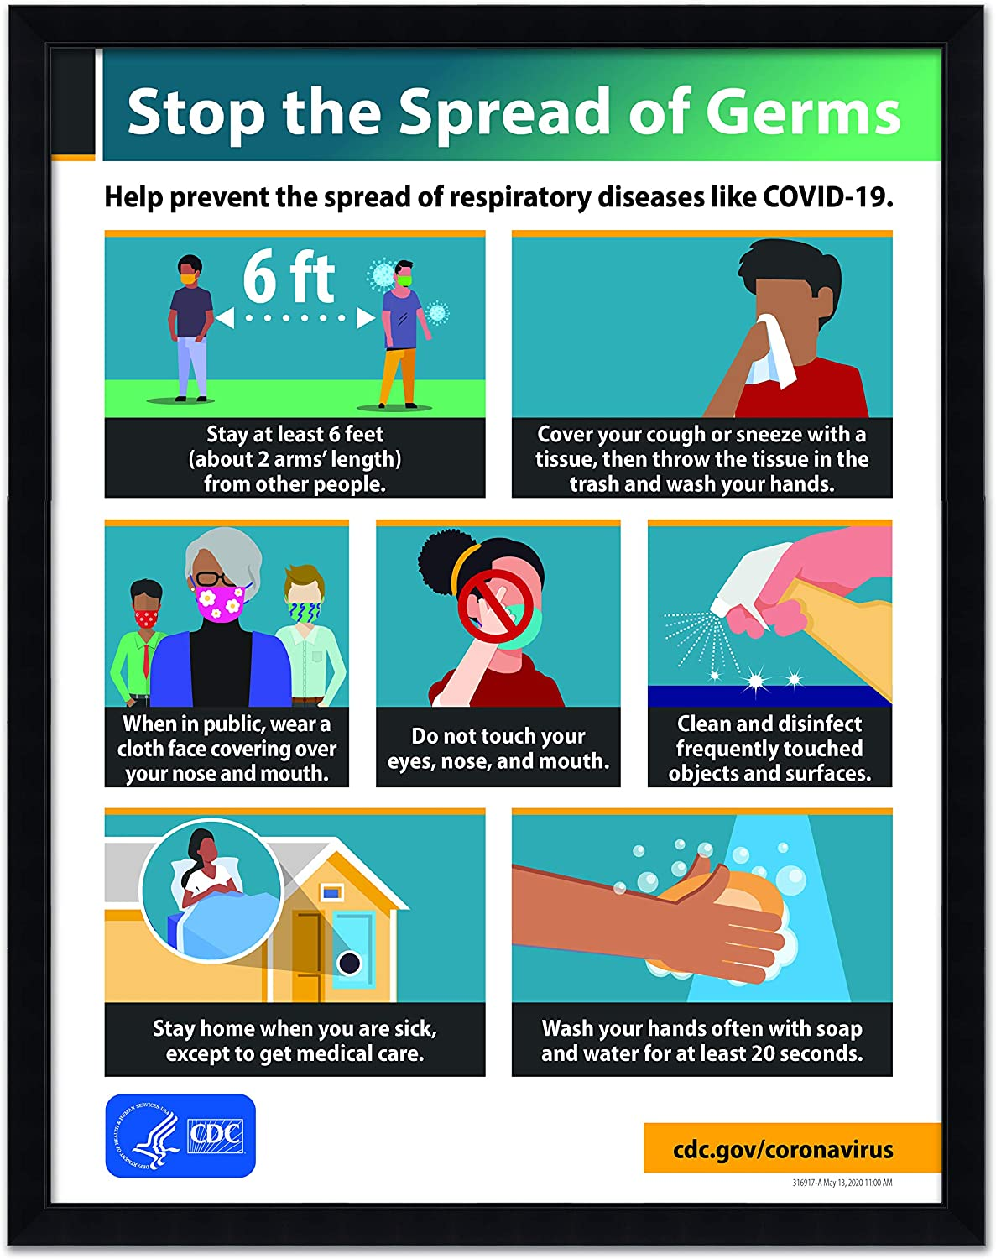
https://www.cdc.gov/coronavirus/2019-ncov/downloads/stop-the-spread-of-germs.pdf
Notes:
Poster Stop the Spread of Germs https://www.cdc.gov/coronavirus/2019-ncov/downloads/stop-the-spread-of-germs.pdf

Slide 9
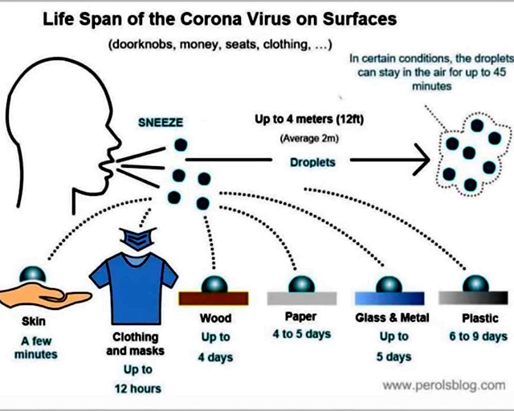
Surface Transmission of SARS-CoV-2
SARS-CoV-2 can survive on surfaces and play a role in indirect transmission
Transferred by touch with the virus must migrate and infect a cell
Less infectious over time but depends on material, temperature and other factors
Notes:
Notes:
not all of what is on a surface will be transferred to their hand which is why it is less likely than person to person
IF CONCERNED ->
Avoid touching surfaces or items unnecessarily
Avoid touching your mouth, nose or face
Follow with handwashing and/or using hand sanitizer
Resources:
Cleaning and Disinfecting Your Facility https://www.cdc.gov/coronavirus/2019-ncov/community/disinfecting-building-facility.html
COVID-19 Preventative Measures Cleaning and Disinfection https://foodsafety.ces.ncsu.edu/wp-content/uploads/2020/03/Cleaning-and-disinfection_COVID-19_Flyer_031520.pdf?fwd=no
COVID-19 Response Plan Template for Fruit and Vegetable Farms https://docs.google.com/document/d/12sLifH-6Dm48lm_s2OIM3rIrN54Fv__z_i52Mvy5yGA/edit
Agricultural Employer Checklist for Creating a COVID-19 Assessment and Control Plan https://www.cdc.gov/coronavirus/2019-ncov/community/pdf/Agricultural-Employer-checklist.pdf
COVID-19 FAQ for Foodservice Cleaning and Disinfection https://foodsafety.ces.ncsu.edu/wp-content/uploads/2020/03/Retail-Cleaning_COVID-19_032620.pdf?fwd=no

Slide 10
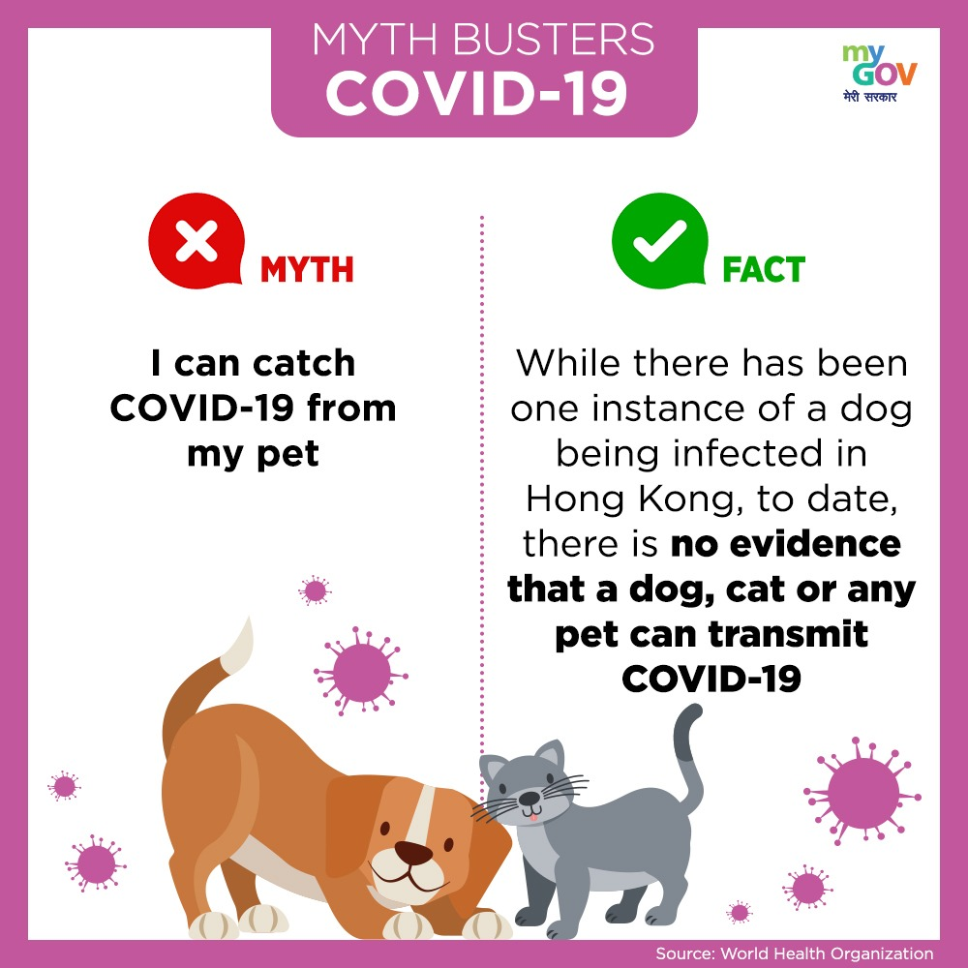
Pet and Livestock Transmission of SARS-CoV-2
Rare examples of transfer from COVID-19 infected people to animals
No evidence animals play a role in spreading SARS-CoV-2
Recommended to practice healthy habits around pets and other animals
Notes:
Notes:
There are some rare instances of transfer of the virus from people to animals after close contact with a person with COVID-19.
cats, dogs, ferrets, fruit bats, hamsters, tree shrews and some other mammals can be infected but we don’t know all the animals that can be at this time.
Most of these are pets that have become sick after contact with people with COVID-19
Laboratory mice, pigs, chickens, and ducks do not seem to become infected or spread the infection based on results from studies.
Several animals in zoos have tested positive including lions, tigers, puma, snow leopard, cougar and great apes.
Reports of minks on mink farms that have reported COVID-19 but there may be a possibility (Netherlands and Denmark). There is guidance available from the USDA, CDC and state animal and public health partners on protecting work and animal health
No reports of SARS-CoV-2 in wildlife
Resources:
Reducing the Risk of SARS-CoV-2 Spreading between People and Wildlife – CDC – https://www.cdc.gov/coronavirus/2019-ncov/your-health/wildlife.html
What You Need to Know About COVID-19 and Pets – CDC - https://www.cdc.gov/coronavirus/2019-ncov/downloads/covid-19-pets-prevention.pdf
Pets and Other Animals – CDC - https://www.cdc.gov/coronavirus/2019-ncov/animals/pets-other-animals.html
Experimental Infection of Cattle with SARS-CoV-2 - https://wwwnc.cdc.gov/eid/article/26/12/20-3799_article

Slide 11
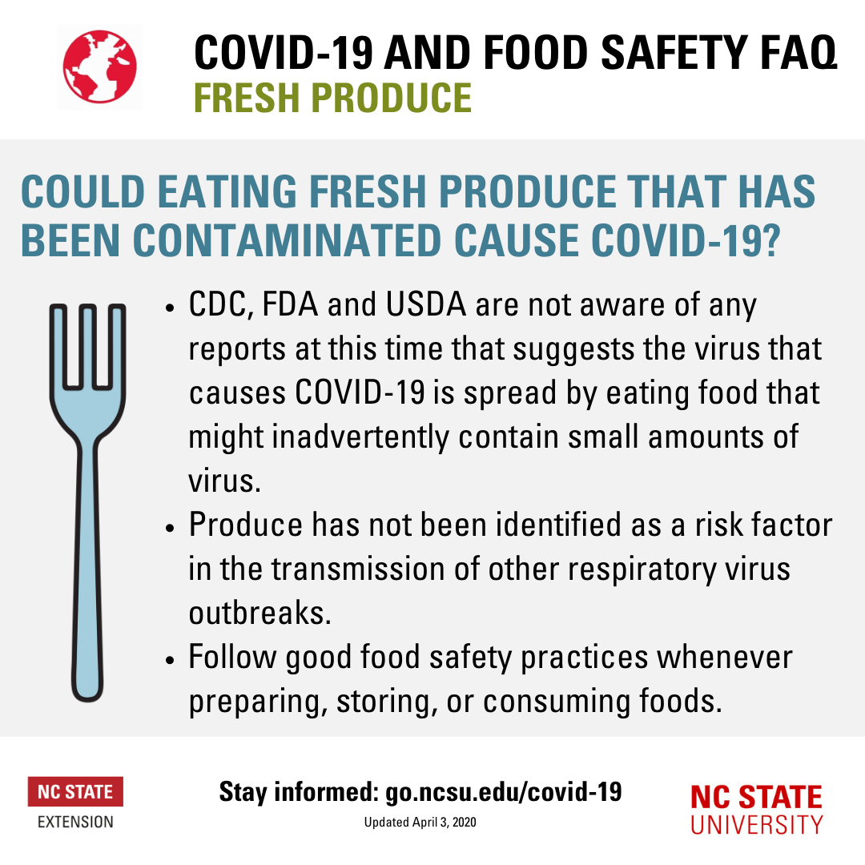
Food and Food Packaging Transmission of SARS-CoV-2
NO cases reported of COVID-19 contracted from food or food packaging
Transmission at food operations has been due to person to person transmission
https://foodsafety.ces.ncsu.edu/wp-content/uploads/2020/04/Produce-COVID-Food-Safety_Social-Media.png
Notes:
Notes:
NO documented cases of COVID-19 contracted from food or food packaging according to the USDA, FDA and CDC (Feb 18 press release)
NO COVID-19 cases have linked to food consumption or handling
Transmission at places where food is served or sold has been DUE to person-to-person transmission especially without face coverings
Resources:
COVID-19 Update: USDA, FDA Underscore Current Epidemiologic and Scientific Information Indicating No Transmission of COVID-19 Through Food or Food Packaging on Feb 18, 2021 - https://www.fda.gov/news-events/press-announcements/covid-19-update-usda-fda-underscore-current-epidemiologic-and-scientific-information-indicating-no
Coronavirus (COVID-19) Update: Joint Statement from USDA and FDA on Food Export Restrictions Pertaining to COVID-19 on June 24, 2020 - https://www.fda.gov/news-events/press-announcements/coronavirus-covid-19-update-joint-statement-usda-and-fda-food-export-restrictions-pertaining-covid

Slide 12
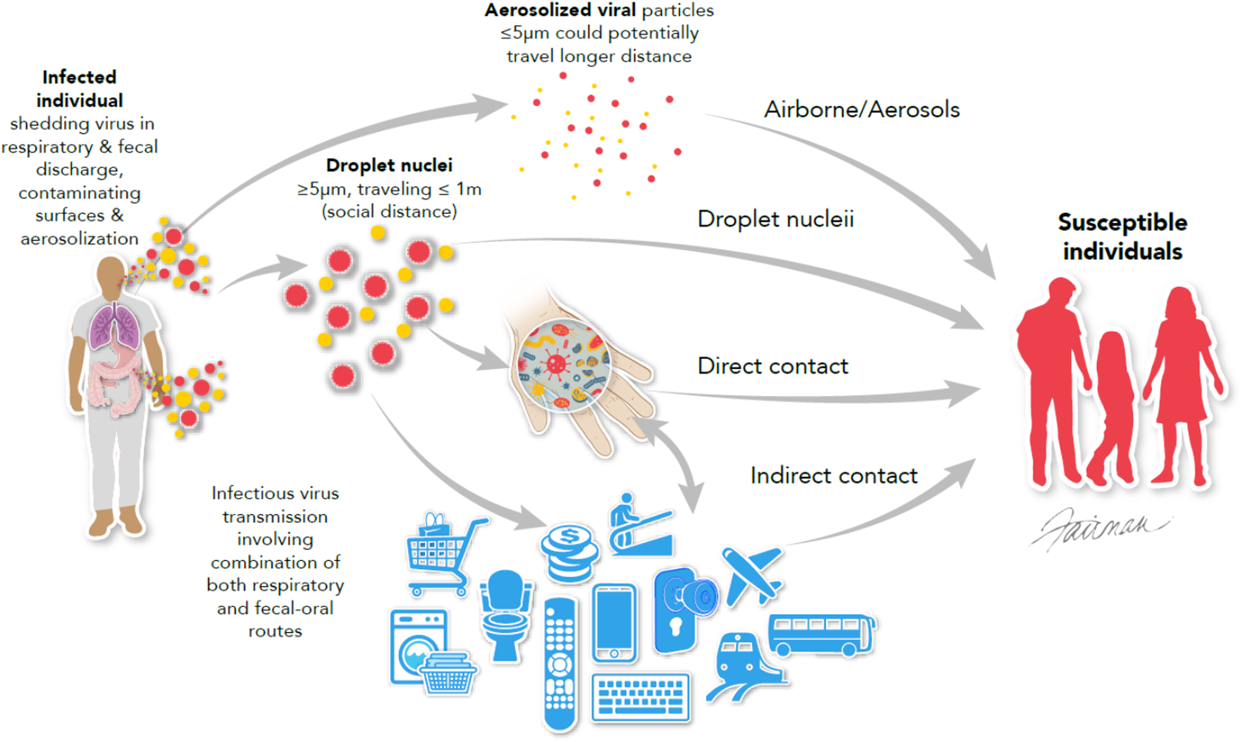
SARS-CoV-2 vs Other Human Pathogens in Food Safety
Other human pathogens in food safety are transmitted via the fecal-oral route
Instead, SARS-CoV-2 is spread thru respiratory droplets
This means we will need to use different strategies to address SARS-CoV-2 spread and how to deal with people who are sick with COVID-19.
DOI: 10.7717/peerj.9914/fig-1
Notes:
Notes:
In food safety training, we discuss how people carry human pathogens such as Shigella, Hepatitis A, Norovirus, Cyclospora and others.
People can also spread zoonotic pathogens like Salmonella, pathogenic E. coli and listeria monocytogenes.
However, all of these human pathogens are spread via the fecal-oral route
Thus trainings involve dealing with staff who are often the last to touch produce before it reaches the consumer, so the training focuses on those risk.
For SARS-CoV-2 and COVID-19 we need other strategies because the spread is thru a different route
Resources:
Ijaz MK, Sattar SA, Rubino JR, Nims RW, Gerba CP. 2020. Combating SARS-CoV-2: leveraging microbiocidal experiences with other emerging/re-emerging viruses. PeerJ 8:e9914 https://doi.org/10.7717/peerj.9914
SARS-CoV-2 Virus Transmission InfoSheet - https://foodsafety.ces.ncsu.edu/wp-content/uploads/2020/08/SARS-CoV-2-TRANSMISSION-1.pdf

Slide 13
Steps Towards Produce Safety
1
Assess Produce Safety Risks
2
Implement Practices
3
Monitor Practices
4
Apply Corrective Actions
5
Keep Records
https://producesafetyalliance.cornell.edu
Notes:
Notes:
Educate yourself on the risks SARS-CoV-2 and COVID-19 pose for your farm. Use the national, state and local health departments as well as your ag service providers for assistance. Coming to this training sets you up to assess your risks.
Implement practices to reduce the risks from SARS-CoV-2 and COVID-19 identified in your operation.
To make sure practices you want to implement take place, you will need to monitor them.
If a problem with implementation is identified then you will need to fix the problem by corrective actions and monitoring to prevent it from occurring again.
Lastly, you may incorporate recordkeeping for some of the tasks to be able to monitor implementation of practices and see if these practices are addressing the problems and reducing the risks.
Resources
Produce Safety Alliance Trainer Resources – Cornell - https://producesafetyalliance.cornell.edu/training/trainer-resources/

Slide 14
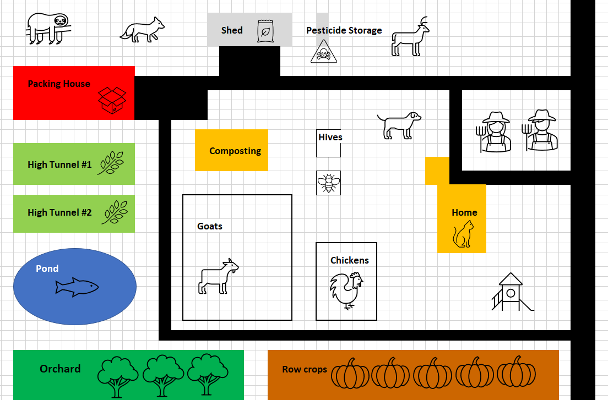
Implementing Practices to Reduce Risks from SARS-CoV-2
Notes:
Notes:
Focus on preventing person to person exposure and contamination from COVID-19
Identify your highest risk areas and develop practices that will reduce these risks. Some possible considerations:
Create a single entry point on the farm for everyone working, visiting or coming on the farm to record their contact info, answer questions and take the temperature
Policies on what to do if someone appears to be “sick” and what to do
Decide on farmer’s markets based on their adherence to the appropriate guidance by the local/state health department
Eliminate farm pickups to reduce the number of people coming on the farm
Create a farm stand that is away from the majority of the farm and staff (and your family)
?
Many of these changes may require modification of current practices and ALSO additional training for staff, visitors, vendors, etc.
In the past year, you may have already implemented these practices.
Ask for help and seek training if you are unsure from the local and state health departments and agriculture service providers
Resources:
Agriculture Workers and Employers – CDC - https://www.cdc.gov/coronavirus/2019-ncov/community/guidance-agricultural-workers.html
Food Safety and the Coronavirus Disease 2019 (COVID-19) – FDA - https://www.fda.gov/food/food-safety-during-emergencies/food-safety-and-coronavirus-disease-2019-covid-19

Slide 15
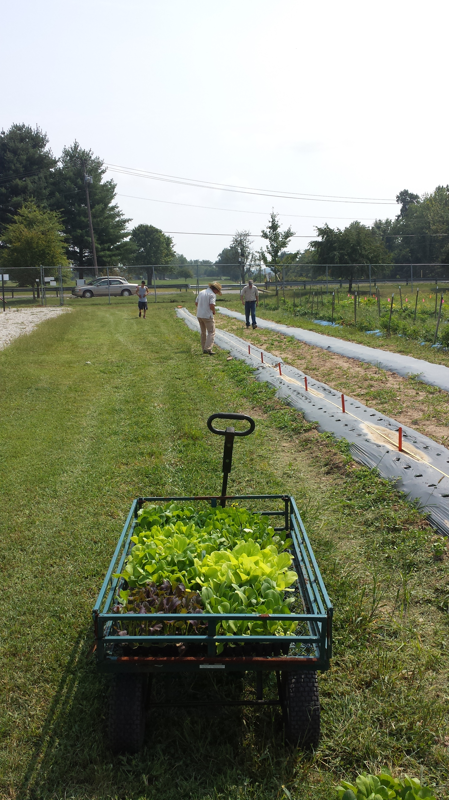
Summary
SARS-CoV-2 is primarily transmitted person to person
NO report worldwide of a person getting COVID-19 from food or food packaging
Safety impacts the farm, staff, customers, vendors, etc.
Produce safety success depends on your commitment to implementing risk reduction strategies for the pandemic as well as food safety
Notes:
Notes:
Because this is primarily spread person to person this impacts your farm
Because SARS-CoV-2 is NOT transmitted thru the fecal-oral route you will need to take additional and different steps than what is standardly used in food safety training to reduce the chance of SARS-CoV-2 and COVID-19 becoming a problem
Farming is not done alone. You interact with staff, customers, delivery staff, repair people, etc. Thus it is imperative that you take this pandemic seriously if not for yourself, then for the other people you interact with for your farm business.
Surface transmission is possible but has not been reported to be the major way this virus is spread. BUT that doesn’t mean you should lessen how you clean and sanitize for basic food safety because microorganisms have not gone away during the pandemic.
There are rare reports of transmission from people to animals.
NO report worldwide of a person getting COVID-19 from food or food packaging
Produce safety success depends on your commitment to implementing risk reduction strategies
Resources:
COVID-19 - CDC - https://www.cdc.gov/coronavirus/2019-ncov/index.html
Agricultural Employer Checklist – CDC - https://www.cdc.gov/coronavirus/2019-ncov/community/pdf/Agricultural-Employer-checklist.pdf
State & Territorial Health Department Websites – CDC - https://www.cdc.gov/publichealthgateway/healthdirectories/healthdepartments.html
FoodCoVNET – NCSU - https://foodcovnet.ces.ncsu.edu/welcome-to-foodcovnet/
Agriculture Workers and Employers – CDC - https://www.cdc.gov/coronavirus/2019-ncov/community/guidance-agricultural-workers.html

Slide 16
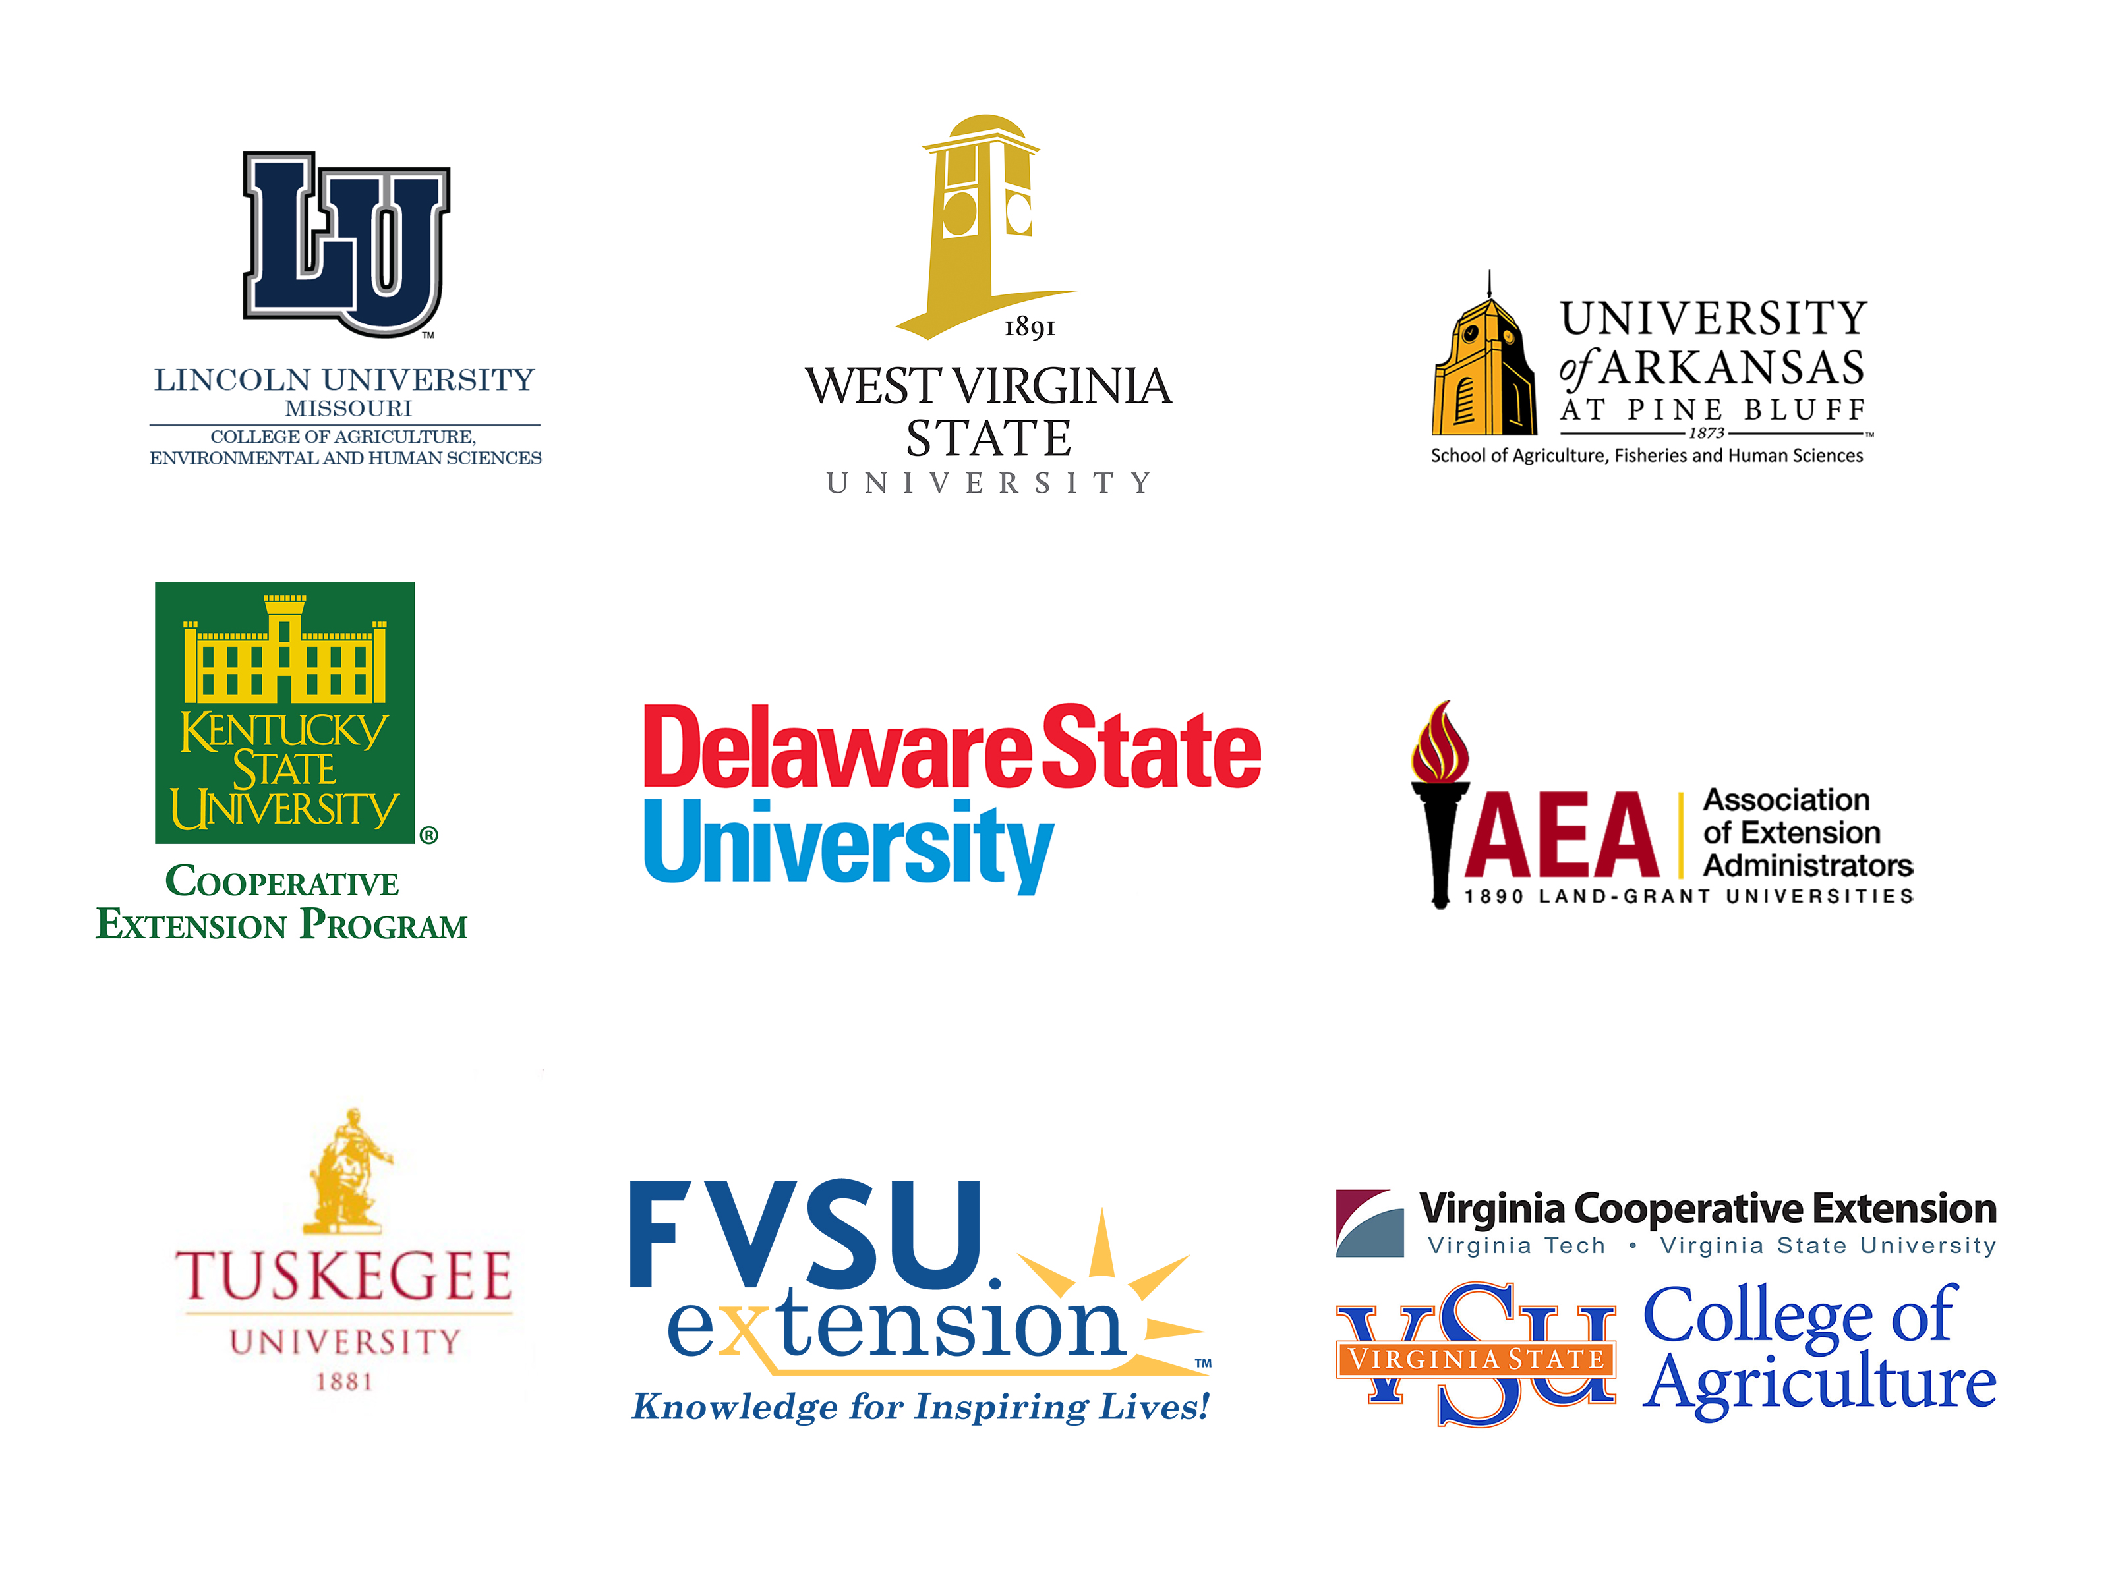
Acknowledgements
This work is supported by Rapid Response to Novel Coronavirus (SARS-CoV-2) Impacts Across Food and Agricultural Systems grant no. 2021-69006-33355 from the USDA National Institute of Food and Agriculture.
Any opinions, findings, conclusions, or recommendations expressed in this publication are those of the author(s) and do not necessarily reflect the view of the U.S. Department of Agriculture.

