Slide 1
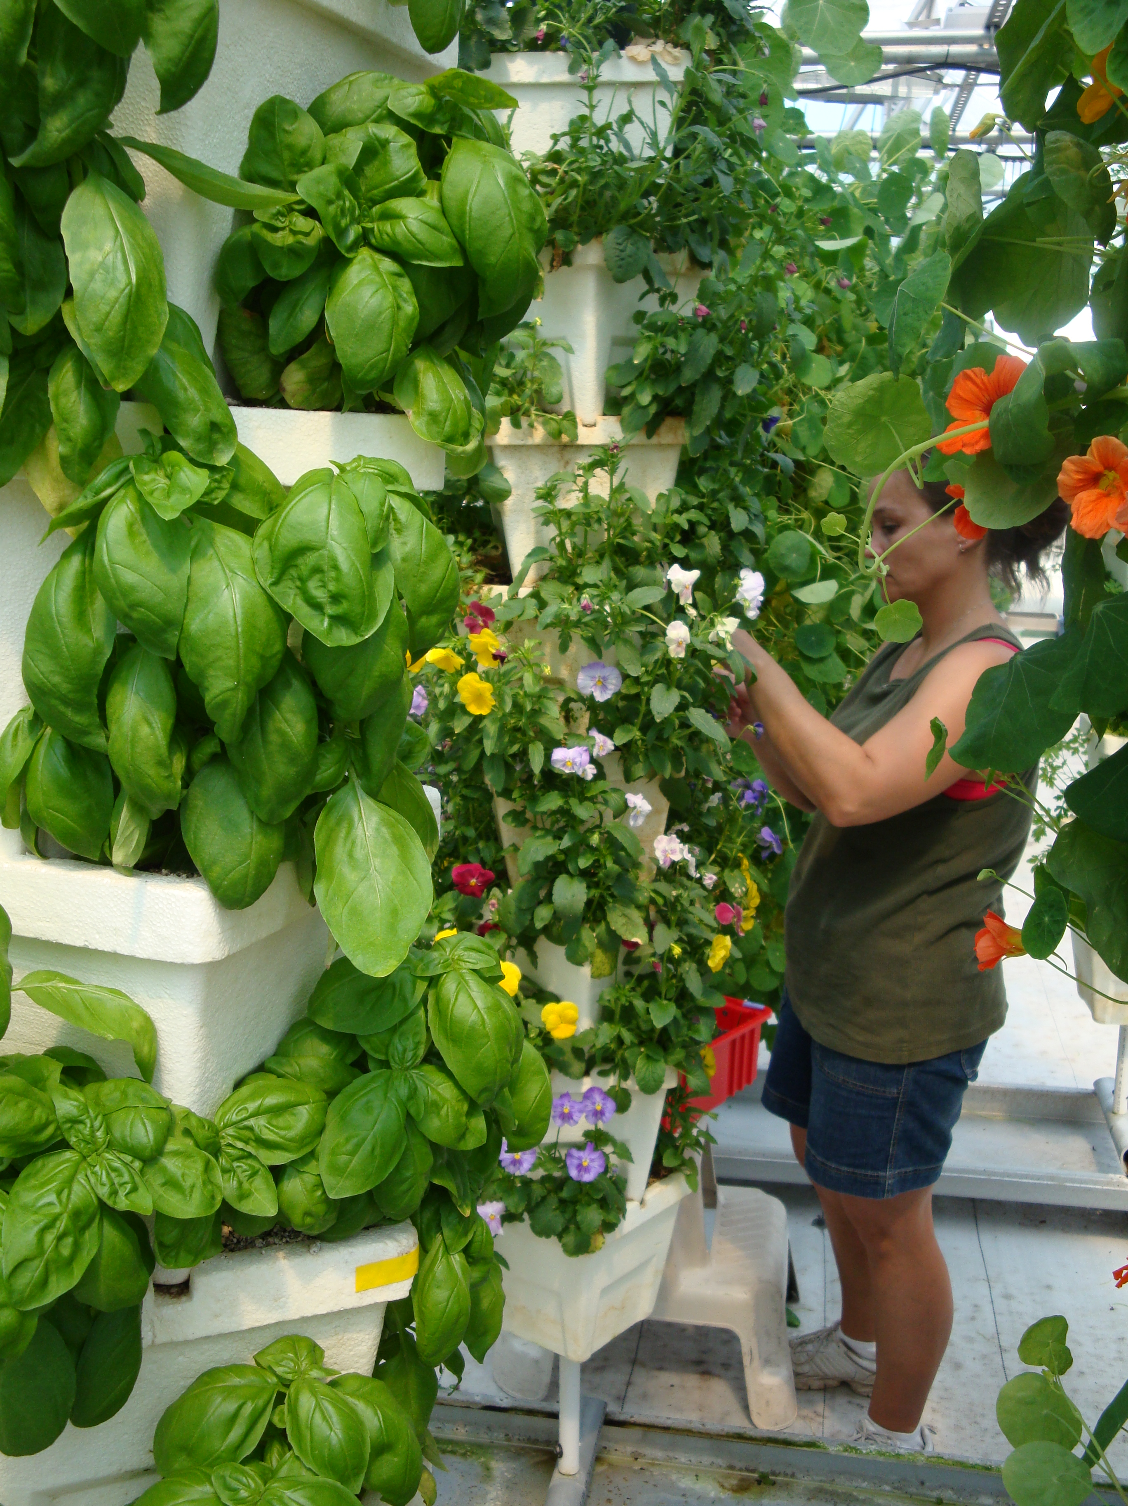
Module D: Produce Safety during Production, Harvest and Postharvest during COVID-19
Barbara E. Liedl, PH.D.
West Virginia State University
liedlbe@wvstateu.edu
Cindy Martel, M.S., CTIS
Future Generations University
cindy.martel@future.edu

Slide 2
Learning Outcomes
Map potential routes of SARS-CoV-2 contamination associated with your operation
Identify practices to reduce possible routes of SARS-CoV-2 contamination for your operation
Modify or create SARS-CoV-2 standard protocols to use for your operation
Design or adapt records and/or signs to inform and document standard protocols to reduce SARS-CoV-2 and COVID-19 in your operation

Slide 3
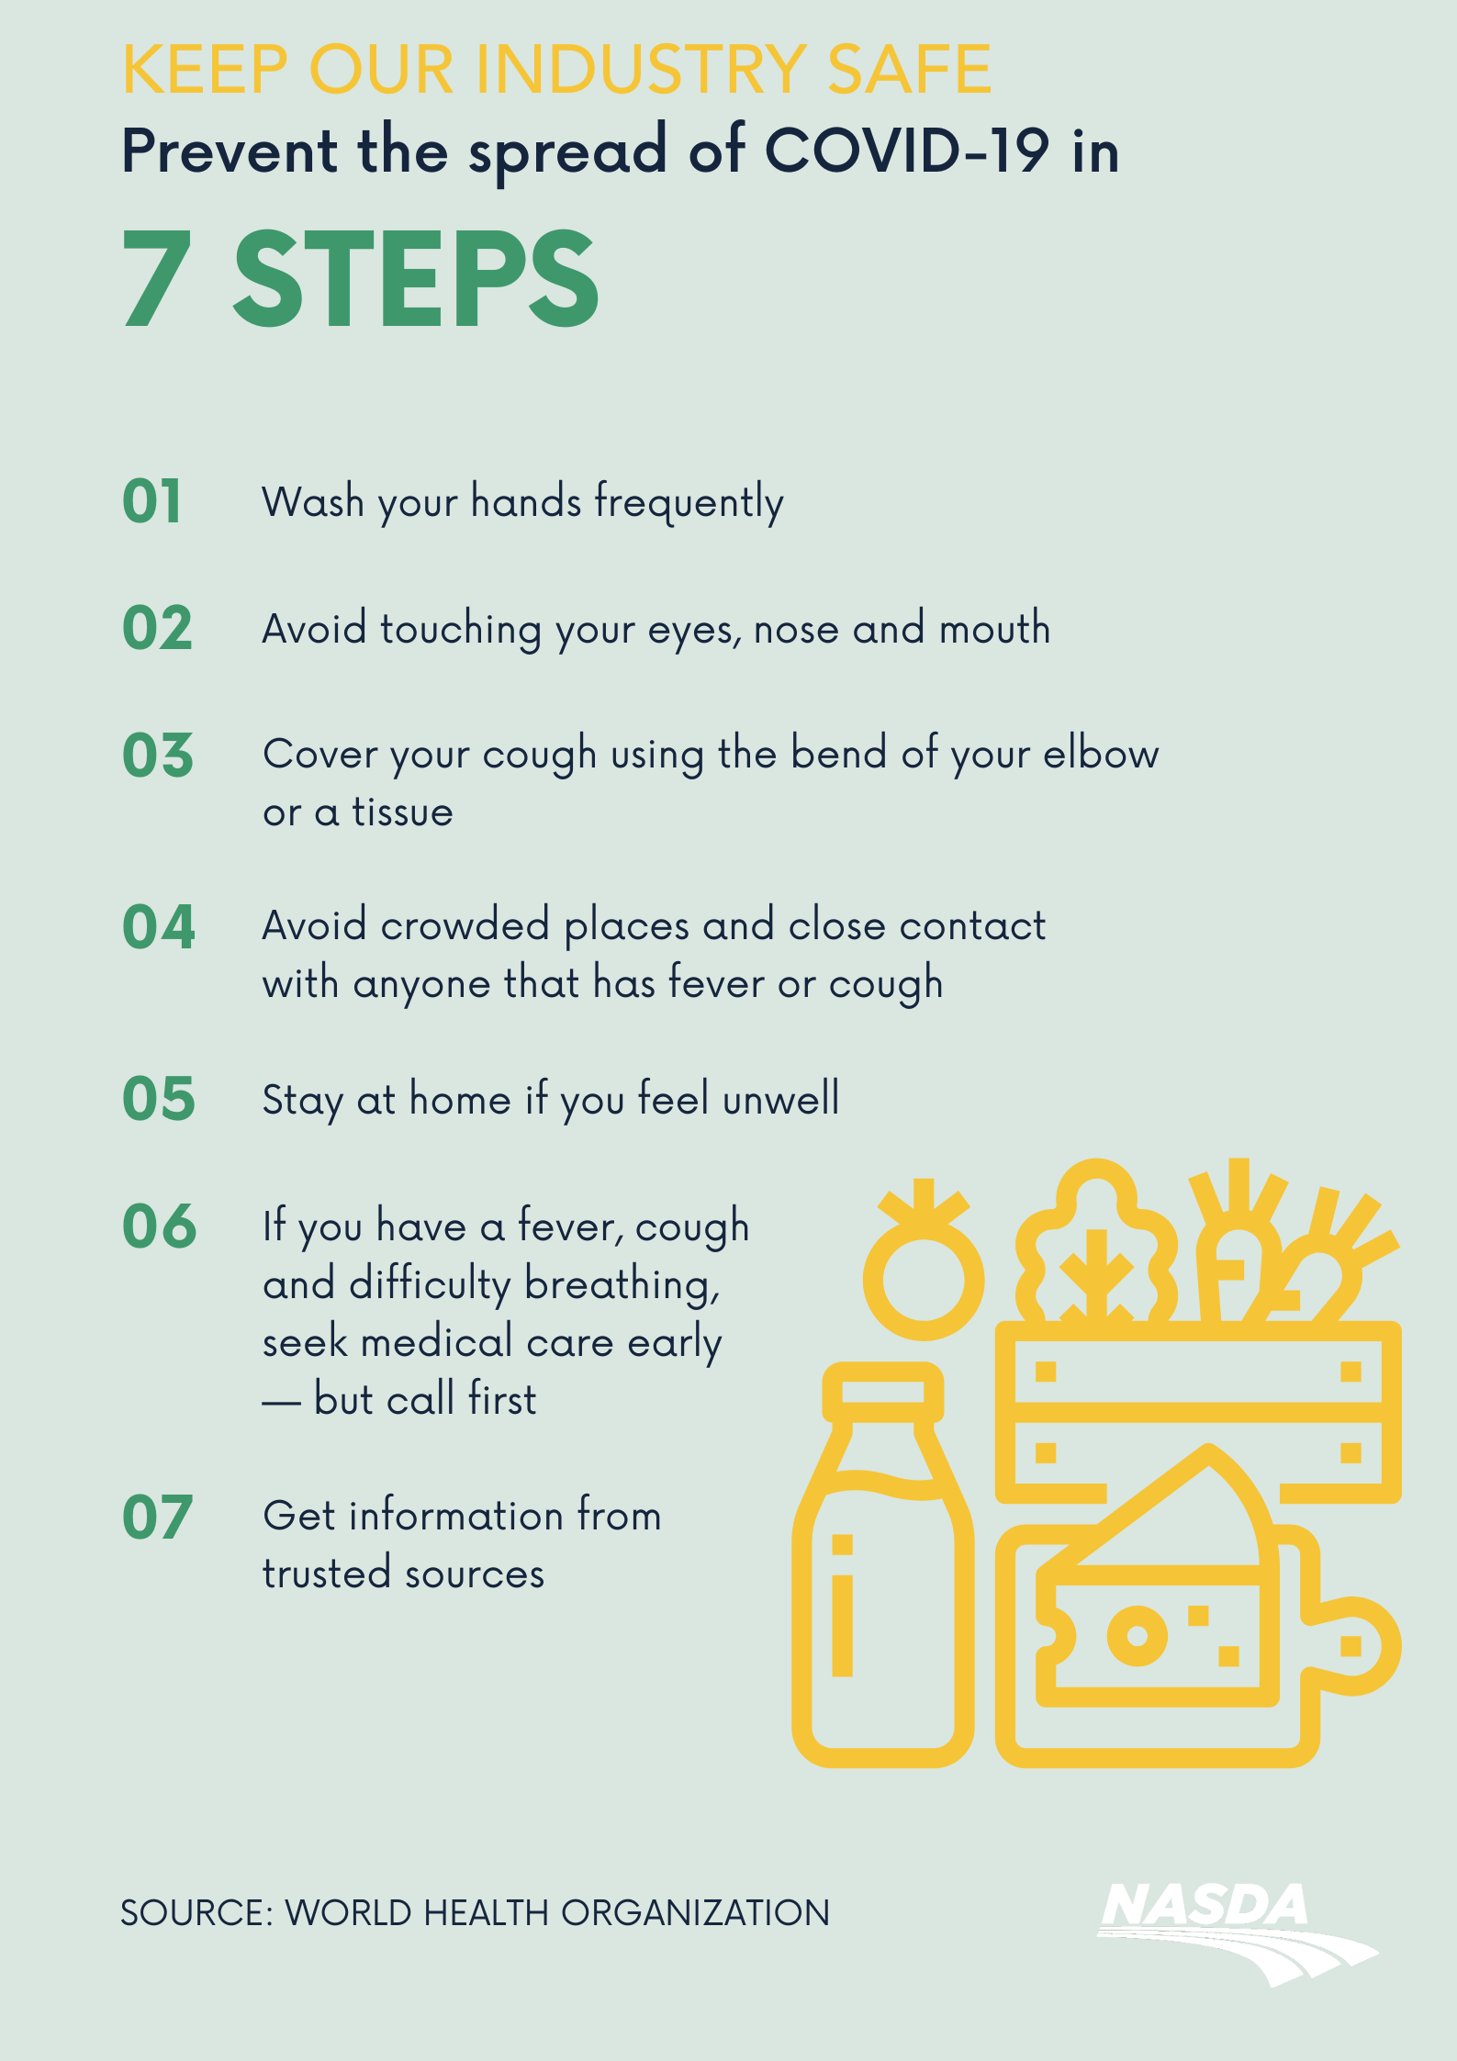
General Recommendations for COVID-19
Keep current on local, state or federal guidelines
General recommendations
  Don’t work if you are sick
  Wear a mask
  Physical distancing
  Handwashing
  Clean and sanitize high touch areas
https://s3.amazonaws.com/nasda2/media/Food-Step-Prevention.pdf
Notes:
Notes
SARS-CoV-2 is a respiratory virus that spreads primarily through droplets during person-to-person contact.
According to guidance from the CDC, the most important actions you can take to minimize the spread of the disease are the following.
Don’t work if you are sick - Know the symptoms like fever, cough, body aches, shortness of breath and do not come to work if you have any of these symptoms.
Wear a mask – The CDC continues to recommend that everyone wear masks when in public, even if they are vaccinated. CDC mask guidance recommends that masks have 2 or 3 layers.
Physical distancing - Maintain at least 6 feet between all staff, and visitors
Handwashing - Wash your hands before work and often while you work for at least 20 seconds.
Clean and sanitize - the high-touch areas including tools and surfaces at least daily to minimize the spread via surfaces.
Even with people being vaccinated the interim CDC guidance recommends, you should keep taking precautions in public places. This protects people who might be unvaccinated, since you might be able to transmit the virus asymptomatically. Continue to follow these precautions until we know more, or your local area achieves herd immunity.
Resources
COVID-19 Graphics for Print and Social Media Use (NASDA) https://www.nasda.org/news/covid-19-graphics-for-print-and-social-media-use
COVID-19 Response Plan Template for Fruit and Vegetable Farms https://docs.google.com/document/d/12sLifH-6Dm48lm_s2OIM3rIrN54Fv__z_i52Mvy5yGA/edit
COVID-19 Response Template for Community Gardens https://docs.google.com/document/d/1WDhovmJjRgeggFRJF2hP1u9yr3nEb2Jy_vb8OIOWryI/edit?ts=5eac5861#heading=h.ljb6h8w5deik
How to Protect Yourself & Other https://www.cdc.gov/coronavirus/2019-ncov/prevent-getting-sick/prevention.html
COVID-19 Safety Tips for Grocery and Food Retail Workers https://www.health.state.mn.us/diseases/coronavirus/materials/tipsgrocery.pdf

Slide 4
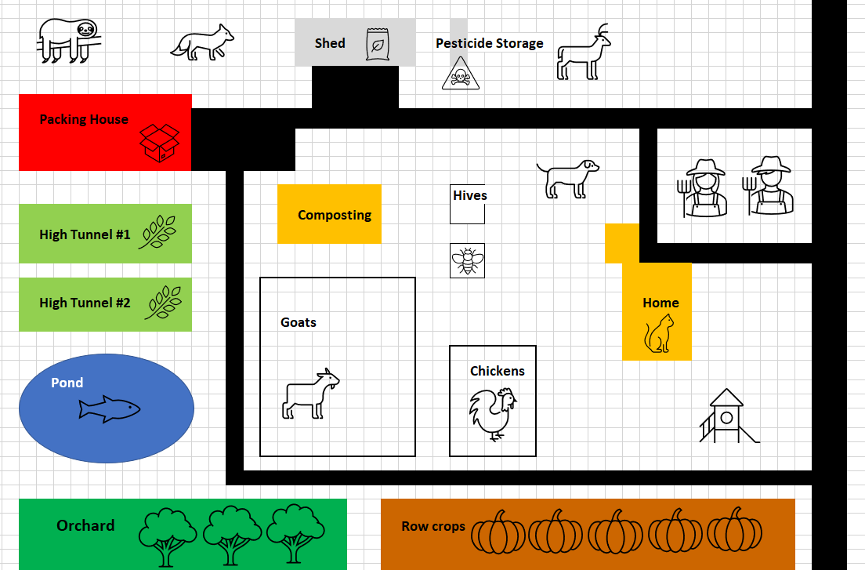
Implementing Practices to Reduce Risks from SARS-CoV-2
Notes:
Notes
You are not required to have a farm food safety plan unless you are GAP certified, however it is a good resource to have for farm operations
Farm Food Safety Plan will also evolve over time with your operation and with situations like COVID-19
The rest of this module will be on incorporating practices and policies as well as trainings, posters and records to use during COVID-19 which can also be modified for future pandemics
Resources
COVID-19 Response Plan Template for Fruit and Vegetable Farms https://docs.google.com/document/d/12sLifH-6Dm48lm_s2OIM3rIrN54Fv__z_i52Mvy5yGA/edit
Agricultural Employer Checklist for Creating a COVID-19 Assessment and Control Plan https://www.cdc.gov/coronavirus/2019-ncov/community/pdf/Agricultural-Employer-checklist.pdf

Slide 5
Evaluate Your Farm
Identify your COVID-19 contact person
Changes on the farm
  New policies and practices
  New trainings
  New communications
Staff situations
  Are they at a high risk of contracting COVID-19?
  Are they or others in their life at a high level of consequences for getting COVID-19?
  Other responsibilities
Notes:
Notes
COVID-19 contact person will likely be the Farm Food Safety person.
Contact for staff with questions and to report if they become ill
Trainer for staff
Contact for local health department if there are questions for contact tracing
Changes on the farm – coming up in the following slides
Discussion with staff on their situations with COVID-19
Do they live with people that are at higher risk of contracting COVID-19
Essential staff
Housemates
Do they live with people who face a greater risk of severe consequences
People who are immunocompromise or with heart conditions
Elderly parent or relative
Infant or children
Do they have other changes in their responsibilities that affects their work?
Need to take care of children or relatives
No longer has transport
Resources
COVID-19 Response Plan Template for Fruit and Vegetable Farms https://docs.google.com/document/d/12sLifH-6Dm48lm_s2OIM3rIrN54Fv__z_i52Mvy5yGA/edit
Agricultural Employer Checklist for Creating a COVID-19 Assessment and Control Plan https://www.cdc.gov/coronavirus/2019-ncov/community/pdf/Agricultural-Employer-checklist.pdf

Slide 6
Creating a Culture of Safety on the Farm
Keeping everyone safe is everyone’s business
No punishment for reporting illnesses or risk factors
Self-screening before coming into work
Introduce and train on new COVID-specific safety policies and supplies
Changes to communication to ensure social distancing
New signs at the farm and markets regarding new policies
Notes:
Notes
How will you create a culture of safety on the farm – not just keeping the food safe now but also keeping the customers and other staff safe as well
Be clear on your sick-leave policies and how you will be handling staff needing to stay home for themselves or taking care of others
Introduce self-screening for all staff before coming into work
You will be developing new or updating existing policies and will need to train the staff on them as well as how to use the supplies
Refresher on Handwashing
How to put on and take off a face covering
How to put on and take of gloves
Refresher on Cleaning and Sanitizing
Update on visitors to the farm
Tools (pens, hoes, etc.) will be assigned to a single person
Discuss how there will be less face to face communications and identify what else you will use
Walkie-talkies
Emails
Zoom meetings
Apps on cell phones – text message, FB messenger, Slack, Discord, etc.
New and updated signage
Hand washing
Social distancing
Sanitizing tools and surfaces
Resources
COVID-19 Response Plan Template for Fruit and Vegetable Farms https://docs.google.com/document/d/12sLifH-6Dm48lm_s2OIM3rIrN54Fv__z_i52Mvy5yGA/edit
Agricultural Employer Checklist for Creating a COVID-19 Assessment and Control Plan https://www.cdc.gov/coronavirus/2019-ncov/community/pdf/Agricultural-Employer-checklist.pdf

Slide 7
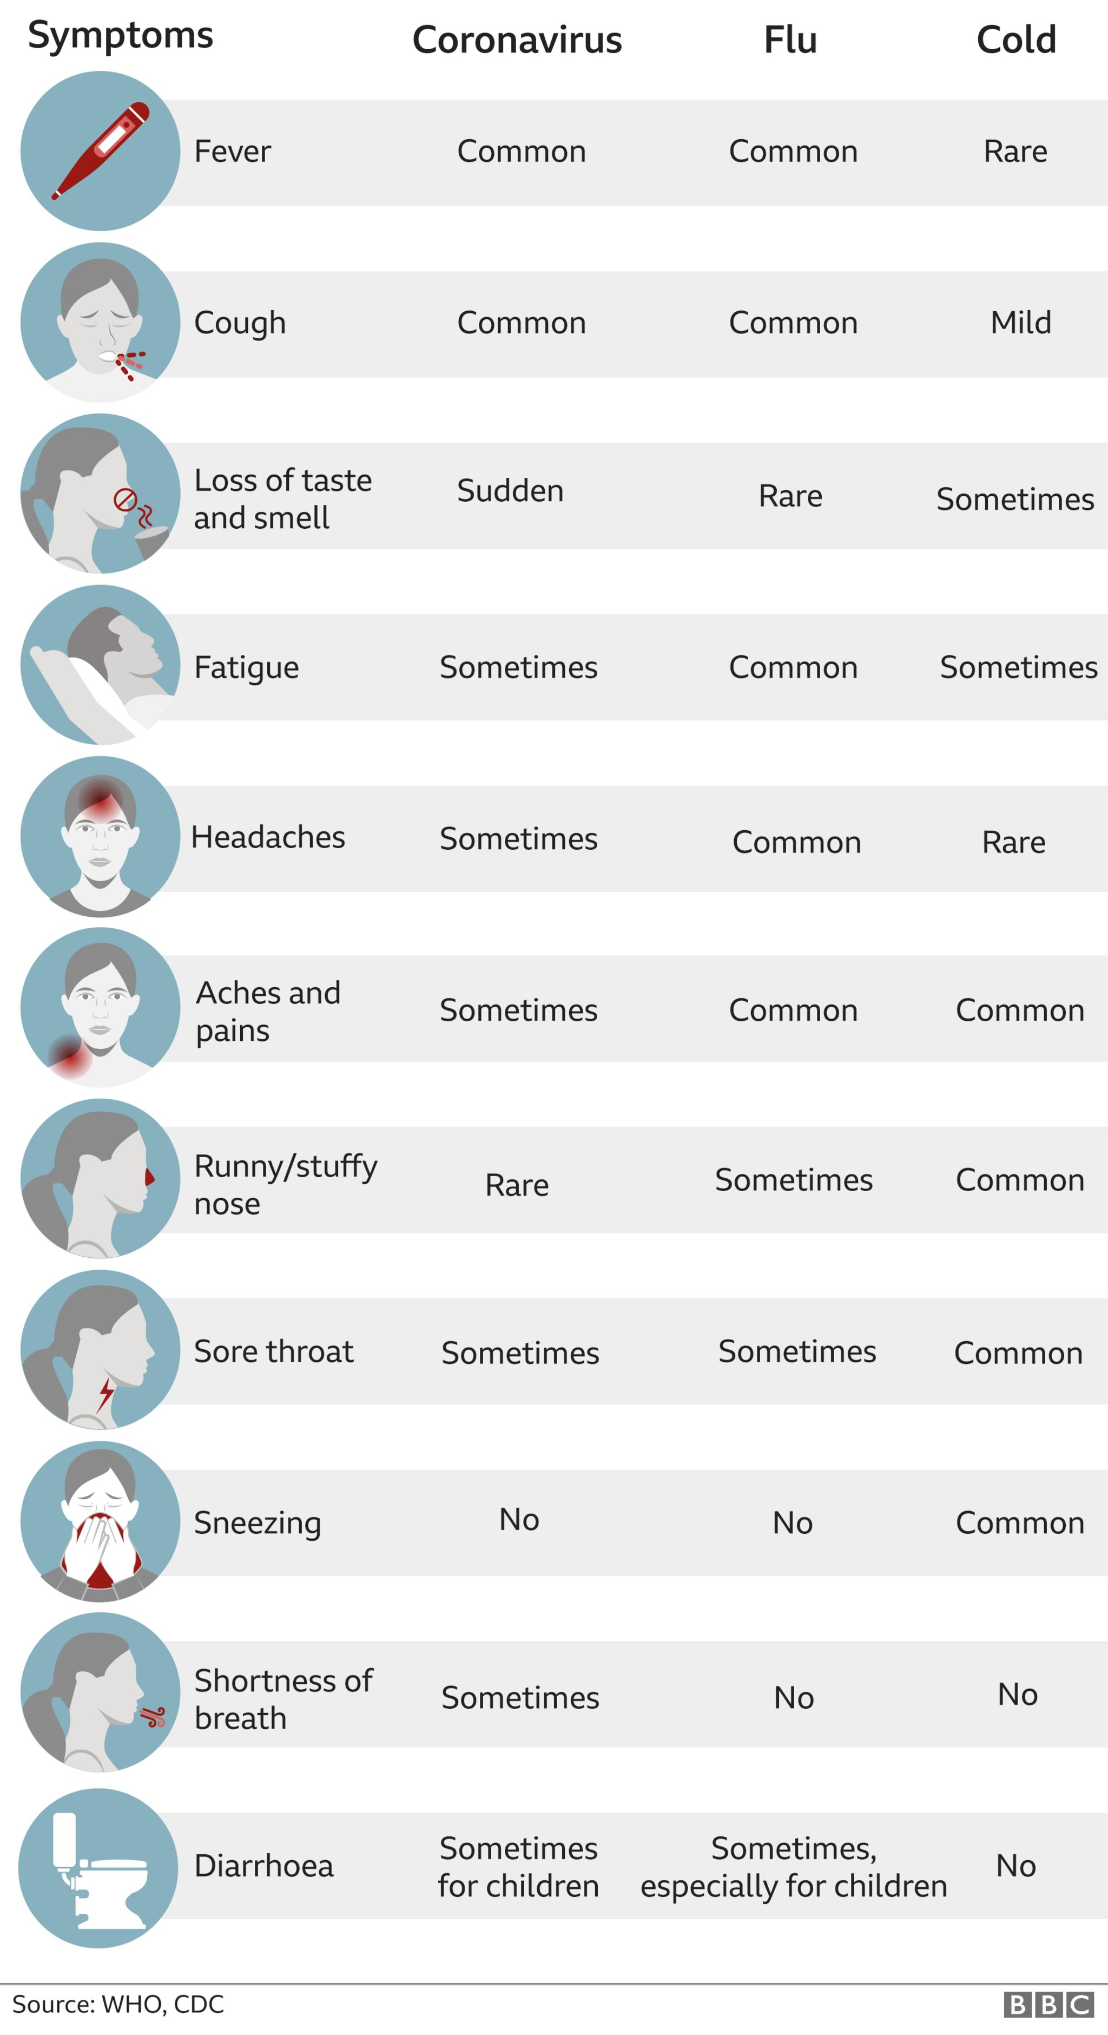
Screening for COVID-19
Train staff on symptoms, how it spreads and how to prevent getting infected
Post signage on COVID-19 in the workplace
Encourage virtual or in-person health checks
  No symptoms of COVID-19
  No fever of 100.4ºF or higher
  Not close contact to someone with COVID-19 in prior 14 days
  Not waiting for a SARS-CoV-2 test
https://www.bbc.com/news/health-54145299
Notes:
Notes
Log training and update with new information as necessary
Resources
Agricultural Employer Checklist for Creating a COVID-19 Assessment and Control Plan https://www.cdc.gov/coronavirus/2019-ncov/community/pdf/Agricultural-Employer-checklist.pdf
Guidance for Businesses and Employers Responding to Coronavirus Disease 2019 (COVID-19) https://www.cdc.gov/coronavirus/2019-ncov/community/guidance-business-response.html
Advisory for Agricultural Worker Protection During COVID-19 Crisis on the Central Coast of California https://www.co.monterey.ca.us/home/showdocument?id=88063
COVID-19 Preventative Measures What To Do If You Are Sick https://foodsafety.ces.ncsu.edu/wp-content/uploads/2020/04/What-To-Do-If-Sick_COVID-19_Flyer.pdf?fwd=no
COVID-19 FAQ for Foodservice General Questions and Employee Health https://foodsafety.ces.ncsu.edu/wp-content/uploads/2020/04/Retail-FAQ_COVID-19_Flyer.pdf?fwd=no
Covid symptoms: Is it a cold, flu or coronavirus? https://www.bbc.com/news/health-54145299
Symptoms of Coronavirus (COVID-19) https://www.cdc.gov/coronavirus/2019-ncov/downloads/COVID19-symptoms.pdf
Symptoms of Coronavirus Disease 2019 https://www.youtube.com/watch?v=F70BzSFAZfw
Episode 13: Health Screening and Unemployment on the Farm During COVID-19 https://farmcommons.org/resources/podcasts/episode-13-health-screening-and-unemployment-on-the-farm-during-covid-19/
Episode 16: Managing Workers on the Farm During COVID-19 https://farmcommons.org/resources/podcasts/episode-16-managing-workers-on-the-farm-during-covid-19/

Slide 8
Staff with COVID-19
Staff should stay home if they are sick OR if anyone in their home is ill
Staff that develop symptoms at work will be sent home immediately
Maintain flexible policies that permit staff to stay home to care for sick family members or take care of children
If possible, wait 24 hours before cleaning and disinfecting an area to minimize potential for other staff
Determine other staff that may have been exposed and take additional precautions
Review human resource policies that are consistent with public health recommendations and existing state and federal workplace laws
Notes:
Notes
Inform staff of their possible close contact (within 6 feet of an infected person for a cumulative total of 15 minutes or more over a 24-hour period) with someone with confirmed or suspected SARS-CoV-2 infection in the workplace, but maintain confidentiality as required by the Americans with Disabilities Act (ADA) https://www.eeoc.gov/laws/guidance/pandemic-preparedness-workplace-and-americans-disabilities-act The most protective approach for the workplace is for exposed staff (close contacts) to quarantine for 14 days, telework if possible, and self-monitor for symptoms. This approach maximally reduces post-quarantine transmission risk and is the strategy with the greatest collective experience at present.
Resources
Agricultural Employer Checklist for Creating a COVID-19 Assessment and Control Plan https://www.cdc.gov/coronavirus/2019-ncov/community/pdf/Agricultural-Employer-checklist.pdf
Guidance for Businesses and Employers Responding to Coronavirus Disease 2019 (COVID-19) https://www.cdc.gov/coronavirus/2019-ncov/community/guidance-business-response.html
Advisory for Agricultural Worker Protection During COVID-19 Crisis on the Central Coast of California https://www.co.monterey.ca.us/home/showdocument?id=88063
COVID-19 Preventative Measures What To Do If You Are Sick https://foodsafety.ces.ncsu.edu/wp-content/uploads/2020/04/What-To-Do-If-Sick_COVID-19_Flyer.pdf?fwd=no
COVID-19 FAQ for Foodservice General Questions and Employee Health https://foodsafety.ces.ncsu.edu/wp-content/uploads/2020/04/Retail-FAQ_COVID-19_Flyer.pdf?fwd=no
Symptoms of Coronavirus (COVID-19) https://www.cdc.gov/coronavirus/2019-ncov/downloads/COVID19-symptoms.pdf
Symptoms of Coronavirus Disease 2019 https://www.youtube.com/watch?v=F70BzSFAZfw

Slide 9
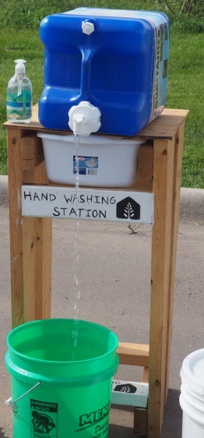
Handwashing
Access to hand washing stations
  Are there enough?
  Add mobile hand wash stations?
When to wash hands
  Create or revise hand washing policy
  Train or retrain
Restocking hand washing stations
  Who is responsible?
  Responsible for restocking and reordering
https://drive.google.com/file/d/1T7QxFI-oYf8on6VbhncsMn7o2ixuWHV2/view
Notes:
Notes
SARS-CoV-2 is spread primarily through person-to-person contact between an infected person and another person. The best ways to minimize spread is by maintaining adequate physical distance between individuals and encouraging people to wash their hands regularly.
Hand washing is critical to all areas of food safety. Suggested at least 1 per 20 staff. Do you need more? If so perhaps adding a mobile hand wash station?
Hand sanitizer is not a replacement for hand washing. However, hand sanitizer (60% ethanol or higher) will kill the virus but it not effective when hands are dirty
If the hand washing SOP is new then all should be trained and it should be documented. If the SOP is revised, then the staff should be re-trained and this training should be documented in the training log at your farm
On person should be given the responsibility of checking the hand washing stations (and sanitizer stations if used) each day to restock and reorder supplies as necessary
Resources
COVID-19 Response Plan Template for Fruit and Vegetable Farms https://docs.google.com/document/d/12sLifH-6Dm48lm_s2OIM3rIrN54Fv__z_i52Mvy5yGA/edit
Agricultural Employer Checklist for Creating a COVID-19 Assessment and Control Plan https://www.cdc.gov/coronavirus/2019-ncov/community/pdf/Agricultural-Employer-checklist.pdf
How to Build a Low-Cost Handwashing Station https://drive.google.com/file/d/1T7QxFI-oYf8on6VbhncsMn7o2ixuWHV2/view
COVID-19 Preventative Measures Clean Your Hands Often https://foodsafety.ces.ncsu.edu/wp-content/uploads/2020/04/Handwashing_COVID-19_Flyer.pdf?fwd=no
Food Safety Hand Washing Station Demonstration (Tuskegee University) https://www.facebook.com/281495325336707/videos/762403254296877

Slide 10
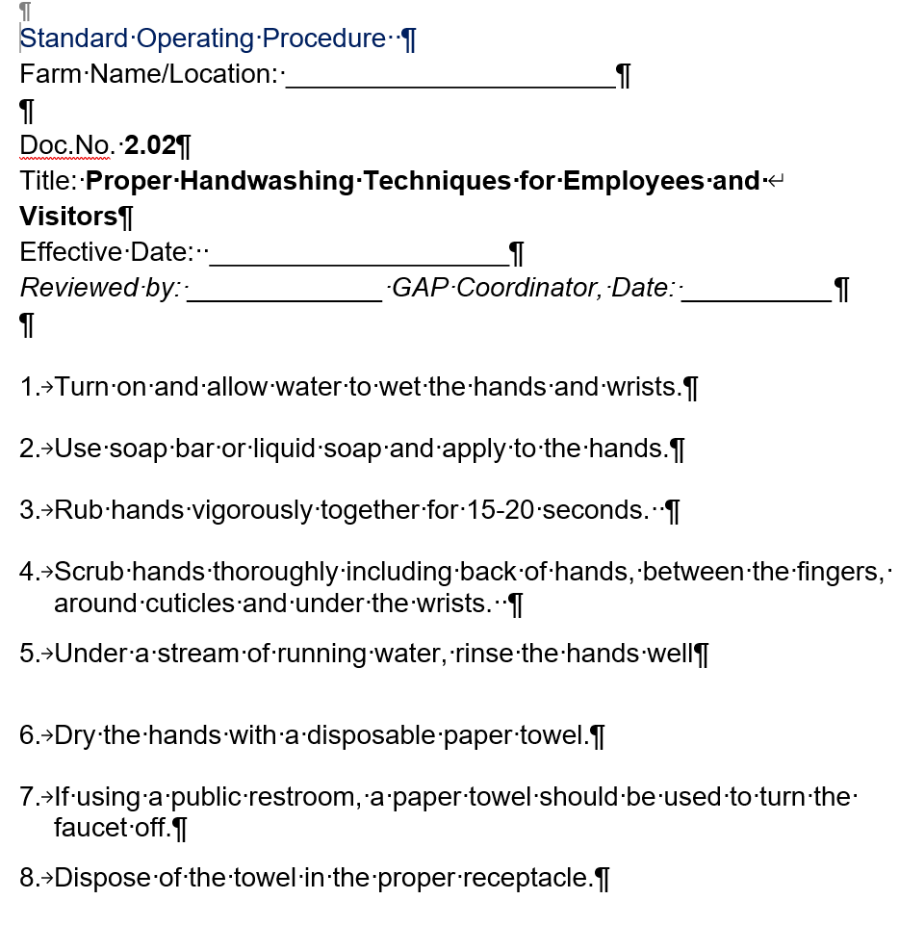
https://www.agconfoodsafety.com/200-standard-operating-procedures.html
Notes:
Notes
An example SOP for handwashing techniques from the Ag Con
Every Farm operation is UNIQUE and DIFFERENT, so any SOPs that are borrowed need to be customized to YOUR farm.
Resources
Policy and Procedures for Safe Food Handling During COVID-19 on the Farm https://ourenvironment.berkeley.edu/sites/ourenvironment.berkeley.edu/files/user/profile2/main/publications/Policy%20and%20Procedures%20for%20Safe%20Food%20Handling%20During%20COVID-19_04_14_20.pdf
Sample SOPs for GAP Plan of Action Manual (AgCon) https://www.agconfoodsafety.com/200-standard-operating-procedures.html

Slide 11
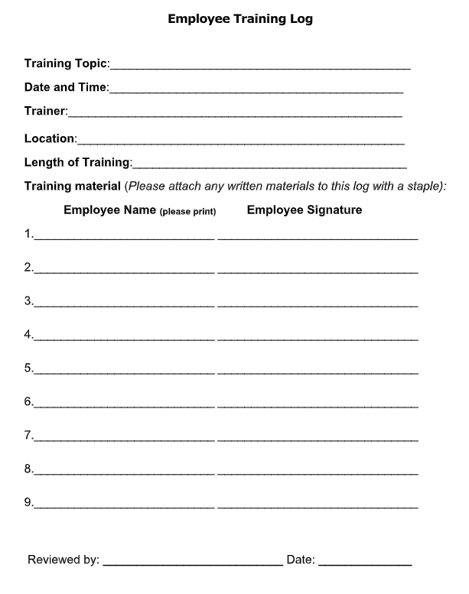
https://extension.umn.edu/safety/growing-safe-food#plan-templates-and-log-sheets-1355910
Notes:
Notes
This is an example employee training log from the University of Minnesota outlining the different pieces of information you should collect each time you train your staff on a topic.
Resources
Plan templates and log sheets https://extension.umn.edu/safety/growing-safe-food#plan-templates-and-log-sheets-1355910

Slide 12
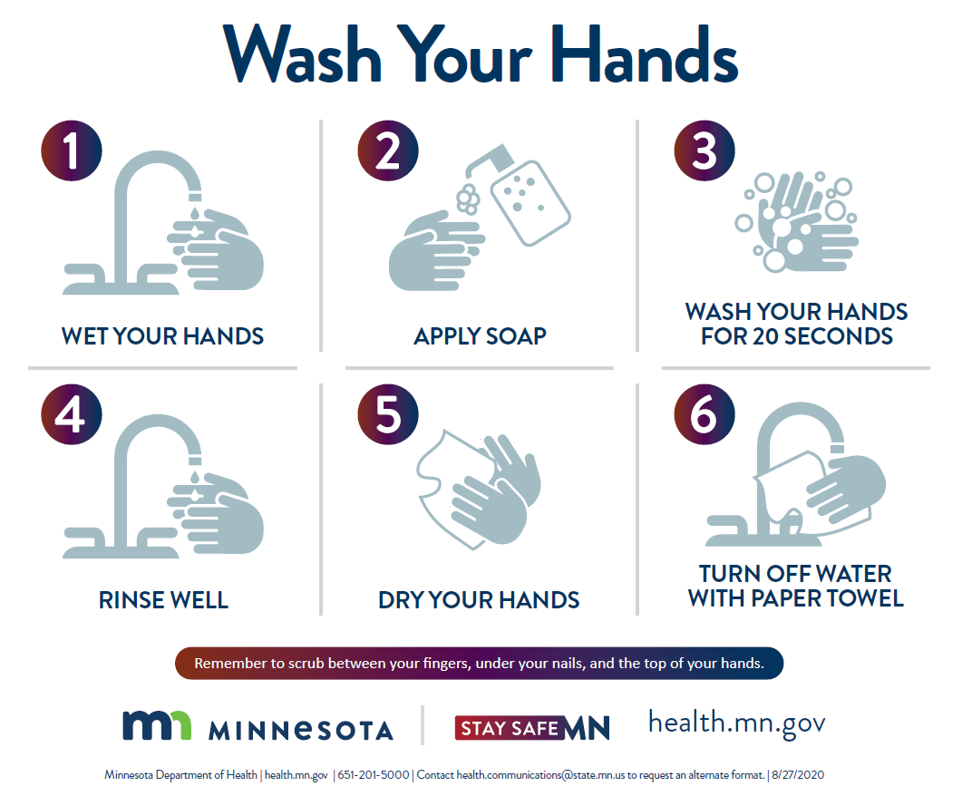
https://www.health.state.mn.us/diseases/coronavirus/materials/washland.pdf
Notes:
Notes
The CDC and the many depts of health continue to recommend that all Americans remember to wash your hands thoroughly with soap and water following the steps provided in this poster.
Resources
Wash Your Hands (MN Dept of Health) https://www.health.state.mn.us/diseases/coronavirus/materials/washland.pdf
COVID-19 Response Plan Template for Fruit and Vegetable Farms https://docs.google.com/document/d/12sLifH-6Dm48lm_s2OIM3rIrN54Fv__z_i52Mvy5yGA/edit
Agricultural Employer Checklist for Creating a COVID-19 Assessment and Control Plan https://www.cdc.gov/coronavirus/2019-ncov/community/pdf/Agricultural-Employer-checklist.pdf
COVID-19 Response Template for Community Gardens https://docs.google.com/document/d/1WDhovmJjRgeggFRJF2hP1u9yr3nEb2Jy_vb8OIOWryI/edit?ts=5eac5861#heading=h.ljb6h8w5deik
COVID-19 Preventative Measures Facemasks and Cloth Face Coverings https://foodsafety.ces.ncsu.edu/wp-content/uploads/2020/04/Facecoverings-101_COVID-19_Flyer.pdf?fwd=no
COVID-19 Preventative Measures Bandanas As Cloth Face Coverings https://foodsafety.ces.ncsu.edu/wp-content/uploads/2020/04/Bandanas-as-Face-Coverings_COVID-19_Flyer.pdf?fwd=no

Slide 13
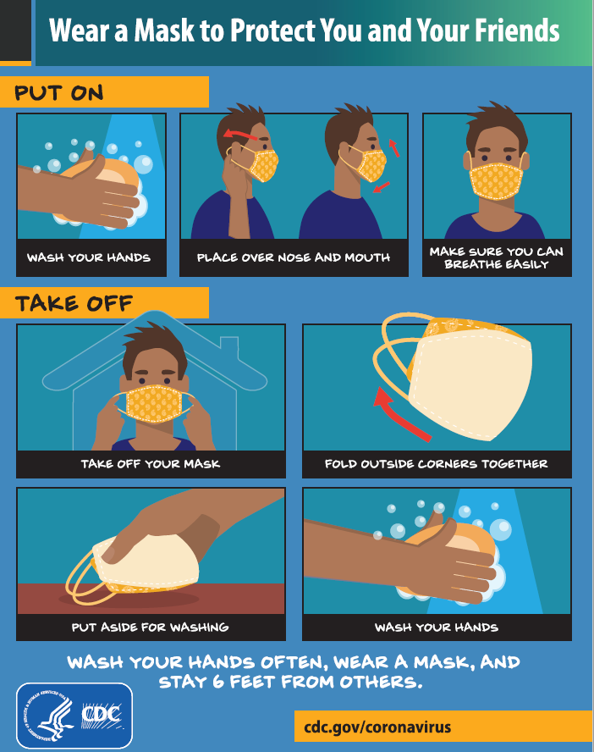
Face Coverings
Abide by your Department of Health and the CDC guidelines
Wear a manufactured or homemade cloth face covering in public settings
It may not be necessary to wear it at all times, if working alone, but they should when working in more confined situations or working with customers
Develop an SOP and training on how to put on and take off face coverings
https://www.cdc.gov/coronavirus/2019-ncov/downloads/Young-Mitigation-recommendations-resources-toolkit.pdf
Notes:
Notes
The CDC and the many depts of health continue to recommend that all Americans wear cloth masks in public, even persons who have been fully vaccinated against COVID-19. It is not currently known how effective vaccines are against asymptomatic spread, that is, people might be able to spread the disease even when they are fully vaccinated. Wearing a mask helps prevent transmission by blocking droplets when we speak, sneeze, cough or breathe.
The CDC recommendations indicate a mask with 2 or 3 layers is best to prevent transmission.
Your operation may want to consider providing masks to staff
Resources
Wear a Mask to Protect You and Your Friends (CDC) https://www.cdc.gov/coronavirus/2019-ncov/downloads/Young-Mitigation-recommendations-resources-toolkit.pdf
COVID-19 Response Plan Template for Fruit and Vegetable Farms https://docs.google.com/document/d/12sLifH-6Dm48lm_s2OIM3rIrN54Fv__z_i52Mvy5yGA/edit
Agricultural Employer Checklist for Creating a COVID-19 Assessment and Control Plan https://www.cdc.gov/coronavirus/2019-ncov/community/pdf/Agricultural-Employer-checklist.pdf
COVID-19 Response Template for Community Gardens https://docs.google.com/document/d/1WDhovmJjRgeggFRJF2hP1u9yr3nEb2Jy_vb8OIOWryI/edit?ts=5eac5861#heading=h.ljb6h8w5deik
COVID-19 Preventative Measures Facemasks and Cloth Face Coverings https://foodsafety.ces.ncsu.edu/wp-content/uploads/2020/04/Facecoverings-101_COVID-19_Flyer.pdf?fwd=no
COVID-19 Preventative Measures Bandanas As Cloth Face Coverings https://foodsafety.ces.ncsu.edu/wp-content/uploads/2020/04/Bandanas-as-Face-Coverings_COVID-19_Flyer.pdf?fwd=no

Slide 14
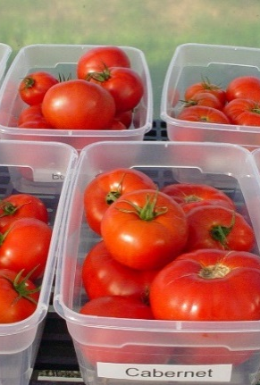
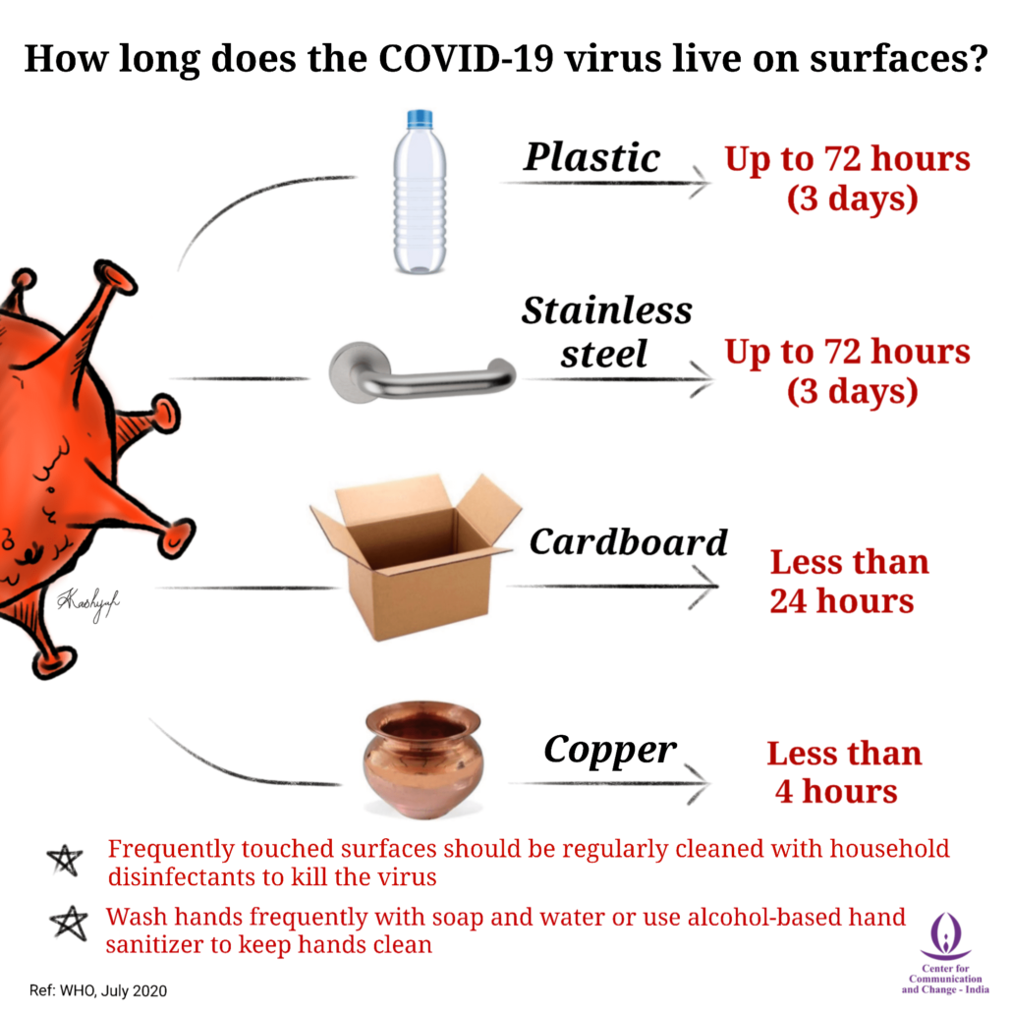
Cleaning and Sanitizing
Create or modify existing SOP and train staff
Identify all the high-touch and food contact surfaces
How often will you clean and sanitize the surfaces?
What sanitizing product(s) will you use?
Modify existing SOP for COVID-19
Keep a log sheet documenting the process
https://covid19communicationnetwork.org/covid19resource/how-long-does-the-covid-19-virus-live-on-surfaces/
Notes:
Notes
What are your high-touch and food contact surfaces on the farm?
Office: keyboard, mouse, iPad, phones, chair armrests, desk area
Restrooms: toilet handles and seats, faucet handles, door handles
Tools and equipment: harvest totes and buckets, scales, clippers, knives, sorting tables,
Greenhouse: watering wand, door handles, vent openers, germination chamber handles
Field: vehicle door handles, steering wheels, stick shifts, PTO handles, shared tools and equipment
Pack shed: dolly handles, cooler handles, door handles, light switches, scale buttons
Other: buttons, pads and touch screens used by staff or volunteers
How often will you clean and sanitize the surfaces?
Depends on how often they are touched and the number of people
At least daily
In some cases make items such as field tools assigned to a person and make them responsible for doing this
How will you clean and sanitize surfaces?
Just like with anything else, we start by removing any visible debris with a broom or hose
Scrub the surface with a detergent to break down the fats and carbohydrates that are present
Rinse with potable water
Spray with a sanitizing agent according to the directions on the label)
Sanitizers to use with COVID-19
EPS List N
Some options
Ultra Clorox Regular Brand Bleach (6.0% sodium hypochlorite product)
VigorOx SP-15
Sanidate 5.0
Resources
How long does the COVID-19 virus live on surfaces https://covid19communicationnetwork.org/covid19resource/how-long-does-the-covid-19-virus-live-on-surfaces/
COVID-19 Response Plan Template for Fruit and Vegetable Farms https://docs.google.com/document/d/12sLifH-6Dm48lm_s2OIM3rIrN54Fv__z_i52Mvy5yGA/edit
Agricultural Employer Checklist for Creating a COVID-19 Assessment and Control Plan https://www.cdc.gov/coronavirus/2019-ncov/community/pdf/Agricultural-Employer-checklist.pdf
FAQ about COVID-19 for fruit and vegetable farms, gardens and markets https://docs.google.com/document/d/14bk7QiKmecysrlksh2j_ElPbdGOqFL_Y28jJSZZR0K8/edit
Cleaning and sanitizing tools, harvest containers and surfaces https://extension.umn.edu/growing-safe-food/cleaning-and-sanitizing-tools-harvest-containers-and-surfaces
Handling COVID-19 Produce Farms and Packinghouses https://foodsafety.ces.ncsu.edu/wp-content/uploads/2020/03/Packinghouse_COVID-19_Flyer-2.pdf?fwd=no
COVID-19 Preventative Measures What is the Difference Between Cleaning, Sanitizing, Disinfecting and Sterilizing https://foodsafety.ces.ncsu.edu/wp-content/uploads/2020/05/Sanitizing-v-Disinfection_COVID-19_Flyer_041620.pdf?fwd=no
COVID-19 FAQ for Foodservice Cleaning and Disinfection https://foodsafety.ces.ncsu.edu/wp-content/uploads/2020/03/Cleaning-and-disinfection_COVID-19_Flyer_031520.pdf?fwd=no

Slide 15
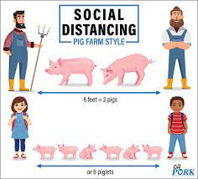
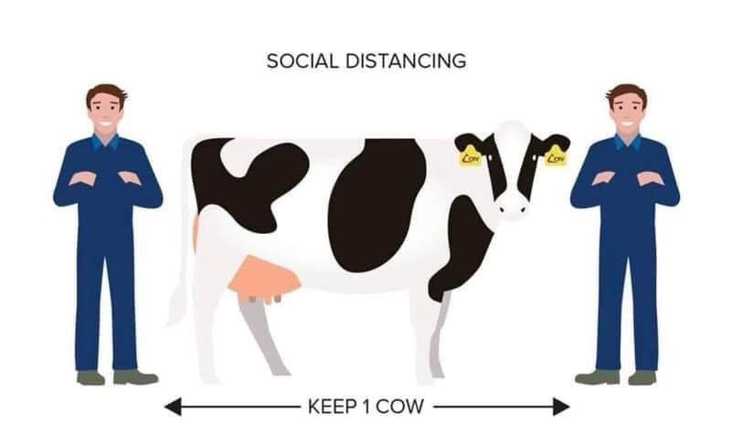

Social Distancing
https://www.lsuagcenter.com/articles/page1593722210875
Separate staff by 6 ft minimum
Stager shifts and break time to reduce number of people
Consider alternatives
https://www.mcheraldonline.com/story/2020/04/09/news/social-distancing-ag-style/4632.html
https://www.lsuagcenter.com/articles/page1593722210875
Notes:
Notes
Identify all tasks that require people to work in close proximity and then brainstorm on ways to maintain physical separating during these tasks
Consider alternatives
Transplant by hand rather than use the transplanter
Transplant with transplanter with staff who live together
Plant to make harvesting easier with a socially distant crew
Create one way rows or aisles in the field, high tunnel or greenhouse
Put tape on the floor to indicate work stations and flow in the packing house
Assign tools to a specific person if possible
Require each person to sanitize tools after use
Assign a vehicle to a specific work crew or provide bicycles
Resources
COVID-19 Response Plan Template for Fruit and Vegetable Farms https://docs.google.com/document/d/12sLifH-6Dm48lm_s2OIM3rIrN54Fv__z_i52Mvy5yGA/edit
Agricultural Employer Checklist for Creating a COVID-19 Assessment and Control Plan https://www.cdc.gov/coronavirus/2019-ncov/community/pdf/Agricultural-Employer-checklist.pdf

Slide 16
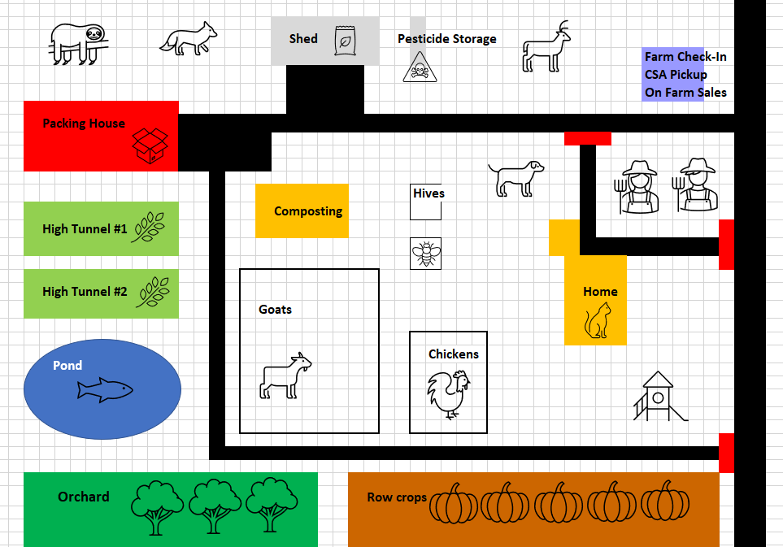
Implementing Practices to Reduce Risks from SARS-CoV-2 Revised
Notes:
Notes
Other changes may need to be made in your operation
Shut down alternative routes into the farm to have everyone come in thru one location to be checked in
Move the office near the front of the operation so that all staff and visitors can be checked in here
Move on farm story or CSA pick up to the front of the operation to minimize exposure to the operation
Resources
Excel workbook with The Farm, The Farm Revised and Off Farm

Slide 17
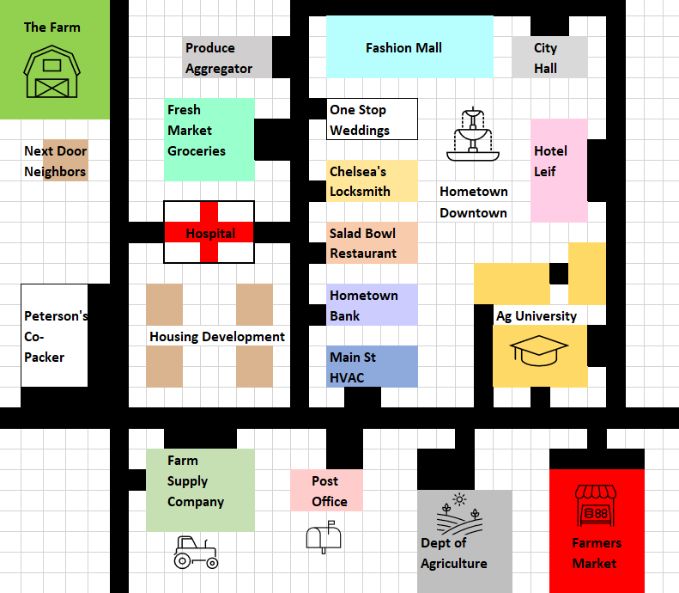
Implementing Practices to Reduce Risks from SARS-CoV-2 Off the Farm
Notes:
Notes
SOPs for staff may apply to anyone coming on to the farm
Alert any visitors to check in at one site
Alert any visitors what is expected for them to be doing while on the farm
This is just expanded of what you would have done prior to COVID-19
Screening
Handwashing
Face covering
Social distancing
Already have SOPs, record sheets and signage to implement this
Face coverings can be required even if your local or state health department do not
Visitors coming on the farm
Customers – buy onsite, CSA, restaurant, aggregator, co-packer, etc.
Vendors – bringing in supplies
Repair people
Ag Service Providers
Inspectors/Auditors
Others not customers – family of owners, staff, neighbors
Staff doing work off the farm
Delivering to customers - CSA, restaurant, aggregator, co-packer, etc.
Farmers Market
Picking up supplies
But do we need to develop any more SOPs, records or signage?
Resources
Excel workbook with The Farm, The Farm Revised and Off Farm

Slide 18
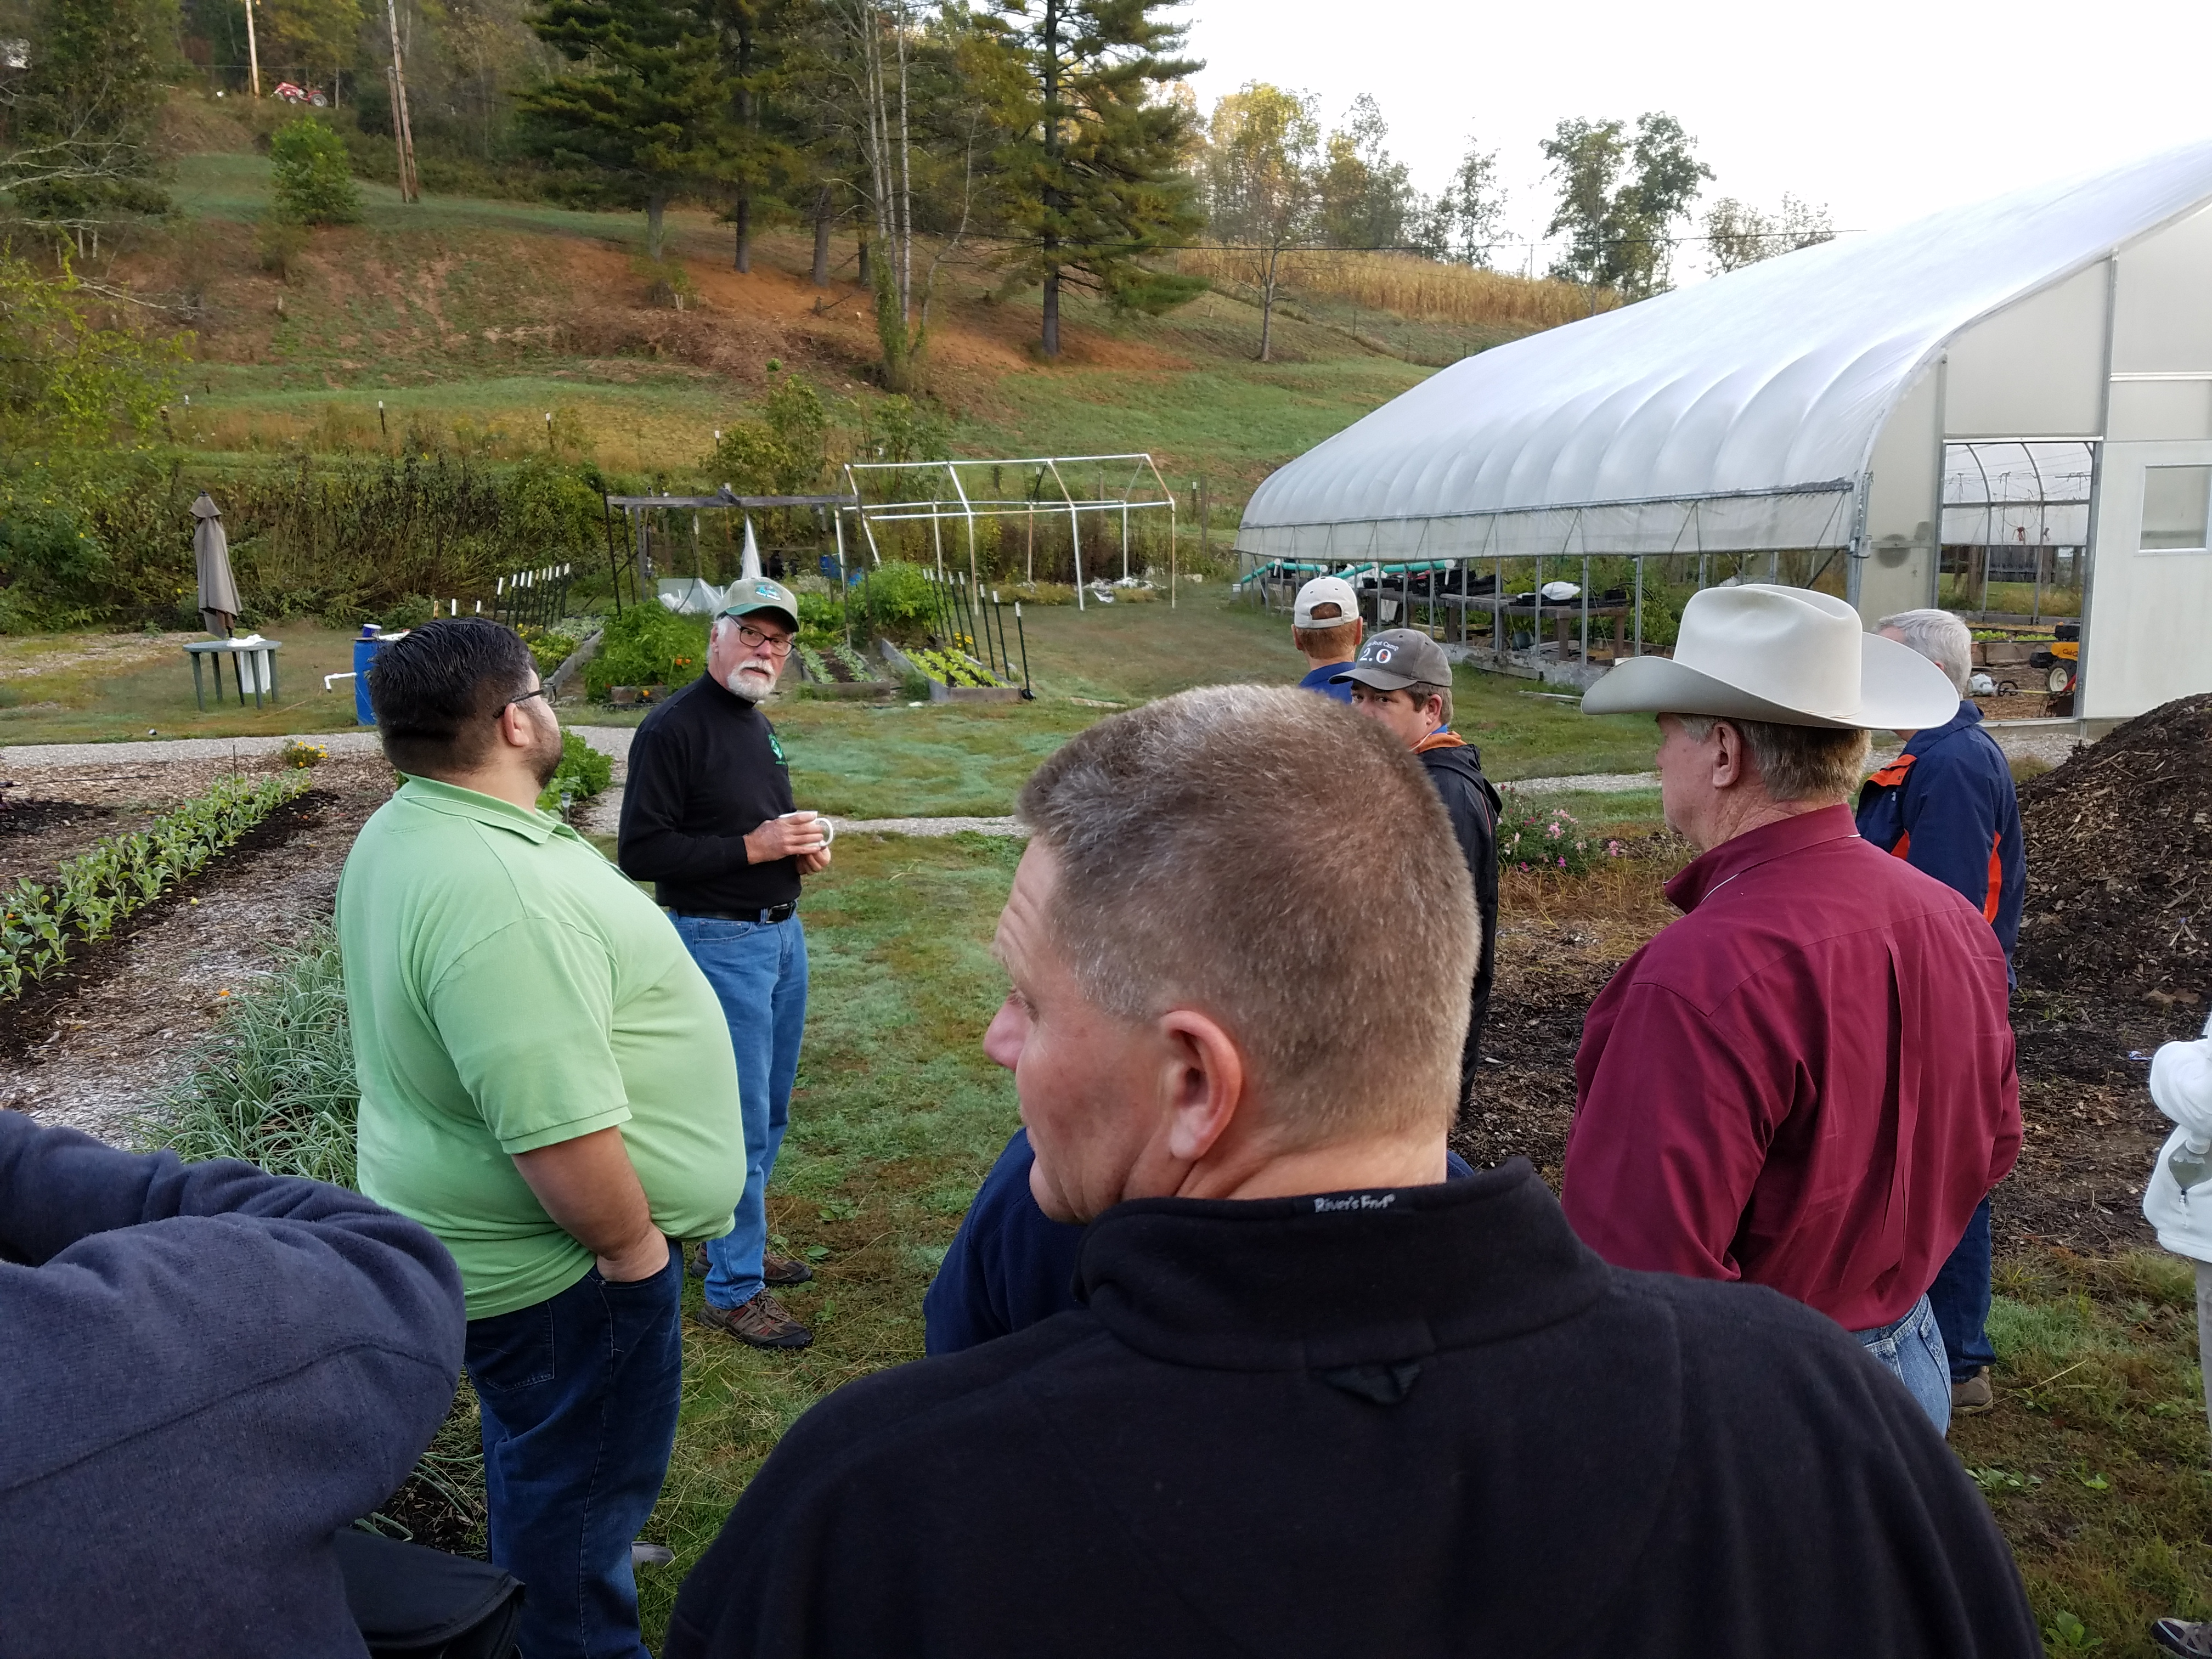
Who is Allowed on the Farm
Who
  Staff
  Customers
  Vendors
Required to follow
  Screening SOP
  Handwashing SOP
  Face Covering SOP
  Social Distancing SOP
Notes:
Notes
Besides essential staff, you may choose some risk-reduction measures to limit customers on the farm
Create a pick up away from the main production site and staff on the farm
Create a pick up away from the farm such as at a farmers market
Schedule pick up times
Limit the number of customers that come at one time
Signage to remind customers of the farm rules
Make hand-washing stations available
Share information on COVID-19 practices at your operation via social media, website or emails on a regular basis
Unusual customer cases
U-pick – look additional specific resources
Rows are uni-directional
Hand washing stations at the entrance and exit
Limited number of customers at a time (timed entry)
Flag the field every 6’ to identify proper physical distance
Use contactless payment options
Alternative: Close U-pick and offer items pre-harvested and pack everything
Agritourism
Vendors
Create an Office site away from the production site and staff on the farm
Create a designated drop-off site where drivers can drop-off if farm staff doesn’t have to be present
Try to consolidate deliveries
Wash hands after handling packages
Resources
COVID-19 Response Plan Template for Fruit and Vegetable Farms https://docs.google.com/document/d/12sLifH-6Dm48lm_s2OIM3rIrN54Fv__z_i52Mvy5yGA/edit

Slide 19
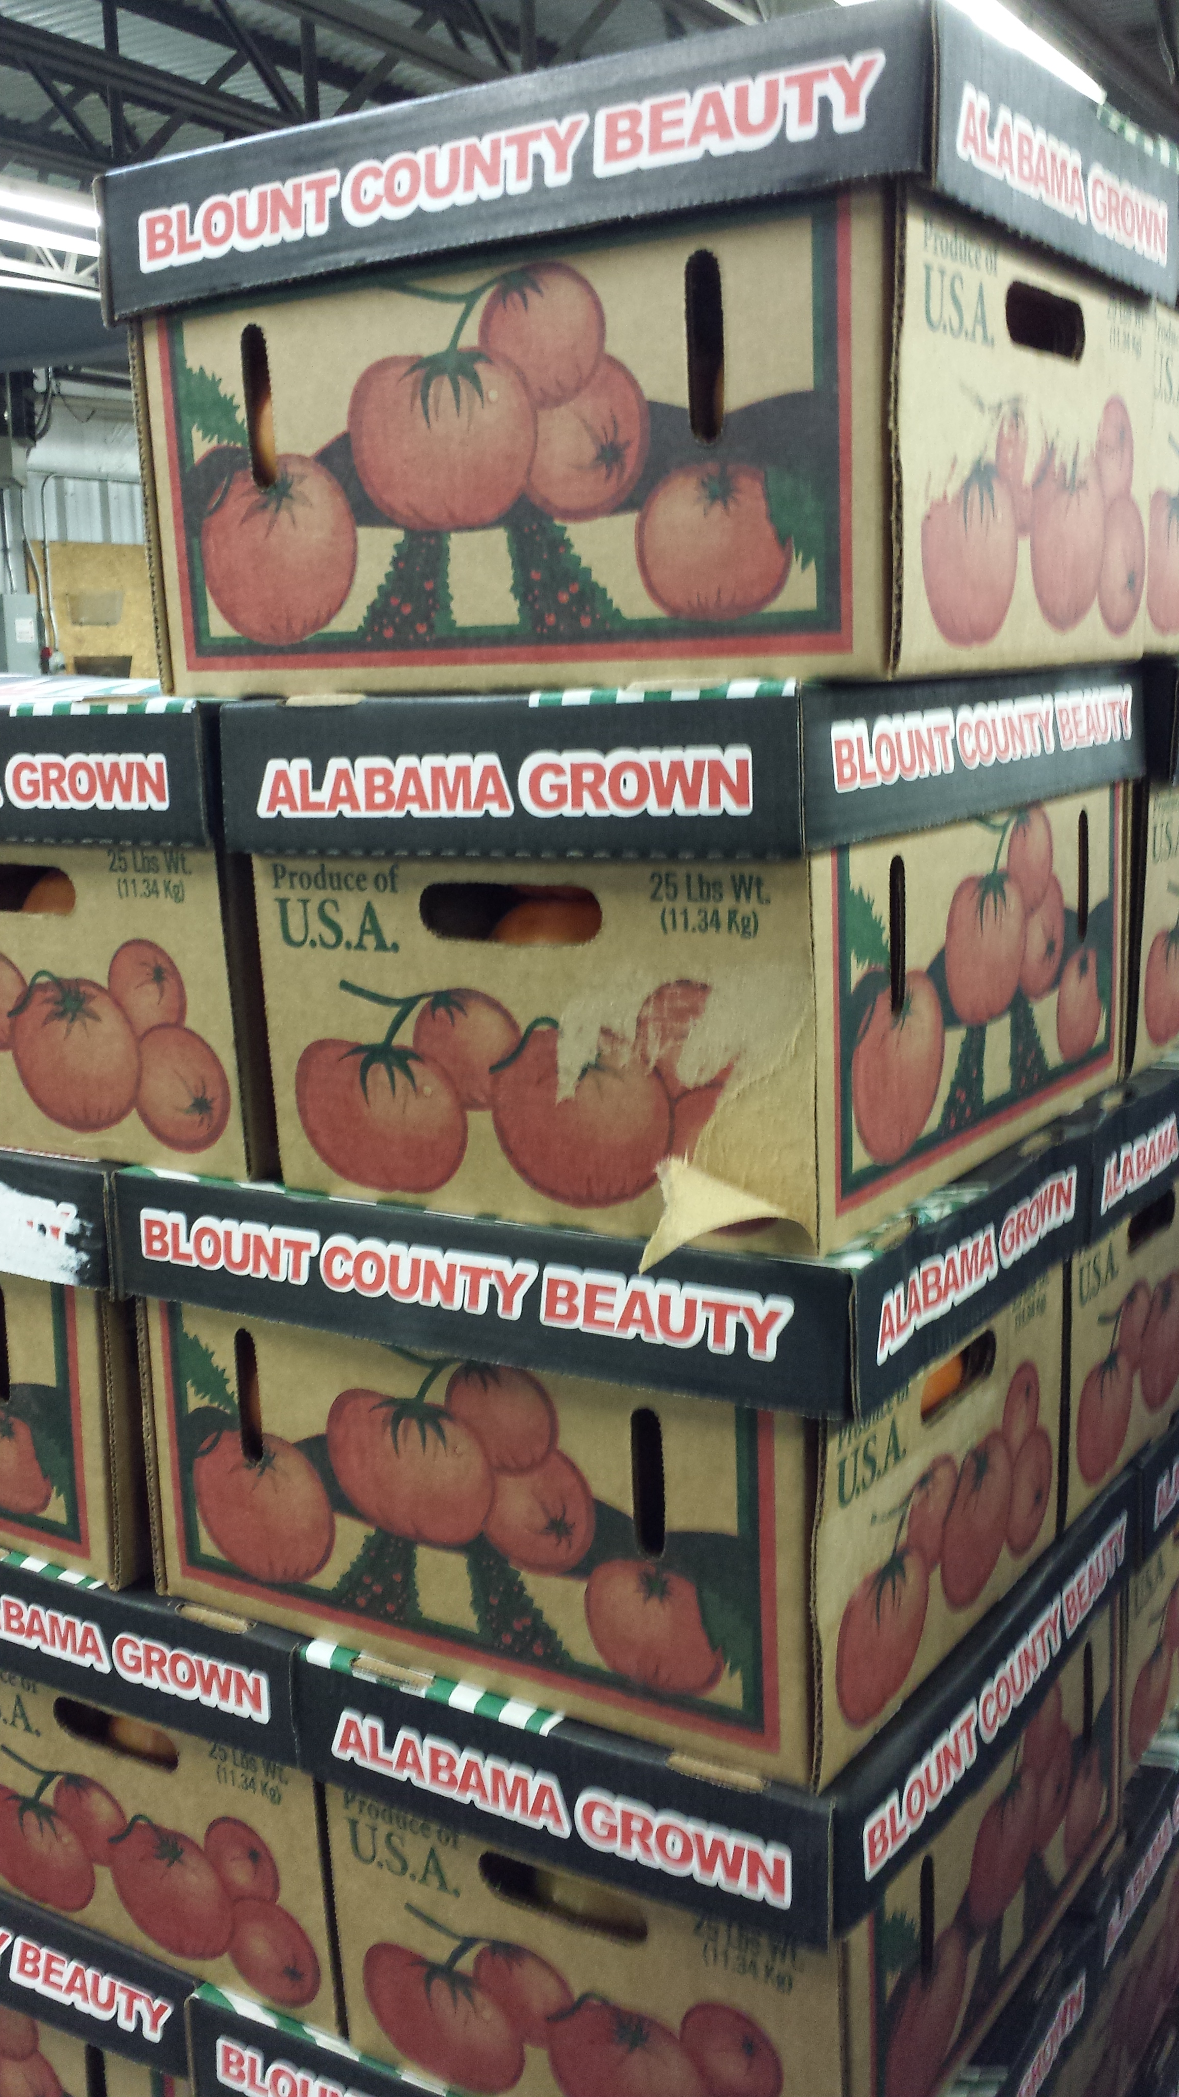
Deliveries Off the Farm
Limit number of staff in a vehicle and keep disposable gloves, masks and hand sanitizer in vehicle
Communicate policies to customers via website, social media, newsletters and/or emails
Consolidate trips and schedule times
Drivers will wear face covering (and gloves)
Deliveries will be pre-ordered and pre-paid only
Use non-returnable containers
Maintain social distancing
Notes:
Notes
Limit staff in a vehicle to only 1 or if more than that they live together or they are socially distant in the vehicle
Require masks of delivery staff
Drivers will NOT go into customers homes
If you have a store or market consider having the CSA pick up at that location and have one staff responsible for CSA pickups at the store or market
Resources
COVID-19 Response Plan Template for Fruit and Vegetable Farms https://docs.google.com/document/d/12sLifH-6Dm48lm_s2OIM3rIrN54Fv__z_i52Mvy5yGA/edit
Best Practices for Retail Food Stores, Restaurants, and Food Pick-Up/Delivery Services During the COVID-19 Pandemic https://www.fda.gov/food/food-safety-during-emergencies/best-practices-retail-food-stores-restaurants-and-food-pick-updelivery-services-during-covid-19
COVID-19 Guidance: Farms and On-Farm Deliveries and Pick-Ups https://mda.maryland.gov/maryland_products/Documents/Ag-COVID19-Delivery-Guidance.pdf

Slide 20
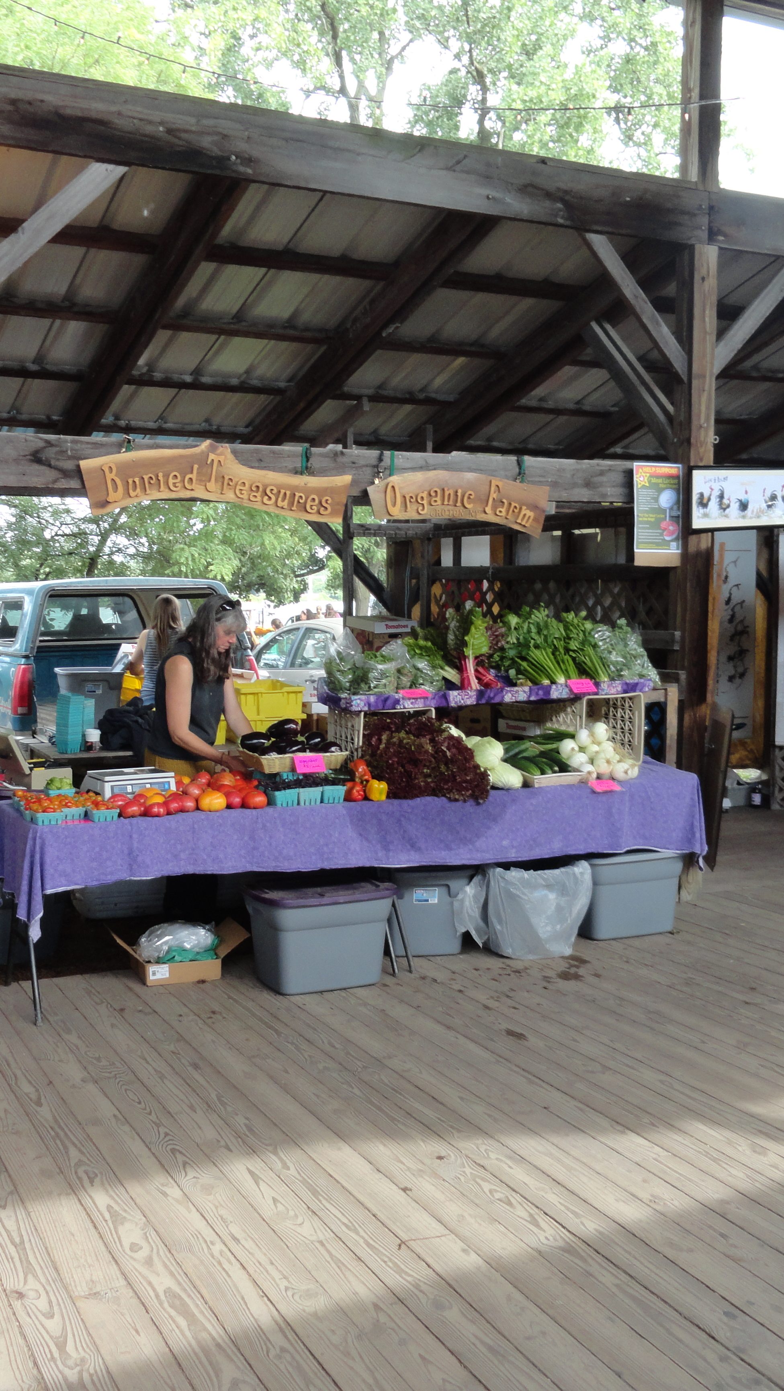
Farm Store/Farmers Market
Post signage regarding farm stand/farmers market expectations
Wear a face covering
Maintain social distancing and/or plexiglass protection
Wash hands and if necessary, use gloves for handling produce
Sanitize surfaces
Designate a waiting line with 6 ft separations
Pre-package produce for easy pickup
Notes:
Notes
Bring portable hand washing station if possible
Gloves are not a replacement for hand washing and staff should be taught how put them on and take them off correctly
Have detergent and cleaner available for cleaning tables, chairs and other surfaces
Deal with one customer at a time
Use tape or chalk to identify separation between customers
Erect a barrier between staff and customers
Plexiglass stand
Clear shower curtain
With multiple staff, designate duties (Subway model)
Answering questions/Restocking
Picking produce to package
Taking payment
Taking payments
Have a dedicated staff who only takes payment
Credit cards – have the customer swipe the card without touching the machine and do not require a signature
Cash – when taken staff will change gloves, wash hands or use sanitizer regularly
Resources
COVID-19 Response Plan Template for Fruit and Vegetable Farms https://docs.google.com/document/d/12sLifH-6Dm48lm_s2OIM3rIrN54Fv__z_i52Mvy5yGA/edit
Best Practices for Retail Food Stores, Restaurants, and Food Pick-Up/Delivery Services During the COVID-19 Pandemic https://www.fda.gov/food/food-safety-during-emergencies/best-practices-retail-food-stores-restaurants-and-food-pick-updelivery-services-during-covid-19
COVID-19 Guidance: Farms and On-Farm Deliveries and Pick-Ups https://mda.maryland.gov/maryland_products/Documents/Ag-COVID19-Delivery-Guidance.pdf

Slide 21
Summary
Identify one person to be the COVID-19 contact person for the farm
Aim to keep staff and customers safe as well as your food
Integrating COVID-19 into your farm should include assessing risks, any SOPs taken to reduce risks and record keeping
Communicate your COVID-19 plan to customers and vendors via signage, website, newsletters, emails and/or social media
Modify the practices as necessary based on information from the state and local health departments and the CDC
Network with other producers, ag service providers and businesses for more solutions

Slide 22

Acknowledgements
This work is supported by Rapid Response to Novel Coronavirus (SARS-CoV-2) Impacts Across Food and Agricultural Systems grant no. 2021-69006-33355 from the USDA National Institute of Food and Agriculture.
Any opinions, findings, conclusions, or recommendations expressed in this publication are those of the author(s) and do not necessarily reflect the view of the U.S. Department of Agriculture.

